Slide 1
Circle Officer Training

Slide 2
Introduction
This is a self-paced module program for all Circle Officers. It will take about 45 minutes to complete. In addition to completing this training, we encourage all new officers to review the Circle Officer Handbook. The handbook is a digital companion to the training which you can refer back to over the course of your tenure with O∆K.
At the end of the program, you will find a quiz to check your understanding of the training.

Slide 3
General O∆K Information

Slide 4
Definitions
Circle - The basic unit of Omicron Delta Kappa is the collegiate circle. Membership in the Society can come only through election and initiation by one of the collegiate circles.
National Headquarters Staff—The professional staff is led by the president and chief executive officer. All members of the National Headquarters team serve the Society by managing operations and ensuring the organization's viability.
Board of Trustees—The Omicron Delta Kappa Society and Educational Foundation, Inc. Board of Trustees is the organization's governing body.
Circle Officer - Any advisor and the student president, student vice president, or treasurer.
Circle Advisor - This term refers to any advisor: faculty advisor, circle coordinator, circle assistant, and alumni advisor
The “Society” - The general term for Omicron Delta Kappa. For example, “Members of the Society enjoy recognition as leaders throughout the country.”
National Initiation Fee - The National Initiation Fee (formerly the National Lifetime Membership Fee) is paid before initiation.
Member - Any individual initiated by a circle. Individuals are members for life.

Slide 5
Definitions (continued)
Annual and Lifetime Membership Dues—Beginning in 2024, Omicron Delta Kappa created a process by which OΔK members may pay annual or lifetime dues to receive lifetime benefits. All OΔK Initiates are Lifetime Members. That status never changes. However, to continue to provide programs and services, OΔK needed to create this revenue stream. Members who want to take advantage of benefits may choose to pay a low Annual Fee (beginning at $50) or a one-time Lifetime Membership Fee ($500).
Key of Membership - This is the pin provided to each initiate during the ceremony.
Institutional Membership Fee—Each circle's charter is awarded to the college or university. As an institutional member of Omicron Delta Kappa, the National Leadership Honor Society, the institution pays an annual fee that helps support the organization's programs, services, and administration.
Chartering Fee - The institution pays a one-time fee to establish a circle.
Ceremonial Key - This large bronze key was presented to the circle upon chartering. The key should be present at all initiation and other formal circle ceremonies.

Slide 6
Mission, Vision, Fast Facts
Mission (The O∆K Idea)
  Identify, honor, and develop leaders in collegiate and community life.
  Encourage collaboration among students, faculty, staff, and alumni to advance leadership.
  Promote, publicize, and enhance our ideals.
Vision
  Omicron Delta Kappa is a multi-generational society that excels in recognizing and connecting collaborative and inclusive leaders.
Fast Facts

Slide 7
Leadership Values
Collaboration – to work together to achieve a defined and common purpose
Inclusivity – to actively seek, embrace, and advance a diverse group of individuals
Integrity – to align one’s values and beliefs with behaviors and speech
Scholarship – to strive for excellence in academics and pursue lifelong learning
Service – to answer the call for action from one’s community or country

Slide 8
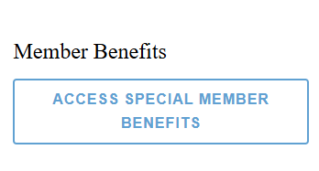
Benefits of Membership
As a member of Omicron Delta Kappa, one can take advantage of many national, regional, and local opportunities offered by the Society. Such opportunities include, but are not limited to, leadership conferences, recognition awards, circle grants, individual scholarships and networking opportunities. Refer potential new members to the benefits of membership page on the OΔK website. It has a comprehensive list of benefits.
All codes and links to utilize the benefits are reserved for members, who must log in to their MyODK account to access them.

Slide 9
Branding and Editorial Guidelines
With more than 250 circles across the country, it is more important than ever for the Society to speak with one, unified voice. To communicate the OΔK Idea cohesively and consistently, the National Headquarters has developed branding and editorial guidelines.
Marketing chairs, as well as circle advisors, should be familiar with the guidelines which are detailed on our website, especially if the circle decides to create its own marketing materials.
Circles must request permission to print the OΔK logo, image or branded marks on merchandise.

Slide 10
Diversity, Equity and Inclusion
Diversity Statement
The OΔK Idea affirms and promotes openness and inclusiveness among all people. Membership selection shall be free of bias so that all qualified will be considered equitably for membership.
Resources to Promote Leadership Embracing DEI
Although Omicron Delta Kappa did not have a diverse membership at the time of its founding, the Society has certainly grown to be more inclusive beginning with its initiation of women and individuals of color beginning in the 1970s. The Morris Brown College Circle was the first circle to be chartered at a Historically Black College of University (HBCU) in 1976. Omicron Delta Kappa is currently located at seven HBCU institutions.

Slide 11
Mission Committee
The Mission Committee is charged to think strategically about matters related to extension to new campuses including those that serve underrepresented populations. In addition, the committee addresses the health and vitality of existing circles and their members and coordinate the annual review of the Omicron Delta Kappa Policies and Procedures Handbook. Furthermore, the committee maintains the standard of membership throughout the Society and review all applications from institutions for the establishment of a circle on their campus under the provisions of the Omicron Delta Kappa Policies and Procedures Handbook. The Mission Committee also considers how extension practices, membership requirements, circle standards, policies, and procedures of the Society support a diverse and inclusive membership.

Slide 12
National Operating Committees
Omicron Delta Kappa believes strongly that members at all levels should participate directly in governance and program development. These operating committees provide advice, planning, and oversight to many programs and services of the organization. National volunteers chair and serve on each of these committees. A member of the National Headquarters staff supports each committee. The members of the committee and chair are appointed by the President/CEO to serve for a term of one year.

Slide 13
Five Pillars of Campus Life
The Five Pillars of Campus Life were identified by the Founders and have been updated throughout the history of Omicron Delta Kappa. Essentially, the Five Pillars are a general way to ensure that leaders from a broad cross-section of the campus are included in the membership of a circle.
  Academics and Research
  Athletics
  Service to Campus and Community
  Communications
  Creative and Performing Arts

Slide 14
Circle Operations

Slide 15
Charter Relationship Statement
The charter for an Omicron Delta Kappa Circle is awarded to the institution, which is then entrusted with the success and management of the circle. While the O∆K circle may be registered as a student organization on campus, O∆K is an honor society.
Details about the relationship between Omicron Delta Kappa and the institution is outlined in the Charter Relationship Statement.

Slide 16
Circle Standards
Omicron Delta Kappa sets circle standards to ensure that circles operate in a healthy and functioning capacity. While circles have some autonomy in their operations, each circle must meet these standards to be considered in good standing with the Society. These are the basic standards a circle must meet to operate, though circles may opt to perform above these requirements.
The 12 O∆K Circle Standards synthesize the various National Bylaws and O∆K Policies and Procedures that require specific action by the circles in one list. Only circles in good standing will be eligible for Circle Recognition Awards.
Circles will soon be able to track their progress toward meeting circle standards through the MyODK Circle Executive Dashboard. National Headquarters staff will post an update in MyODK each time a circle meets one of these standards.

Slide 17
Circle Best Practices
The circles that are successful in maintaining membership, empowering leaders, and serving the Society have many things in common. Below is a list of best practices that have proven to serve as a solid base for circle.
• Make sure all five pillars of campus life are represented when selecting members.
• Initiate faculty, staff, alumni, and honorary (one free honorary each year) members.
• Maintain two faculty advisors (circle coordinator and faculty advisor).
• Send members to the national leadership conference and encourage them to participate in OΔK sponsored webinars
• Apply for a Clay Grant to fund leadership programs
• Host the Signature Leadership Program and Signature Service Program to elevate the reputation of the circle on campus which in turn should help with recruitment
• Select a Circle Leader of the Year and submit to the National Headquarters.
• Pay institutional fees

Slide 18
Fall Events Example
• Host a circle officer meeting
• Host a general circle meeting
• Host annual signature event focused around leadership
• Conduct recruitment
• Selection committee meets to choose new members
• Facilitate initiation
• Host a social after initiation
• Host a second general circle meeting

Slide 19
Spring Events Example
• Host a circle officer meeting
• Host a general circle meeting
• Host annual signature event focused on service
• Participate in the National Day of Service/Giving
• Elect new student officers
• Appoint selection committee
• Optional second recruitment
• Optional second initiation ceremony/officer and senior appreciation
• Host a social
• Host a second general circle meeting
• Submit national annual report

Slide 20
Engage First and Second Year Students
Circles are encouraged to connect with first and second year students to make them aware of Omicron Delta Kappa, particularly since sophomores are eligible for membership. Recognition of emerging leaders, providing leadership development programs, and including underclassmen in select circle events are all appropriate activities. Circles may also consider getting involved with orientation on campus, and connecting with Phi Eta Sigma, Alpha Lambda Delta, and the National Society of Collegiate Scholars on campus if applicable.
Circles should be cautious in involving first and second year students in any activities that may be perceived as “pledging” before earning full membership in OΔK. Omicron Delta Kappa prohibits the hazing of current and prospective members.

Slide 21
Circle Recognition Honors
There are several ways in which circles may be recognized:
  Circle of Distinction, Superior Circle, or Presidential Award of Excellence
  Membership Growth and Stability
  Circle Stewardship Award
A circle must meet all of the Circle Standards to be eligible for circle recognition awards. All required criteria for each award must be met by June 30 of each academic year.

Slide 22
Circle Leadership

Slide 23
Officer Selection
All circle officers must be elected/selected by the circle membership. The circle bylaws should specify the manner in which the officers are elected/selected. In some cases, the circle advisors are appointed by the institution to serve as an advisor.
All circle advisors are required to complete and sign the Circle Advisor Agreement. Student officers must complete the Student Officer Update.
Circles must ensure that the names of the required current circle officers are up to date with the National Headquarters each fall.

Slide 24
Advisor Transition
If a circle advisor is planning to retire, change jobs, or move to another institution, it is imperative that the National Headquarters is informed as soon as one knows a transition will take place. Outgoing circle advisors are also responsible for assisting in the identification and transition of a replacement.
Reference the Transition Checklist for Circle Advisors and Coordinators here.
Poor transition of advising responsibilities is one of the key factors in the poor health of a circle. Please communicate with your Circle Contact to ensure a smooth process.

Slide 25
Student Officer Transition
Outgoing and incoming officers should set up a meeting during the transition to review responsibilities and circle strengths, challenges, programs, and goals for the future. The ultimate goal should be for the circle to continue to operate and thrive once its leadership has changed.
New student officers and circle advisors should be installed during an initiation ceremony as part of the public acknowledgement of the transition of leadership. New student officers should complete all financial, institutional, and circle documents and forms before the transition. Recognize the outgoing officers for their service at the ceremony.
Reference the Transition Process for Student Officers checklist here.

Slide 26
Student Officer Responsibilities
Establishing a regular circle meeting schedule as well as officer meetings
Working with advisors to set the circle’s calendar for the year ensuring that membership selection, reporting, and initiation happen in a timely manner
Facilitating goal setting
Leading, supporting, and motivating circle members
Updating institutional administrators on the circle’s activities
Keep current with national bylaws as well as the circle’s bylaws and policies
Encouraging members to remain in contact with O∆K after graduation
Working with advisors to meet circle standards
Hosting an orientation for new members, explaining O∆K’s history and purpose, and sharing the obligations of membership in the Society
Presiding over initiation ceremony
Helping maintain circle documents
Determining appropriate programming for the campus
Making certain that circle is represented at national O∆K events

Slide 27
Circle Advisors
Circle advisors serve a vital role in the operation and development of any circle. The Circle Coordinator and Faculty Advisor shall be elected or appointed by the circle or the institution and meet the following requirements:
  A full or part-time staff member at the host institution;
  Able to act on behalf of the circle in administrative matters at the host institution and
  Complete and sign the O∆K Advisor Agreement before assuming the circle coordinator or faculty advisor role.
Failure to meet this obligation is assumed to be a decision not to serve in the office to which one has been elected or appointed. Circle advisors are voting officers of the circle. A circle must always maintain an active circle coordinator and faculty advisor.

Slide 28
Circle Coordinator Role
Responsibilities for the Circle Coordinator may include:
  Responsible for the collection and submission of national lifetime membership fees from new members
  Maintain a file containing regular circle meeting minutes, a list of current and past members with their addresses and classifications, and all other records of the circle
  Submit the membership certificate order form via MyODK no less than 14 calendar days in advance of each initiation ceremony
  Ensure payment of the annual $125 circle institutional dues (formerly affiliation fees)
  Submit the annual report online to the National Headquarters by June 30
  Send news items to the National Headquarters for possible promotion through O∆K’s communications outlets

Slide 29
Faculty Advisor Role
Responsibilities for the Faculty Advisor may include:
  Assist student officers in the arrangement of public tapping procedures, including local campus publicity and public relations with the community at large
  Assist in a thorough orientation for new members by providing information and support and ensuring that all pertinent information is communicated
  Make sure that the circle is current with its registration as a student organization with the institution’s student activities or dean of students’ office

Slide 30
Alumni Advisor
Alumni advisors shall be selected by an affirmative vote of the local circle membership. Alumni advisors must be an initiated O∆K member and in good standing, as verified by the National Headquarters. The alumni advisor must also submit an advisor agreement.
Duties and responsibilities of alumni advisors may include the following:
  Assist student officers and other advisors (circle coordinator, faculty advisor) in the fulfillment of duties
  Assist in the identification of potential alumni or honoris causa members
  Assist circles with community outreach efforts
  Attend circle meetings to provide assistance to officers and other advisors

Slide 31
Circle Assistant
A circle may also have a circle assistant, who is required to be initiated into the Society. This individual assists the circle coordinator and faculty advisor in performing their duties. A circle assistant must be a full or part-time faculty/staff member at the host institution and must complete the advisor agreement.
This individual is usually employed by the faculty advisor or circle coordinator in another capacity – many times as an administrative assistant. The circle assistant can be given authority to submit certificate orders, pay invoices, request forms, and act on behalf of the other circle advisors in administrative tasks. The alumni advisor must also submit an advisor agreement.

Slide 32
Recruitment and Initiation

Slide 33
Requirements for Membership
Class Eligibility:
Undergraduate students: must be a sophomore, junior, or senior by credits enrolled in a degree-granting program
Graduate/Professional students: enrolled in a degree-granting program
Faculty, staff, and administrators: full or part-time positions at the institution
Alumni: an individual must wait at least five years to be initiated into the circle where they received their degree.
Local, national, and international leaders who qualify for honorary membership
Academic Eligibility:
Undergraduates must be in the top 35% of their class (usually 3.5/4.0 GPA)
Graduate/professional academic eligibility is determined by each circle (usually 3.6/4.0 GPA)
All student candidates must have been enrolled on their campus for at least one-half year (one semester)
Leadership Eligibility:
All candidates for membership must demonstrate leadership in one of the Five Pillars of Campus Life and embrace the OΔK Leadership Values.

Slide 34
Membership Fees and Local Dues
Payment of the National Initiation Fee and any local dues are a critical step before the final acceptance of new members. In MyODK, the circle will be required to choose one of two payment options for the payment of the $94 National Initiation Fee. This decision must be made at the time of the application setup and can not be changed once approved.
No individual should participate in the Initiation ceremony who has not paid the national fees to the circle or to the national office, with the exception of the approved honorary memberships, gift of membership, and new advisor initiates. The circle is ultimately responsible for all fees paid.

Slide 35
Recruitment Materials
Circles have access to a variety of recruitment materials, including:
  Email templates (invitation to apply, accepted notice, rejected notice, faculty nominations)
  Two-sided recruitment card (physical copies available from headquarters)
  Color and black/white one-page flier
  11x17 poster
  Join O∆K business card (physical copies available from headquarters)
  Black/white handbill
  Recruitment video
  Tapping templates

Slide 36
Recruitment Materials
Using recruitment materials provided by the National Headquarters ensures that the circle is providing updated information to prospective members, ensures compliance with the Society's brand standards, and saves the circle time, money, and effort.
In addition, circles can utilize the Interactive Circle Recruitment Timeline to plan their recruitment cycle. This Excel workbook allows circles to choose a 45, 60 or 90 day cycle, enter their initiation date, and see a list of scheduled tasks of all items that must be taken care of leading up to initiation.

Slide 37
Horizontal v. Vertical Leadership
Recruitment and selection from the five pillars should look for leaders who have either breadth across multiple pillars or depth in one pillar. Each leader has much to contribute to a circle and to OΔK as a whole.
Horizontal Leadership
Vertical Leadership
One engaged as a leader in many different pillars of campus life.
  Presented research at a conference = Academics
  Writes for the campus paper = Communications
  Leads the campus food pantry = Service
One who has engaged deeply in leadership in one pillar of campus life.
  Lead role in theater productions = Arts
  Directs one-act plays = Arts
  Served on the arts council = Arts

Slide 38
Information Sessions
Information sessions can be an important part of the recruitment process and introduce leaders who may not have heard of OΔK to the organization and its mission. This is a good time to discuss the benefits of membership, networking opportunities, the potential for continued leadership development, and ways to contribute to the campus's leadership culture. Recruitment materials (available for free in limited quantities from National Headquarters) can be distributed at these sessions.
National Headquarters staff may attend information sessions virtually or in person to assist the circle in its recruiting efforts. Circle leadership can reach out to their circle contact to discuss scheduling.

Slide 39
Recruit Faculty, Staff and Alumni
Omicron Delta Kappa is purposefully a multigenerational organization. A key element of OΔK tradition is the strong relationship between students, faculty, staff, and alumni.
Circles should actively recruit faculty, staff, and alumni members alongside their prospective student members. Circle members are encouraged to recommend faculty and staff whom they believe meet OΔK’s standards of leadership and scholarship. Circle officers should then reach out to these individuals to invite them to join OΔK, even using tapping ceremonies to publicly acknowledge their leadership.
Circles can partner with their campus alumni association to identify potential alumni initiates.
All faculty, staff and alumni members must pay the National Initiation Fee.

Slide 40
Utilizing Campus Resources
Below are a few ideas of how to utilize campus resources to recruit:
  Contact the institution’s registrar to get a list of email addresses of sophomores, juniors, seniors and graduate students who are in the top 35% of their class in order to invite them to join
  Participate in campus organization fairs
  Identify organizations that may partner well with OΔK such as student involvement and leadership offices, as well as other leadership organizations
  Use free printing to print OΔK provided marketing materials if the campus provides this service
  Apply for student organization funds through student government if the campus provides them to honor societies

Slide 41
Membership Application Review
Each circle manages the application review differently. However, the three fundamentals of application review must be the same for all circles.
  Prospective members must complete the National Membership Application via MyODK. There are no exceptions to this rule.
  OΔK does not permit anyone to complete an application on behalf of a prospective member except in the case of honorary or “special recognition” members.
  Once the application deadline has passed, the application CANNOT be reopened. The Application Deadline is set as part of the Application Set Up. Be sure you know your deadline and that it works in the new MyODK timeframe.

Slide 42
Circle Selection Meeting
The selection meeting may be the second most important gathering of OΔK members on campus after the initiation ceremony. This meeting (or meetings) should be scheduled as part of the planning process and all members of the circle should be required to attend. This meeting should not be open to nonmembers.
Depending on the circle bylaws, the voting on members can be by ballot, voice vote, or other means. The actual slate of candidates can also be determined by the circle bylaws. Some circles use a membership committee to identify a list of candidates for approval. For some circles, the membership committee only removes those that do not meet minimum requirements. Regardless of the way in which the list for voting is established, the circle membership should have the time to review all applications presented and vote on membership accordingly.

Slide 43
Selection Criteria
Before any applications are received, the circle must establish how it will score the applications fairly and equitably. Central to the scoring must be the core OΔK criteria.
OΔK was founded on the principle of bringing different campus constituencies together. We are NOT an exclusive honor society. Exclusive means the recruitment process seeks to EXCLUDE those who do not meet the criteria. We are a restricted society. Restricted means only undergraduate sophomores, juniors, and seniors in the top 35% and identified graduate students, faculty, staff, alumni, and community leaders are eligible. All otherwise qualified individuals could be INCLUDED.
A circle can initiate up to 3% or 5% (depending on total enrollment) of the host institution’s entire student population. Therefore, the circle’s goal should be to include as many leaders as possible.
The Society strongly discourages any self-limiting practices. Circles should be open to the widest possible pathways to recruit and initiate members as the policies and procedures will allow.

Slide 44
DEI Recruiting Practices

Slide 45
Commitment to Diversity, Equity, and Inclusion
OΔK has redoubled its commitment to increasing our recognition of individuals of underrepresented populations.
In order for OΔK to have the membership representative of the future of this country, this world, we need our circles to expand their recruitment practices.
The recommendations in this section are designed to held guide circles to seeking out the leaders who may not be recognized in traditional leadership programs.

Slide 46
Suggestions for Inclusive Recruiting
Move beyond traditional avenues of recruitment.
Target recruiting efforts at Historically Black, Hispanic/Latino, Asian and other fraternities and sororities.
Host information sessions specifically for groups that may be traditionally underrepresented in your membership.
Invite faculty/staff members with connections to Multicultural Centers or other special programs to recommend leaders for membership.
Seek faculty and staff persons of color to recommend individuals and to be recruited as possible members.
The most important factor is to open the recruitment process to those populations that are underrepresented in your circle and even your institution.

Slide 47
Initiation

Slide 48
Initiation Planning
Consider the planning and execution of the initiation ceremony or ceremonies a circle activity that involves all active members of the circle. It is not just the responsibility of the student president and advisors. Here are a few general tips:
  1. Make it formal. The more reverence given to the ceremony, the more important the members feel.
  2. Make it public. OΔK ceremonies are never secret. Invite the campus. Specifically, senior administrators and faculty should be invited to participate. Invite family and friends of the initiates. This should be a public celebration of leadership.
  3. Make it memorable. Including an important speaker, inducting well-known faculty and staff as honorary members, and creating a tradition that is unique to your circle will make the event one that members, families, and guests remember for many years.

Slide 49
Planning Ahead
The initiation date should be determined in the semester prior to the event. Two rooms for the initiation should be reserved. You should have one room for the ceremony and one room (or area) to gather the initiates before the ceremony.
Reserve the rooms at least one semester before the planned ceremony. For example, during the spring or summer, reserve space for fall and during the fall, reserve space for the spring ceremony.
Review the Recruitment and Initiation Guide for more details.

Slide 50
Programs

Slide 51
Scholarships
Every year, Omicron Delta Kappa awards scholarships to more than 40 collegiate members to continue their educations through graduate and professional study. These recipients demonstrate exceptional academic performance and leadership abilities.
Scholarships are only available for graduate or professional study (dual degree students are also eligible).
Scholarships range from $1,000 – $7,000.
Review more details here.

Slide 52
Signature Programs
Circles should host one signature leadership program and one signature service program each academic year. Not only does this meet the requirements of the Circle Standards, but these programs help to build awareness of the circle and help make Omicron Delta Kappa synonymous with leadership and service on campus. A program report must be submitted for the circle to receive credit for the event.
  Signature leadership programs should provide an opportunity to improve individual leadership skills and abilities within the circle, campus organizations, community organizations, or personal life.
  Signature service programs should be a volunteer initiative that brings together members of the circle and campus community for the benefit and betterment of their community without any form of compensation.

Slide 53
Clay and Circle Grants
Maurice A. Clay Leadership Development Initiative Grants
Clay Grants are awarded to circles that seek funding (up to $1,000 each) to provide leadership development opportunities through innovative, engaging, and collaborative programming. In addition, two additional diversity, equity, and inclusion grants (up to $750 each) are dedicated to programs that support the leadership development of historically underrepresented and marginalized populations or seek to bring leaders together to address issues of racial and ethnic injustice in their campus community. A circle must have submitted the Circle Annual Report the previous year in order to apply for Clay Grants.
Endowed Circle Grants
Circles that have raised $10,000 or more for their circle through OΔK are eligible for a yearly grant. Eligible circles are contacted directly by OΔK staff but must receive approval for using their funds.

Slide 54
The second Saturday in April is the OΔK National Day of Service. Service is one of the Society’s core values and as such, and all circles are encouraged to participate in the National Day of Service. Plan a service project on that day. For circles that have service projects at other times during the year, post photos and information on social media on the National Day of Service to demonstrate the circle’s commitment to service.
  O∆K has adopted a theme for service through the end of 2026: Education and Youth Empowerment. Circles which have not developed their signature service program are encouraged to consider adopting this theme.
The first Tuesday in May is the OΔK National Day of Giving. Consider supporting the Society with a gift!

Slide 55
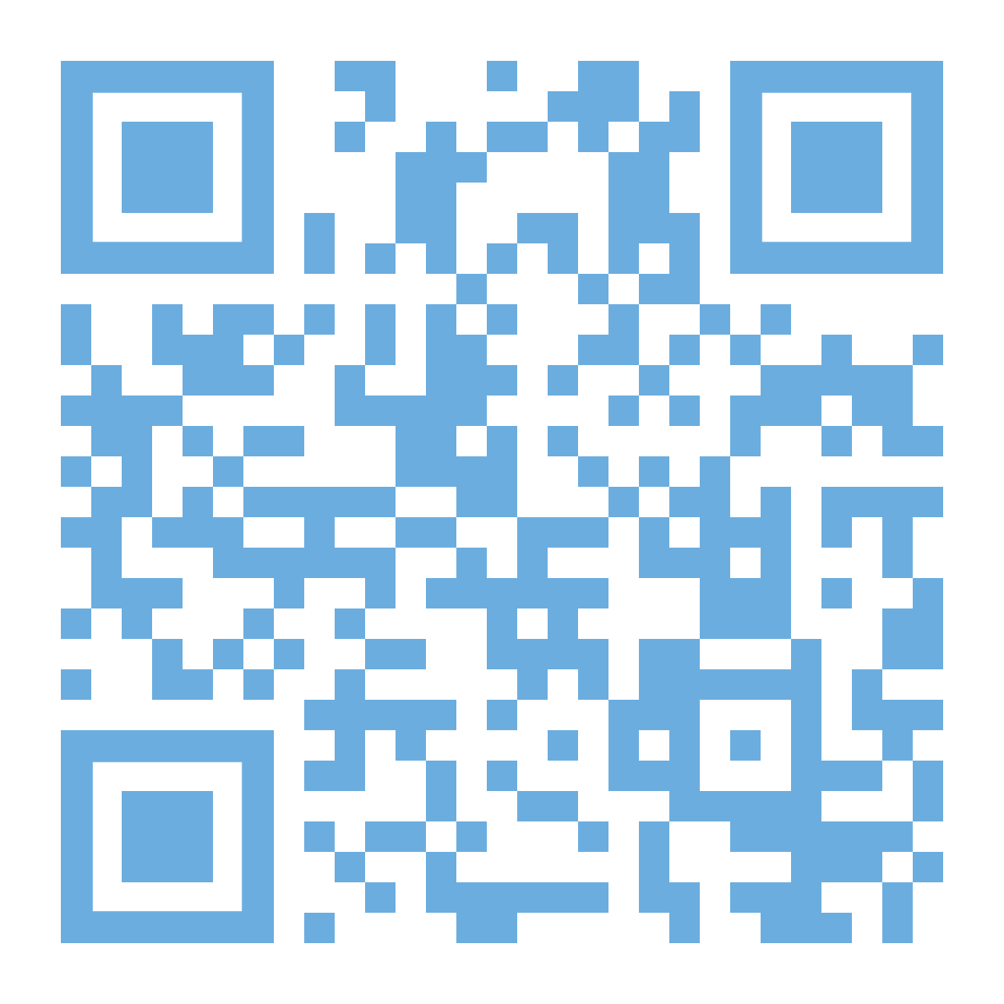
Knowledge Check – Click here to access the quiz

