Slide 1
Membership Management System (MMS)
Basic Instructions for Circle Advisors
2018-19

Slide 2
Table of Contents
What is MMS?
How to Access My MMS Account
Log In Credentials
Officer Administration Page
Edit Your Account
Developing Your Membership Applications
Application Review, Approval, and Rejection
Special or Surprise Inductions
Change a Membership Application
Membership Payments
Membership Certificate Order
Returning Certificates/Pins
Clearing Unhandled Records
Downloading Past Certificate Orders
Search for an Individual Member
Exporting Rosters
MMS Assistance

Slide 3
What is MMS?
MMS refers to the Membership Management System developed by Omicron Delta Kappa to coordinate the mandatory national membership application, approval, and certificate process.
MMS allows circle advisors, and with some limitations circle presidents, to:
  Approve or reject individuals who have applied for membership
  Review initiation rosters from previous years
  Download reports and spreadsheets of applicants and approved members
  Manage their personal administrative accounts
MMS provides specific initiation reports but not real time membership rosters and contact information.

Slide 4
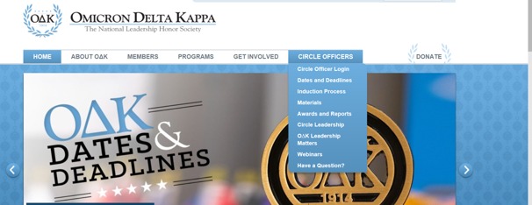
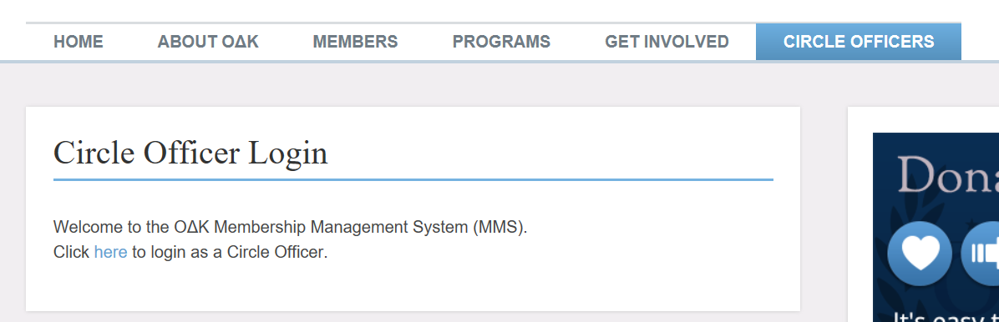
How to Access My MMS Account

Slide 5
Login Credentials
Click “Circle Officer Login” under “Circle Officers” tab:
If currently listed as a circle officer, you will automatically have an account created for you. Your email address serves as the login.
If you have trouble remembering your password or need an account created for you or for student officers, email the Membership Services Coordinator, at odknhdq@odk.org.
On your first time logging in, you should create a new password. To do this, click on the link labeled, “Forgot your password.” This link will take you to a form that will ask for your email address. After you submit your email address, you will receive an email, to that address, that will include a link to create a new password.
You can also login by clicking the “key” at the top of the membership application.

Slide 6
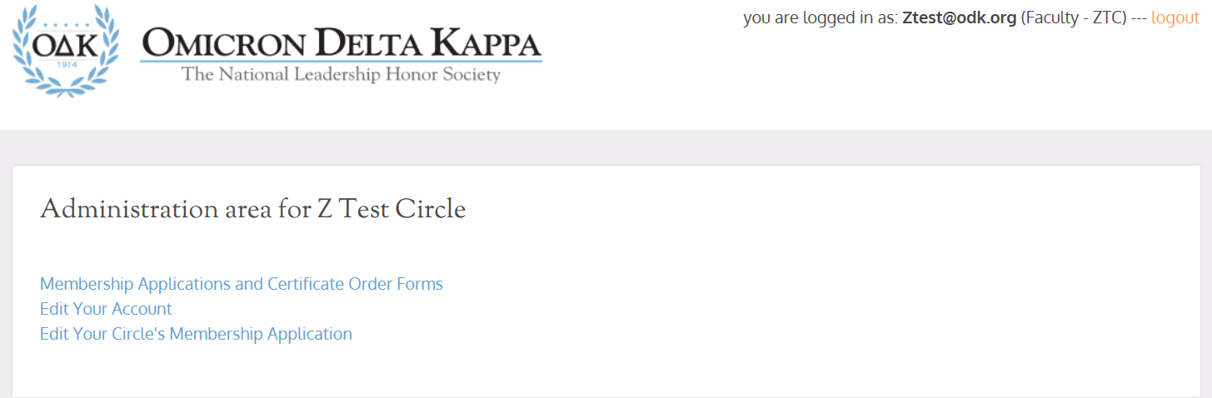
Officer Administration Page

Slide 7
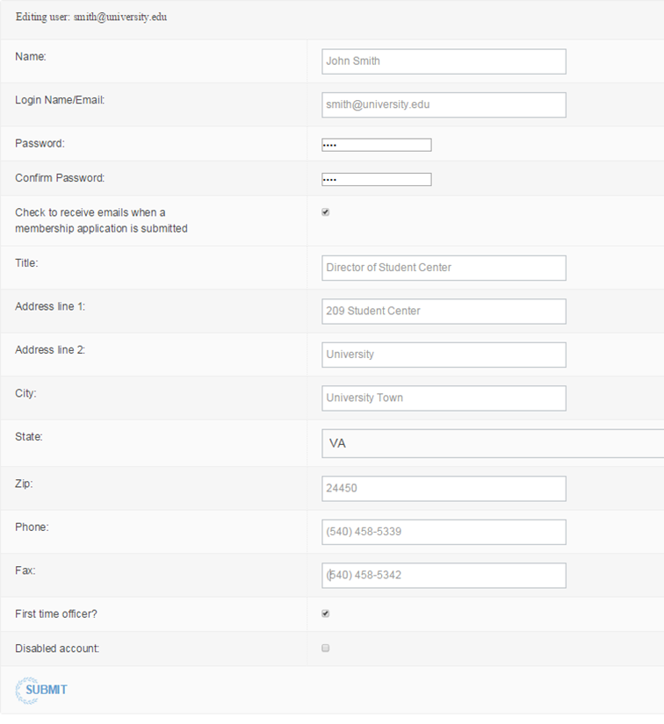
Edit Your Account
To further edit your account, click “Edit Your Account” from your Circle Administration page. You will be taken to a page containing all of your stored information.
You should ensure all information is complete and updated regularly to maintain the most current information. You can also change your password from this page by typing in a new password in both fields that ask for it.
You may also click the checkbox so you are sent an alert by e-mail whenever an individual submits an application for membership at your institution. We recommend you do this during membership recruitment time unless you check your applications page regularly.

Slide 8
Developing Your
Membership Application
Beginning in July 2018, circles have the ability to tailor the national membership application to suit their needs.
The basic membership information (name, email, address, etc.) is required and cannot be changed.
The application a prospective member sees will be determined by the “Class” they select. If an applicant selects “Junior,” s/he will receive the application with academic data and custom questions. If the applicant chooses Faculty/Staff, s/he will receive an application that has fewer fields unless the circle requires them in the specialty section.
The three areas that can be tailored by a circle are:
  Pin Type: Choose 1 pin for all members or allow members to select from the 3 pins offered by ODK.
  Specialty Selections: This allows circles to collect employment information about members who are not juniors or seniors. It also allows to seek information about past higher education degrees for graduate students and faculty/staff appointments. Circles may also ask for the student’s institutional ID number, if required.
  Custom Questions: This section allows circles to select up to 20 questions from our database to include on your application. Everything from short statements about phases to essays is available.
The default application is the new basic version with a few extra fields added by the national headquarters. If you do not change any fields, this is the application your prospective members will see.

Slide 9
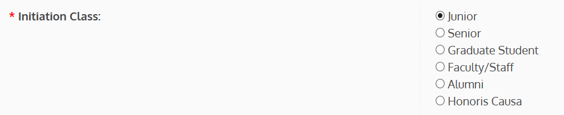
A Dynamic Application
The new application is dynamic. It changes based on the first two (2) choices made by the applicant.
When first opened in a web browser, ALL applicants see the same application.
The first change occurs when they select College/University. This narrows their choices to only that circle.
The second change occurs when they choose Initiation Class. Juniors and Seniors may see a different application depending on the selection made in the Special Request Fields.

Slide 10
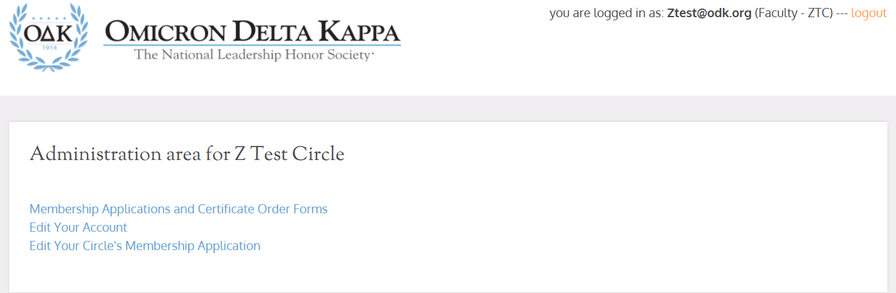
Changing Membership
Application Fields
To edit your custom fields, select “Edit Your Circle's Membership Application”
Start Here

Slide 11
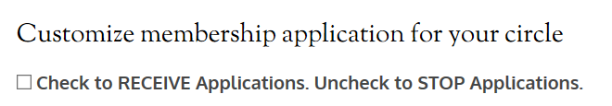
Activating/Deactivating
Your Application
Anytime you are not in actively accepting applications, turn off your application.
To DEACTICATE Applications:
  UNCHECK the box at the top of the Customization page
To ACTIVATE Applications:
  CHECK the box at the top of the Customization page..

Slide 12
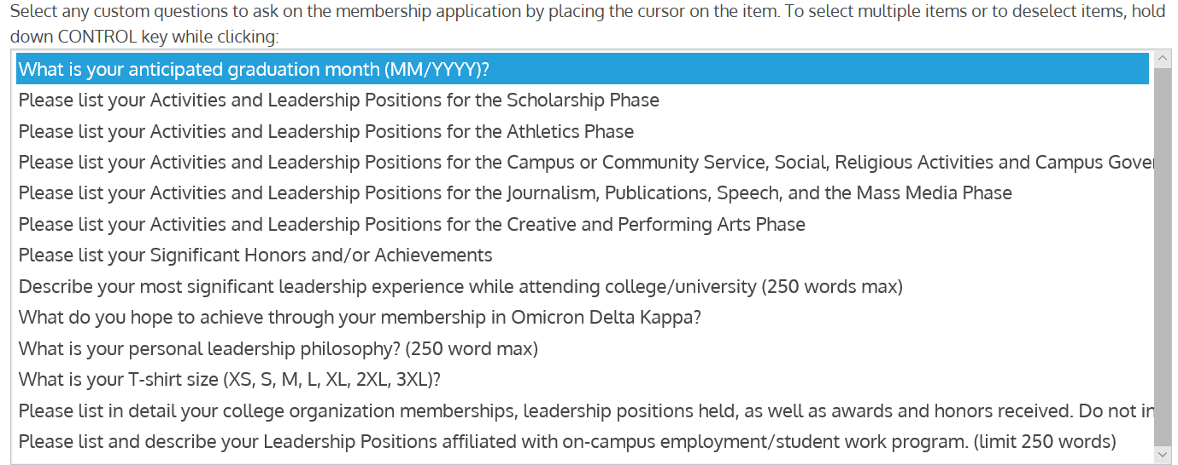
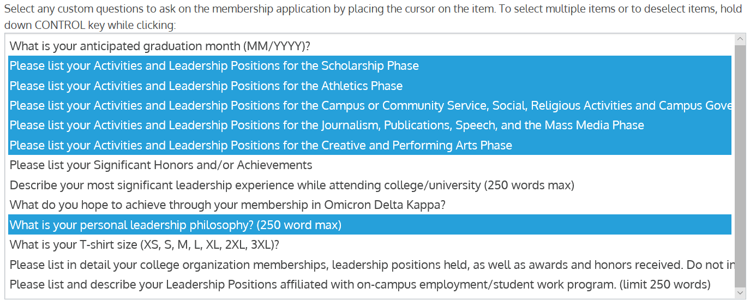

Custom Text Fields
Highlighted fields above represent fields selected by the circle to appear on the application
Before Selection
After Selection
Don’t forget to Submit!

Slide 13
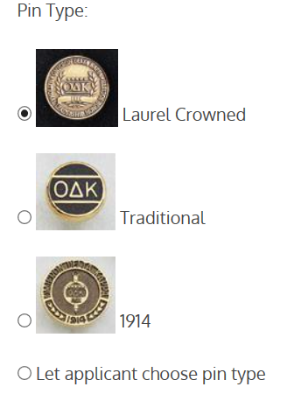
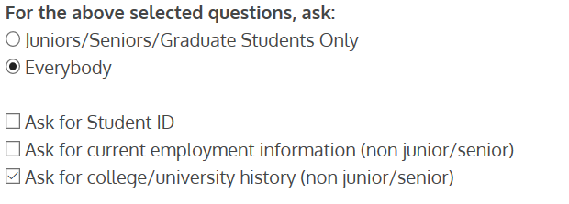
Special Items & Pin Type
Special Request Fields
Pin Type
You can allow students to select one of three pin types or remove the choice and select to have all student receive the same pin.
You can limit the items non-students view and control specific items like Student ID, employment and university history for non students.

Slide 14
Application
Development Timeframe
Application revisions should always occur BEFORE you start accepting applications for a cycle. All applicants should receive the same application version.
Any field(s) you add to the application will add data to your spreadsheet downloads.
To remove a selected Custom Question: Select Control/Enter
  If you remove this field, the column will remain since the older data is still in the system.
You can manage your downloads by simply deleting spreadsheet columns you do not use once you have completed the download.

Slide 15
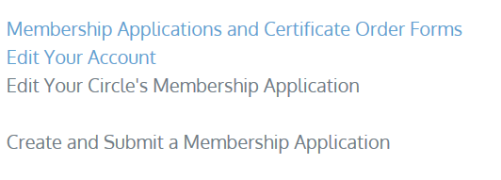
Special or Surprise Initiation
Many circles want to surprise a faculty member, alumnus, or honoris causa member with initiation into ΟΔΚ. That is perfectly fine to do. Please note the following:
Anyone using the circle’s customized form will receive notification that an application has been received.
If you do not want your “surprise inductee” to be notified, you can complete the application form that individual.
This is the ONLY time you can complete an application for the individual.
This should not be used for student inductees.
  To complete the special or surprise application:
  Go to the Administration Area on MMS.
  Select “Create and Submit a Membership Application”
  Complete the form with all information and submit.
  Because the advisor is completing the form, the advisor will receive confirmation from the system that application has been received.

Slide 16
Application Review and Approval
There are 3 steps in the Application Review and Approval Process:
  Review Applications
  Approve/Reject Applications
  Certificate Order Processing
All of these steps must be completed no less than 14 calendar days prior to your initiation ceremony. This ensures that ΟΔΚ can process your order, print certificates, and ship them to you in time. Many times is takes less than14 days. However, in order to qualify for national recognition, the circle must meet the 14 day rule.
Only faculty advisors and circle coordinators are permitted to access applications. Applications can be printed for officers or committee to review.
Advisors can download a spreadsheet of application information to provide to officers or committee as well.

Slide 17
Application Review
The online Membership Application form is designed to be processed online.
IMPORTANT NOTICE: Effective July 2017, we no longer permitted circle coordinators, faculty advisors, or other members of the circle to complete an application for the initiate. This includes FACULTY/STAFF and ALUMNI because the application constitutes a contract and includes permissions that must be accepted by the member, a third party may no longer complete the application for the initiate. Honoris Causa can be completed by a third party but MUST include all required information accurately submitted.
When an application is submitted it will be made available for review by the circle advisors at the circle where the member is applying. Email notification is not given unless you specifically request for this to be turned on.
To review submitted applications:
  Go to Circle Officer Login and login.
  Go to Circle Admin Page. Click on the “Membership Applications and Certificate Order Forms” link.
  On this page you will notice the bold “Unhandled.” This means that the application has not been approved or rejected.
  Select the name to view the submitted application.
  The Faculty Advisor or Circle Coordinator can then accept or reject membership applications.
  Once all applications have been accepted or rejected, the initiation class has been established.

Slide 18
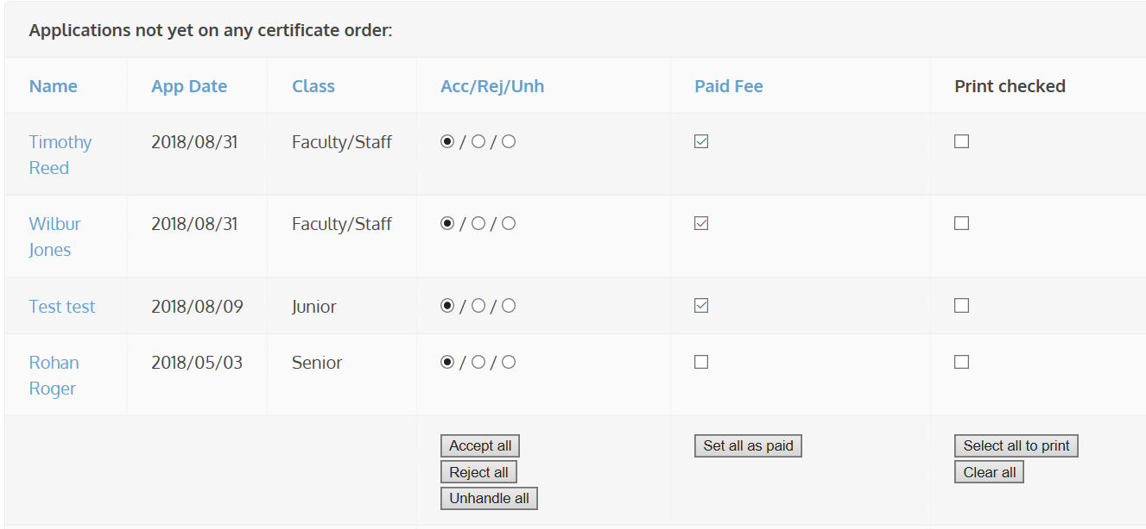
Application Approval/Rejection
By clicking on the name of the individual, you will be shown a copy of the membership application submitted by the prospective member. Individuals are not considered members until their membership fees are paid to the national headquarters, their application is accepted and ordered, and they attend an initiation ceremony. (See Membership Payment slide)
Rejected applications will be stored on a page called Rejected Applications, while the approved applications will appear with the bold term “Accepted.”
The membership certificate order form will automatically include the names of approved applicants.
Each column can be sorted by clicking on the column header in blue.

Slide 19
Membership Acceptance
The Omicron Delta Kappa Bylaws state that no one should receive the symbols of membership (certificate and pin) prior to payment of the National Lifetime Membership Fee.
We recommend you set a deadline for payment of fees. Only after you have received the fees or confirmation from the National Headquarters that we have received the payment online, should you process the Certificate Order Form through MMS.
If an accepted applicant did not pay the fees, a circle officer can reject that application before it is processed.

Slide 20

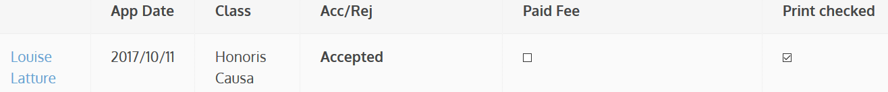
Change a Membership
Application Form
If you need to reject or accept a candidate AFTER you have submitted the final order. You must do this BEFORE the order is processed.
  (We do not recommend this but it may be necessary if a student pays late or decides to drop out BEFORE we process the order.)
Open the Membership Order Form
Select the Membership Summary
Select and Open the Member Application
Scroll to Bottom, Accept or Reject AND mark paid or unpaid.
Select Save Changes
Double Check the Certificate Order to ensure Name has been added or removed from the order.
FINAL STEP: Notify ODK HQ that you have made any alterations IMMEDIATELY.

Slide 21
Membership Payment
The circle is responsible to make sure each new member pays the national lifetime membership fee. There are two options:
Circle Pays from Invoice - Each circle has the option to either collect the fees from the initiate and remit a single check or credit card payment to the national headquarters.
Initiates Pay via web form - Initiates can also pay online, but the circle is responsible to verify that each new member has paid before the initiation date. http://odk.org/national-membership-enrollment-and-payment/
  NOTE: Individuals are not considered members until their membership fees are paid to the national headquarters, their application is accepted and ordered, and they attend an initiation ceremony.

Slide 22
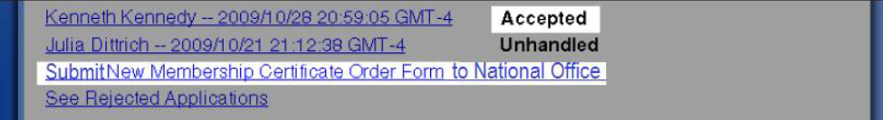
Membership Certificate Order
Once your circle accepts applications, the Faculty Advisor or Circle Coordinator must submit a Membership Certificate Order Form to complete the membership process.
The link to this order form will only be visible after accepting applications that have yet to have been ordered. The link to the order form will appear underneath the list of applications and above the “See Rejected Applications” link.
The membership certificate order form will automatically include the names of accepted applicants.
Please verify the individuals, spelling of names, and the total number, fill in all the remaining information including shipping address, and submit the membership certificate order form.
You MUST click SUBMIT for your order to be processed. We recommend you email ODK headquarters (odknhdq@odk.org) to ensure your order has been received.

Slide 23
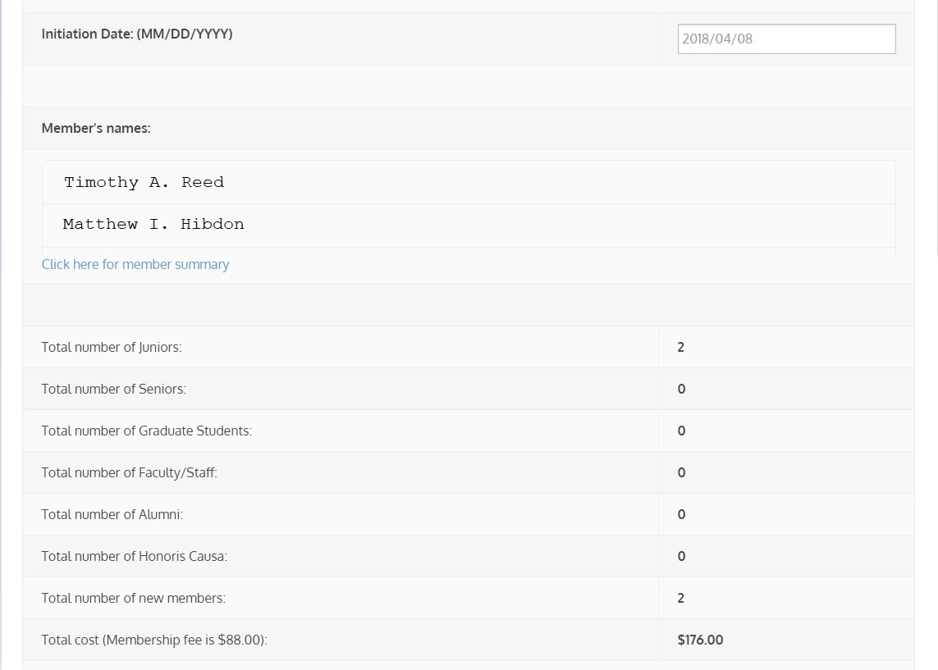
Example of the
Certificate Order Form
Important things to look for:
Make sure all the names are spelled correctly and are appropriate. ΟΔΚ does not permit nicknames like “Scooter” on the certificate.
Are the numbers correct? Did you miss approving someone?
Is the initiation date correct? (In January, we get many “the year before” dates!)

Slide 24
Returning Certificates/Pins
The official policy of Omicron Delta Kappa is that there are no refunds once certificates have been printed.
We will refund membership fees provided the certificate and pin are returned to the ΟΔΚ Headquarters no less than 30 days after the initiation ceremony. After 30 days, ΟΔΚ has the right to refuse to refund the fees. Please note that because the individual was not fully initiated, he/she will still not be considered a member of ΟΔΚ even if the fees were not eligible for a refund.
If the certificate and pin are returned, a credit will be issued to the circle or individual (depending on original payment) of $80.00 ($88 less an $8 certificate fee).
If the pin is not returned, an additional $10.50 will be withheld from the credit.
If no certificates or pins are returned, the circle will be held accountable for all membership fees approved as part of the membership order.

Slide 25
Clearing Unhandled Records
Once a ceremony has been held, all fees are fully paid, and the initiation process is closed, the circle advisor should log in to MMS and process “unhandled” applications.
All unhandled applications should be marked “rejected.”
Once this process is complete, the application queue should be empty and ready for the next round of applications.
ΟΔΚ national headquarters will audit all circle records on an annual basis and reject any application that has been left “unhandled” for more than 12 consecutive months.

Slide 26
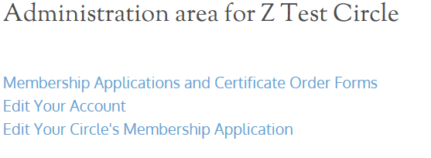
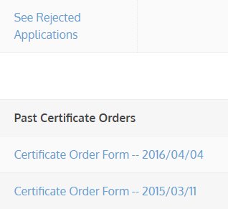
Downloading Past
Certificate Orders
Advisors can download past certificate orders, Excel or .csv file of applications, initiated or rejected members, and unhandled records.
  Select Membership Applications and Certificate Order Forms
  Select Certificate Form you want, open and print.

Slide 27
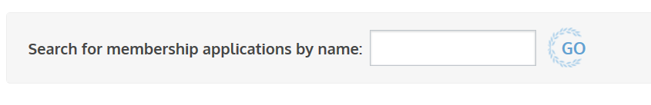
Search for an
Individual Member
Advisors can now search all MMS records for an individual using the search function under the Membership Applications link.
  Select Membership Applications and Certificate Order Forms
  Type the name you want to find and select Go.

Slide 28
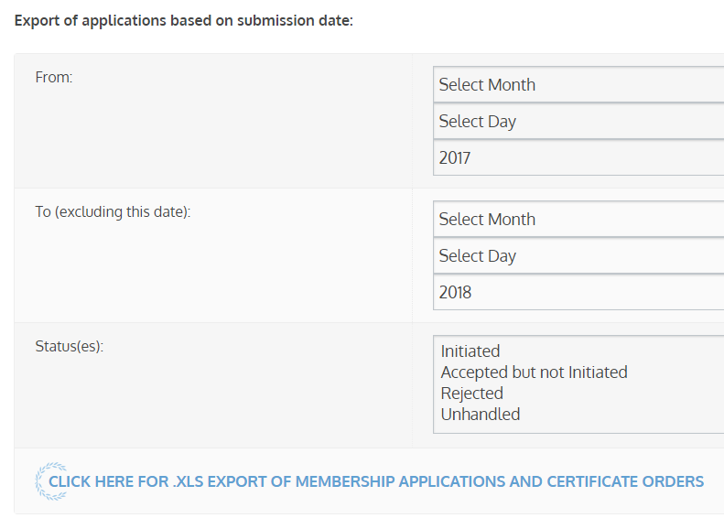
Exporting Rosters
Advisors can download an Excel or a .csv file of applications, initiated or rejected members, and unhandled records.
  Select Membership Applications and Certificate Order Forms
  Scroll down to “Export of applications based on submission date:”
  Enter dates.
  Select Status
  Click to Download

Slide 29
MMS Assistance
If you ever need assistance with MMS, do not hesitate to call the ΟΔΚ national headquarters (540-458-5336). Our office hours are 8:30 am – 5:30 pm Eastern, Monday through Friday. You can also email us at odknhdq@odk.org
Some reminders:
  Certificate request submission should be placed NO LESS than 14 days BEFORE your CEREMONY.
  ALL initiates must have PAID BEFORE we will issue certificates and pins. For circles paying by check, this means an invoice has been issued. For those paying online, we will only process those paid.
  Do not count on weekend deliveries for certificate orders.
  We will not process refunds after 30 days post-ceremony.

