Slide 1
Recruitment and Initiation Guide
Fall 2023

Slide 2
New Recruitment Challenges
Omicron Delta Kappa, like all honor societies, is working extremely hard to ensure that leaders on our campuses continue to be recognized through membership in O∆K. We fully understand the recruitment, selection, initiation, and member engagement has and will continue to present unique challenges.
Many of the practices our circles have used need to change to allow circles to thrive and grow. These guidelines have been developed to assist circles maintain the balance between the traditions of the past and the new reality of today.
If you have any questions about the recommendations and requirements in this guide, do not hesitate to reach out to your circle contact. Their email can be found on the Administrative Page in the MMS after you login.

Slide 3
Contents
To use this guide fully, open it in PowerPoint viewer. You will be better able to access hyperlinks to resources.
Membership Recruitment
Membership Process
Membership Cycle
Recruitment Timeline
Recruitment Process
Recruiting All Campus Leaders
Recruiting Sophomores
Horizontal v. Vertical Leadership
Materials
Applications and Fees
Initiation
Ceremony Planning
Pre-Planning
Monthly Tasks
Weekly Tasks
Ceremony
Post-Ceremony
Officer Selection

Slide 4
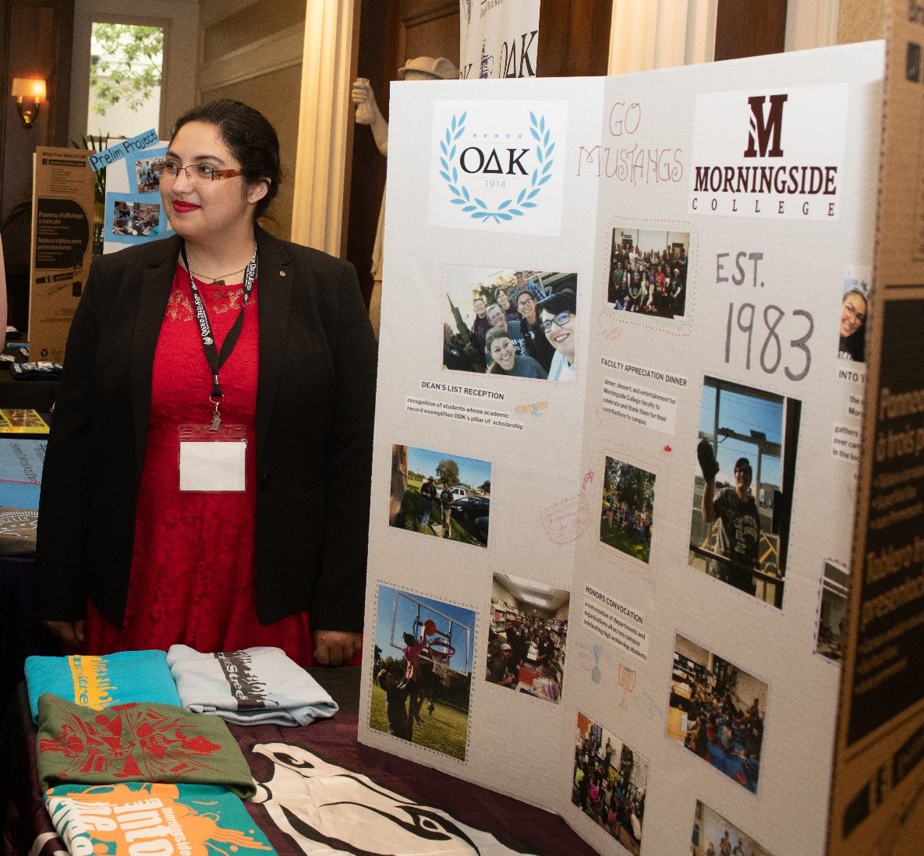
Membership Recruitment

Slide 5
Circle Membership Process
O∆K seeks to identify, celebrate, and engage collegiate and community leaders from different backgrounds, perspectives, and generations.
The circle’s goal should be to cast a wide net to recruit all campus and community leaders who emulate our mission and values and meet our membership criteria. This includes undergraduate students, graduate students, faculty, staff, alumni, and community leaders.
A circle should initiate individuals from each of the five pillars of campus life.

Slide 6
The Membership Cycle
Step 1: Preparation
Step 2: Recruitment
Engage Campus Resources
Conduct Information Sessions
Step 3: Selection
Review Applications
Step 4: Initiation
Implement Marketing Plan
Engage First-Year Students and Potential Members in Signature Programs
Seek Nominations from Faculty/Staff
Set a Goal for New Members
Establish a Recruitment Calendar
Consider the National Invitation to Membership Program
Develop Marketing Materials
Set Up Application in MMS
Attend Recruitment Webinar
Create Recruitment Team
Vote on Members at a Circle Selection Meeting
Conduct a Tapping Ceremony
Accept/Reject Applications
Coordinate Membership Fee Payment
Complete Membership Order Online
Determine Selection/Criteria Scoring
Plan Initiation Ceremony
Invite Families, Friends, Campus Community
Engage a Keynote Speaker
Test Technology Well in Advance
Conduct the Ceremony
Complete Post-Ceremony Duties

Slide 7
General Notes on Recruitment
Recruitment is specific to each circle; however, the most successful circles do the following:
Establish a firm timeline and maintain it year after year. This recruitment pattern becomes known on campus so leaders can anticipate the recruitment cycle.
Delegate the bulk of the day-to-day recruitment operations to a membership committee with an elected/selected chair. The circle officers should oversee but not manage the process.
Establish firm target estimates of new members needed to grow the circle in numbers, diversity or both. Work with your Circle Contact to devise a plan.
Market heavily throughout campus including emails, postings, and invitations for nominations from senior administrators and faculty.
Conduct information sessions (either online or in person) for students who may be eligible but not aware of O∆K. Invite your Circle Contact to participate in these!

Slide 8
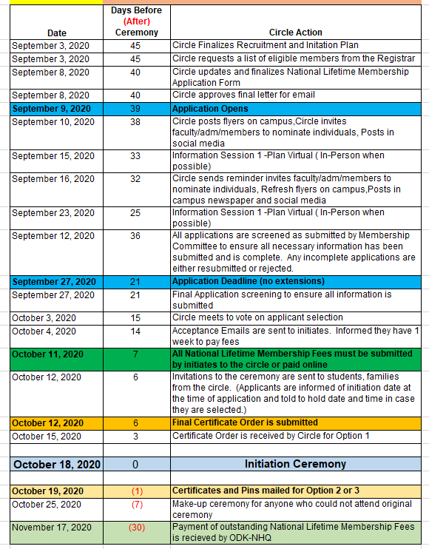
Recruitment Timeline
The recruitment timeline provided here is a recommended template for an efficient recruiting period of 45 days. The timeline does not include some additional preparation time.
45 days is more than adequate to conduct a complete recruitment process with information sessions, application review, and circle voting ending with an initiation ceremony.
The entire process can be managed virtually if needed, because the application, payment, and initiation ceremony can all be completed online. Familiarity with Zoom, WebEx, and other conferencing software allows circles to hold information sessions and meetings for voting without ever having to be in the same room.

Slide 9
Recruitment Process
Recruitment is specific to each campus
Develop relationships with freshman and sophomore programs to identify potential leaders
Make it personal – invite potential candidates to circle meetings or virtual forums
Use campus resources to gather names of the top 35%
Make sure you recruit from each of the 5 pillars
Once you have your recruitment plan, you are ready to navigate the Member Management System.

Slide 10
Recruiting ALL Campus Leaders
OΔK was founded on the principle of bringing the leaders of different campus constituencies together.
We are NOT an exclusive society. Exclusive means the recruitment process seeks to EXCLUDE those who don’t meet the criteria.
We have only three criteria:
Class: Undergraduates must be a sophomore, junior, or senior by credits.
Academic Eligibility: Undergraduate students must be in the top 35% of their class and enrolled for at least one-half year. Graduate/professional student academic eligibility is determined by each circle.
Leadership: Undergraduate students, Graduate/professional students, Faculty/Staff, and Alumni must have demonstrated leadership in the campus and/or community.

Slide 11
Guidelines for Including Sophomores
General Guidelines
The Mission Committee and National Headquarters staff recommend the following guidelines for circles to consider as they incorporate sophomores into a circle.
1) Definition of Class
Omicron Delta Kappa has five classes of membership as defined by the O∆K Policies and Procedures: Undergraduate student, graduate student, faculty or staff member, alumni, and honorary (honoris causa). The undergraduate class has three sub-classes: sophomore, junior, and senior. At some institutions these are known by other designations such as second-year, third-year, and fourth year. The graduate student class includes students in graduate and professional programs such as law, medicine, dentistry, pharmacy, etc.

Slide 12
Guidelines for Including Sophomores (continued)
2) Determining the credits required for a class.
The O∆K Policies and Procedures state that the class of a student is determined by the institutional guidelines. The credit hours required to attain each sub-class varies, but the list below can be used as a guide.
Sophomore, or second-year, typically at least 30 credit hours completed
Juniors, or third-year, are typically 60+ credit hours completed
Seniors, or fourth year, are typically 90+ credit hours completed
Circles should include in their local bylaws what the institutional criteria for determining the class of a potential initiate is so that it is clear to any candidate what the class level.

Slide 13
Guidelines for Including Sophomores (continued)
3) Requirement to Initiate Sophomores
There are no provisions in O∆K Policies and Procedures that prevent circles from accepting only one class of students; however, circles are strongly encouraged to initiate all classes within the policies that limit graduate, faculty and staff, and alumni initiations. The Society strongly discourages any self-limiting practices. Circles should be open to the widest possible pathways to recruit and initiate members as the policies and procedures will allow.
4) Strategy for the Initial Inclusion of Sophomores
Each circle is expected to develop a strategy for the inclusion of sophomores into the circle. The strategy should include three basic principles:
1. Purpose
2. Specialized Leadership Development
3. Numeric Targets – how many of each class do you intend to initiate

Slide 14
Guidelines for Including Sophomores (continued)
5) Sophomores must have full membership status
The revised O∆K Policies and Procedures now include sophomores as full members of O∆K. Circles may not in any way create a system that allows for sophomores to be considered anything less than full members. Criteria for circle officer positions may include expectations of experience within the circle but should not be written in such a way as to always exclude sophomores from executive leadership.
6) Petition to increase the maximum number of initiates
The O∆K Policies and Procedures place maximum limits on the number of undergraduate students a circle may initiate based on the undergraduate population. At this time, very few circles ever approach their maximum number. If the inclusion of sophomores in significant numbers would conflict with the maximum limit, a circle may petition the National Headquarters for a waiver. Waivers will be granted for two years. The National Headquarters will monitor the requests and if it becomes necessary to change the maximum percentage allowed for all circles, the National Headquarters will work with the Mission Committee to propose recommended changes to the maximum levels.

Slide 15
Commitment to Diversity, Equity, and Inclusion (DEI)
OΔK has redoubled its commitment to increasing our recognition of individuals of underrepresented populations.
In order for OΔK to have the membership representative of the future of this country and this world, we need our circles to expand their recruitment practices.
The recommendations in this section are designed to help guide circles in seeking out the leaders who may not be recognized in traditional leadership programs.

Slide 16
Suggestions for DEI Recruiting
Move beyond traditional avenues of recruitment.
Target online recruiting efforts at historically Black, Hispanic/Latino, Asian and other fraternities and sororities.
Host online information sessions specifically for these and other groups that may be traditionally underrepresented in your membership.
Invite faculty/staff members with connections to Multicultural Centers or other special programs to recommend leaders for membership.
Seek faculty and staff persons of color to recommend individuals and to be recruited as possible members.
The most important factor is to open the recruitment process to those populations that are underrepresented in your circle and even your institution.

Slide 17
Selection based on the 5 Pillars: Horizontal v. Vertical Leadership
Recruitment and Selection from the 5 Pillars should look for leaders who have either breadth across multiple pillars or depth in one pillar. This is the process of looking for Horizontal Leadership or Vertical Leadership.
Horizontal Leader: One engaged as a leader in many different pillars of campus life.
Presented research at a conference = Academics and Research
Writes for the campus paper = Communications
Leads the campus food pantry = Service to Campus and Community
Vertical Leader: One who has engaged deeply in leadership in one pillar of campus life.
Lead role in theater productions = Creative and Performing Arts
Directs one-act plays = Creative and Performing Arts
Served on the arts council = Creative and Performing Arts

Slide 18
Selection based on the 5 Pillars: Horizontal v. Vertical Leadership
Each leader has much to contribute to a circle and to OΔK as a whole.
If you balance the Horizontal and Vertical you will complete the Circle!

Slide 19
Use National Recruiting Materials
National Recruitment Materials
National Invitation to Membership Program
YouTube Videos of Conferences and Important Speakers
Invite National Officers to join an information session virtually
email odknhdq@odk.org or reach out to your Circle Contact

Slide 20
National Lifetime Membership Applications
All potential OΔK members must complete the National Leadership Honor Society Membership Form.
The membership form can be tailored to circle needs, so there is no need to use a separate application. When setting up the application, refer to the Membership Management System (MMS) Guide
The circle advisors and student president can download and review applications.
Officers must accept applications in MMS before informing applicants that they have been accepted for membership.
Only applicants that have been marked accepted should pay the National Lifetime Membership Fee.

Slide 21
National Lifetime Membership Fees
All regular initiates must pay the Lifetime National Membership Fee ($94) before initiation.
Membership fees may be paid through the circle or the national membership payment portal.
Online Payments
If a circle chooses to use the online portal, a circle advisor must inform the National Headquarters of the dates to open and close the payment portal. This is a manual process and must be done by the HQ staff.
All online fee payments are assessed a $4 service fee. Please ensure applicants know this.
HQ staff will mark MMS as “Fee Paid through ODK Portal” as payments are received.
(Continued on the next page)

Slide 22
National Lifetime Membership Fees
Local Payments (Payments to the Circle or Institution)
If a circle chooses to accept the payments locally, a circle officer is responsible for marking each applicant as “Fee Paid to Circle” in MMS
“Fee Paid to Circle” should only be marked once the circle has received the payment.
Local Dues
Circles are encouraged to collect nominal local/circle dues to fund circle operations.
Local dues for initiates should be paid at the same time as the national lifetime membership fees.
The National Headquarters cannot accept local/circle dues through the payment portal.
Only applications marked as accepted and “paid” will be processed for membership.
Once all applications have been approved and membership fees collected, one of the circle advisors must complete the Membership Certificate Order. Student officers cannot submit the order.
For both options, the National Headquarters will invoice circles for all memberships submitted via the Membership Certificate Orders. Funds received through the online form will be credited. No member who has not paid the national fees may be initiated to the circle or the national office, except for the approved honoris causa, gift of membership, and new advisor initiates.

Slide 23
Initiation Ceremony Planning

Slide 24
ΟΔΚ Initiation Ceremony Planning
This section is a general guide to planning the ΟΔΚ Initiation Ceremony.
This guide was designed with a three-month planning process for the ceremony. The process can be compressed based on the needs and experience of the circle. All of the activities in this section are considered important to the planning of a successful ceremony but do not have to take as much time as suggested.
NOTE: The recruitment process is separate from ceremony planning. The date of the ceremony must be set before the recruitment process begins, but the recruitment process will end well in advance of the ceremony. Furthermore, depending on the campus, you may need to start as much as six months in advance to reserve rooms and invite speakers on your campus for an in-person program.
The official O∆K Initiation Handbook is available online.
The O∆K National Bylaws and Handbook dictate the ritual parts of the ceremony that may not be changed.
Enhancements to the initiation ceremony, like a keynote speaker and reception, are at the discretion of the circle.

Slide 25
General Notes
The planning and execution of the initiation ceremony or ceremonies should be considered a circle activity that involves all active members of the circle. It is not just the responsibility of the student president and advisors. Here are a few general tips.
Make it formal. The more reverence given to the ceremony, the more important the members feel.
Make it public. OΔK ceremonies are never secret. Invite the campus. Specifically, invite senior administrators and faculty to participate. Invite family and friends of the initiates. This should be a public celebration of leadership.
Make it memorable. Including an important speaker, inducting well-known institutional members as honoris causa, and creating a tradition that is unique to your circle will make this event one that members, families, and guests remember for many years.
Decide in advance whether your ceremony will be in-person, virtual, or hybrid.

Slide 26
In-Person, Virtual, or Hybrid
In-Person: OΔK recommends In-Person ceremonies whenever possible. We believe the strongest connection to the circle and to the value of OΔK is for individuals to physically be in the same space to receive their emblems of membership and to meet others from the circle.
Hybrid: Hybrid ceremonies are the most complicated to produce because you have to plan for both the in-person and virtual aspects of the ceremony.
Virtual: Virtual ceremonies are permitted but must be followed with in-person meetings and activities where possible. Virtual ceremonies allow for remote members to be initiated and participate in the ritual.

Slide 27
Pre-Planning
The initiation date should be determined in the semester prior to the event.
Determine if this will be an in-person, hybrid, or virtual ceremony.
The instructions for ceremonies from this point will offer suggestions for both in-person and virtual. If you are holding a hybrid ceremony, you will need to follow the guidelines for both in-person and virtual in nearly all cases.
In-Person
Two rooms for the initiation should be reserved.
You should have one room for the ceremony and one room (or separate area) to gather the initiates before the ceremony.
Reserve the rooms at least one semester before the planned ceremony. For example, during the spring or summer, reserve space for fall and during the fall, reserve space for the spring ceremony.
If your institution has an annual space reservation process, take advantage of that to reserve space for all ceremonies.
Virtual
Determine the virtual platform (Zoom, Teams, etc.)
Establish the web links for future publishing and invitations
Be sure all involved in leading the ceremony are set up as hosts
Determine if you will live stream the ceremony to YouTube, Facebook, etc.
Arrange technical support well in advance
O∆K offers a sample presentation to use for a virtual ceremony – connect with your Circle Contact for more information.

Slide 28
Three Months Prior
In-Person
Ensure that the rooms are reserved and the reservations with all equipment and needs are finalized and secured.
The Circle Coordinator should inform National Headquarters of intended date of the initiation.
Check the circle ceremony supplies list to determine if supplies need to be ordered.
The selection process should be under way at this time.
Create a Ceremony Planning Team (CPT) (ex: President, Circle Coordinator, Social Chair and Elections Chair). They should meet to discuss ceremony plans. Remember – all candidates should be informed of the ceremony date and time and that participation is required to be a member at the time applications are available.
If there are plans for a speaker, you should be planning this now.
Virtual
Ensure that the virtual platform and reservation times are final
The Circle Coordinator should inform National Headquarters of intended date of the initiation.
The selection process should be under way at this time.
Create a Ceremony Planning Team (CPT) (ex: President, Circle Coordinator, Social Chair and Elections Chair). They should meet to discuss ceremony plans. Remember – all candidates should be informed of the ceremony date and time and that participation in initiation is required to be a member at the time applications are available.
If there are plans for a speaker, you should be planning this now.

Slide 29
Two Months Prior
In-Person
Make sure the ceremony is on all members’ calendars and that the CPT assigns roles for preparations and execution.
If a speaker is planned, the topic, travel arrangements if any, and other logistics for the speaker should be finalized.
Secure a photographer for the ceremony. This should be a volunteer or someone willing to work for a very nominal fee. This is mostly to get candid shots of the ceremony and to take the official picture at the end.
If catering is being used, a caterer should be secured at this time even if final menu is not.
Virtual
Make sure the ceremony is on all members’ calendars and that the CPT assigns roles for preparations and execution.
If a speaker is planned, the topic and other logistics for the speaker should be finalized. Ensure the speaker has a high quality mic or recent version mobile phone to allow for the best quality audio

Slide 30
One Month Prior
In-Person
Selection of new members should be complete by this time, or least very close to complete.
The CPT updates menu with caterer.
The CPT reviews script and updates the various speaking parts, starts adding names of candidates as they pay dues, etc.
The Selection Committee or Advisors send invitations to acceptance correspondence to the candidates with instructions on how to pay the National Lifetime Membership Fee.
Ensure all institutional rules for social distancing, masks, etc. are explained to all participants, as required.
Virtual
Selection of new members should be complete by this time, or least very close to complete.
The CPT reviews script and updates the various speaking parts, starts adding names of candidates as they pay dues, etc.
Draft PowerPoint and other graphics should be in development at this point.
The Selection Committee or Advisors send invitations to acceptance correspondence to the candidates with instructions on how to pay the National Lifetime Membership Fee.

Slide 31
Two Weeks Prior
In-Person
All National Lifetime Membership Fee payments should be complete.
The Circle Coordinator or Faculty Advisor completes the certificate order form for certificates and pins.
NOTE: for In-person Ceremonies, the National Headquarters needs several days to process, complete, and ship the certificates and pins to the circle. It is crucial that this process be completed well in advance of the ceremony to ensure materials arrive before the ceremony.
Review all institutional rules for social distancing, masks, etc. Order necessary PPE if needed.
Virtual
All National Lifetime Membership Fee payments should be complete.
The Circle Coordinator or Faculty Advisor completes and submits the certificate order form for certificates and pins.
NOTE: OΔK will not ship certificates and pins directly to initiates. Circles should plan for the items to be sent to the school, and then arrangements made for initiates to receive their items after the ceremony. The National Headquarters will not ship the materials until all payments have been received for each member.

Slide 32
One Week Prior
In-Person
Check RSVPs for initiates. All initiates should attend. If someone cannot attend, determine when the make-up ceremony will be held.
Complete the Ceremony Program with names, order of ceremony, etc.
Food order finalized with caterer.
Any last minute changes to room set up should be finalized with the local event planning office.
Ensure all institutional rules for social distancing, masks, etc. are being followed. Check PPE order if it has not arrived.
Virtual
Check RSVPs for initiates. All initiates should attend. If someone cannot attend, determine when the make-up ceremony will be held.
Test all technology.
Complete a practice session with all officers leading ceremony. Make sure there are multiple hosts set up, in case one person cannot attend.
Make sure webcams, mics, recording devices, and live streaming programs are tested.

Slide 33
Day of Ceremony
In-Person
Assemble the circle officers at least one hour prior to the ceremony to set up the room and ritual elements.
Place name cards on seats
Set up table according to Initiation Handbook
Place scripts on the podium
Ensure area for reception is set and catering has arrived
Make sure that all room preparations are complete before the guests and initiates arrive.
Have initiates gather in the separate room or area at least 30 minutes prior to the ceremony. The CPT leader or Circle Coordinator should explain the process of signing the Record Book, receiving the pin and certificate to the initiates.
If there is recorded or live music, this should start no less than 15 minutes prior to the ceremony.
Begin the ceremony with the march of the candidates who enter the room and take their seat.
Virtual
Assemble the circle officers at least one-half hour prior to the ceremony to prepare for the broadcast.
Make sure that all web and live stream preparations are complete before the guests and initiates log-in.
Have initiates gather in the separate web program or chat area at least 30 minutes prior to the ceremony to provide instructions.
The CPT leader or Circle Coordinator should explain the process of signing the Record Book and presenting the pin and certificate to the initiates.
Begin the ceremony.

Slide 34
Post Ceremony
In-Person
Pack and store all supplies so they will be ready for the next ceremony.
If there are any members not initiated who will not be initiated in a “desk ceremony,” return those certificates and pins to the national headquarters as soon as possible (within 30 days).
Send thank you notes to speakers and any special guests who attended.
Add all new members to your communication rosters.
Send copies of ceremony photos to O∆K or provide access to a shared folder.
Virtual
Verify recording of program
Post program on website or other media.
Send link to recording to odknhdq@odk.org so OΔK HQ can add to social media
If there are any members not initiated who will not be initiated in a “desk ceremony,” return those certificates and pins to the national headquarters as soon as possible (within 30 days).
Send thank you notes to speakers and any special guests who attended.
Add all new members to your communication rosters.

Slide 35
Elements of an O∆K Ceremony Table
Left Side
Candles
Key of Membership pins
Membership Certificates
Center
Ceremonial Key
Table Cloth or Podium cloth
Right Side
Floral Bouquet
Official Record Book and Pen

Slide 36
ΟΔΚ Initiation Ceremony In-Person Supply List
Head Table Area:
ΟΔΚ Banner or podium cloth
Stoles for officers and advisors
Safety pins
5 candles with lighter or battery candles with extra batteries
Official Record Book and pens
ΟΔΚ Bronze Key
White table cloths
Certificates and pins
Flowers
Seating Area:
Name tags for seats
Programs
Cord or ribbon to rope off seating for ΟΔΚ officers and initiates.
Food tables:
Tablecloths
Decorations
Punch bowls
Food
Plates, cups, napkins and utensils (don’t forget serving utensils)
Ice bucket to refill punch bowls
Quart and gallon sized Ziploc bags for leftover food

Slide 37
ΟΔΚ Initiation Ceremony Virtual Supply List
Head Table Area for Video:
ΟΔΚ Banner or podium cloth
Stoles for officers and advisors
5 candles with lighter or battery candles with extra batteries
Official Record Book
ΟΔΚ Bronze Key
White table cloths
Sample Certificates and Pins
Flowers
Software and Graphics:
Zoom, WebEx, or other web conference program
ΟΔΚ Head Table Image
ΟΔΚ Initiation Power Point (from odk.org)
Background music

Slide 38
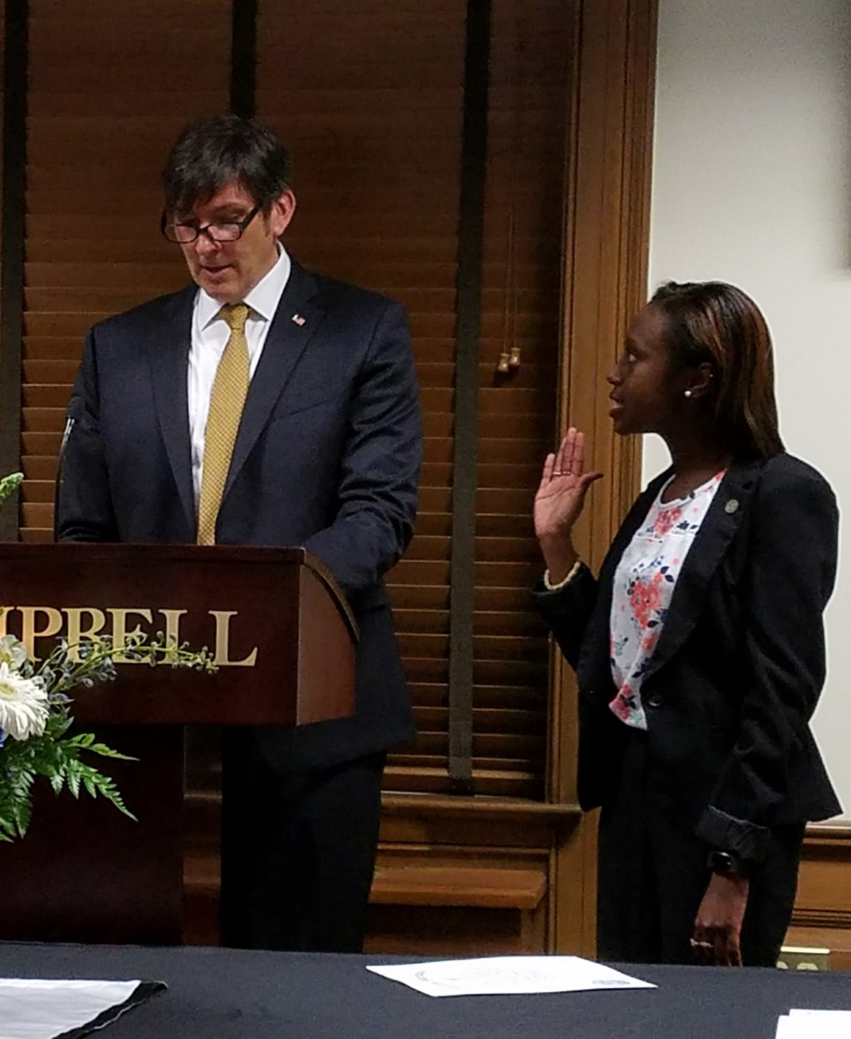
Last Word

Slide 39
Officer Selection
Student officers and new advisors should be installed during an initiation ceremony as part of the public acknowledgement of the transition of leadership.
The election/selection of officers should be outlined in the circle bylaws and should be strictly followed.
The current circle officers should manage the initiation/installation of the new officers with a specific transition date set prior to installation.
Complete and submit the Student Officer Update Form as soon as the new officers are installed. Ensure that all financial, institutional, and circle documents and forms are complete before the previous officers step down from their positions.
Recognize the outgoing officers for their service at the ceremony.

Slide 40
Summary
Membership recruitment is critical for the circle, the national organization, and the individual member. When ΟΔΚ recruits the best and provides them with purpose and meaning on campus, those members improve the quality of their relationship with ΟΔΚ in the future.
Remember, you are not just recruiting for the circle or campus. You are identifying members who will lead our national organization in the future. Your recruitment efforts may lead to a future Board of Trustees chair, President and CEO, or major gift donor who supports scholarships.

Slide 41
National Headquarters Assistance
We are always ready to assist you with your ceremony plans.
Email: odknhdq@odk.org
Phone: (540) 458-5336
Best wishes on a successful a successful recruitment cycle and initiation ceremony!

