Slide 1
MyODK Circle Officer
Basic Instructions for Circle Officers
2024-2025
Updated September 30, 2024
Notes:
Add this message to the chat:
Please fill out the check-in form for this training here: https://docs.google.com/forms/d/e/1FAIpQLSehjNvpZlszq7ziEKydsfvLbtdzjkkzAtmtCX0z7-j-Qnv2Og/viewform Without completing this training form, attendees will not receive credit for attending today.
Welcome and introductions if needed
Today’s training will cover the fundamentals of MyODK for accessing your account, the circle executive dashboard, creating your membership application, the application review and approval process, and instructions for your applicants.
If you have any questions, please unmute or add them to the chat.

Slide 2
Table of Contents
What is MyODK?
How to Access a MyODK Account
Log In Credentials
Edit Your Account
Circle Executive Dashboard
Creating Your Membership Applications
Application Development Process
Application Structure
Application Management
Application Creation
Set Dates
Select Custom Questions
Review and Submit
Special or Surprise Initiation
Application Review and Approval
Step 1: Application Review
Step 2: Accept or Reject
Step 3: Membership Payment/Verification
Step 4: Certificate Order Form
Instructions for Applicants
To return to the Table of Contents at any time, click the MyODK logo in the top right corner.
Notes:
This presentation will be shared with you via email later, and eventually will be on our website. The links you see in the table of contents are clickable so you can navigate through the guide.

Slide 3
What is MyODK?
Description of the Program

Slide 4
What is MyODK?
MyODK is a Member Engagement Platform (MEP) that provides members with 24/7 access to stay connected and engaged with OΔK throughout their lifetime. MyODK is powered by aarwinMEP, developed by JL Systems.
For Members
Permanent Record for your OΔK Experience
Update Personal and Professional Information (addresses, emails, career changes)
View all OΔK activities (officer positions, volunteer roles, events attended)
Access Member Benefits (links to members-only benefits)
Networking (connect with members through the Discord Communities, register for the National Leadership Conference, search for other OΔK members in your field)
For Circles
Application process with more customizable fields
Access to reports and data about members
National and local fee payment options during the recruitment process
Greater access to training and support
Notes:
MyODK is our new member engagement platform to replace the Membership Management System.
Officers will use this portal to create their application, gain access to reports and data about their members, select new members, submit initiation orders, and utilize national and local fee payment options.
A brand new element is that for the first time, members will have access to their ODK records and can make updates. A member directory is coming later this year so that circles and members can search for members. Members will be able to view the committees they have served on and events attended, and prospective members will be able to view their application status.
Member benefits will move behind the MyODK system, so members will need to log in to MyODK to gain access to the codes and links. New benefits are coming soon as well!

Slide 5
How to Access a MyODK Account
Log In Credentials, CIRCLE EXECUTIVE Page, Edit Your Account

Slide 6
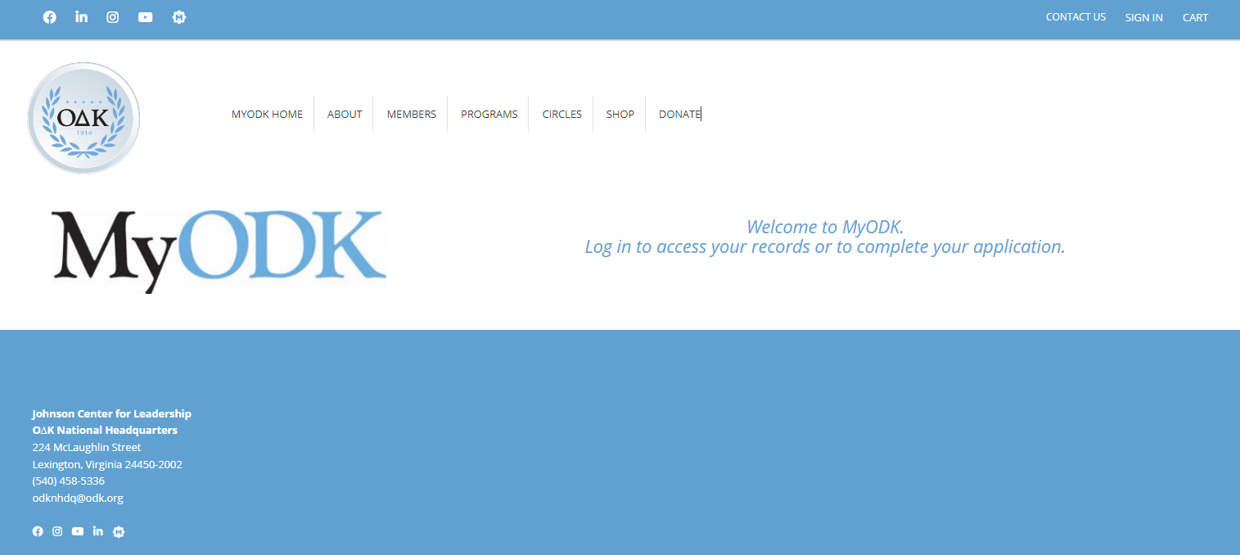
Start at my.odk.org
Sign in with your email and MyODK password
Notes:
Sign in is located at my.odk.org

Slide 7
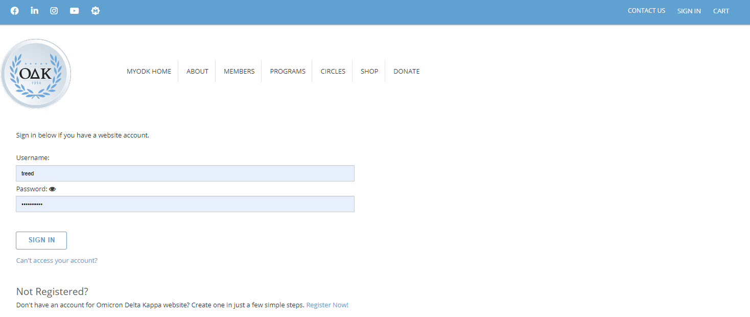
Login Credentials
First Time: You should have received an email providing you with a link to set up your credentials. As a member of OΔK, you already have a record in the portal. You need to activate it.
The first time you sign in, go to “Can’t access your account?” You will need to enter an email. If the system does not recognize the email, you need to contact myodk@odk.org
If you have received a Quick Activation link, go to Register Now! and select Quick Activation.
Notes:
Those who are already members have an existing account that the Society created on their behalf. They just need to activate it!
New applicants will use the “register now” feature.
If you, or any prospective members, have any login issues, please email myodk@odk.org. This is the dedicated email address for concerns or questions about the new portal.

Slide 8
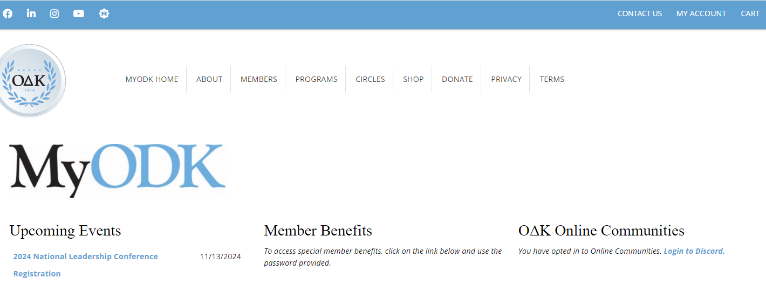
MyODK Home Page
Features of the MyODK Home Page
Notes:
The homepage will feature:
Upcoming Events - NLC registration will be available through MyODK, plus other events such as webinars and the Circle Advisor Training Workshop. This will save attendees from having to input their information multiple times because the system will recognize you and put in your personal data.
Member Benefits – Soon, all codes and links for access to member benefits will move off our public website, and members will have to log in to the portal first to access the private website. This will make our benefits much more exclusive for our members. We will be launching some exciting new benefits later this year as well!
Online Communities – If you have not opted in to be part of our Discord server, you will be able to do so from the homepage.
This page will be updated frequently as new features come online.

Slide 9
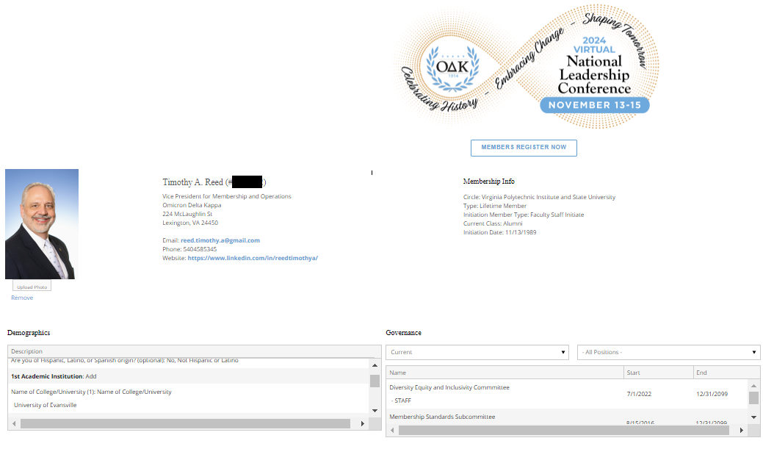
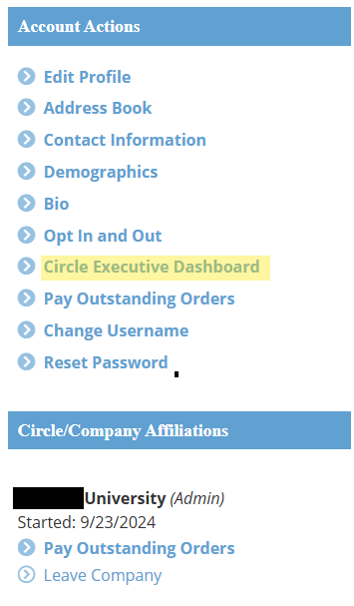
Your MyODK Account Dashboard
General Membership Information
Account Actions
These are how you update personal information and access the Circle Executive Dashboard
These images are for informational purposes only!
Notes:
Governance = circle officer roles will appear here, attending previous conferences, and volunteer positions such as serving on committees. This information is still being updated, so more information will be added, but if you see anything that needs to be changed, please let us know.
Use “Change Username” or “Reset Password” to update that information - ODK staff cannot change passwords or usernames.
Use “Edit Profile” or “Contact Information” to update your profile information. You can also update “Demographics” if anything has changed, this information was only included if you answered the optional demographics questions in your membership application.
Circle Officers will use “Circle Executive Dashboard” to access the applications, etc.

Slide 10
Circle Executive Dashboard
Notes:
The Circle Executive Dashboard is a lengthy page, so we have broken it up across multiple slides.

Slide 11
Circle Executive Dashboard
NOTE: Student President does not show because she was entered on June 30, 2023. Student Officers automatically expire after one year unless they submit a new form or contact OΔK to say their appointment has been extended.
The first part of the dashboard area provides information about the officers for which OΔK has received Officer Agreements. This is required for Circle executives to have access to the Circle Executive Dashboard. Faculty Advisors, Circle Coordinators, Alumni Advisors and Circle Assistants must submit the Circle Advisor Agreement. Student officers must submit the Student Officer Agreement.
Notes:
New features are coming online as we progress through the launch.
You can find your Circle Contact, Circle Officers, etc. here.
Student Officers have an automatic one calendar year expiration date, and ODK must be notified if this needs to be extended. Advisors remain active until we are notified of a change.
All new officer must complete the forms through the “Update Circle Leadership” link.

Slide 12
Creating Your Membership Application
Circles can add special questions and fields to the national application
Notes:
Much of this is similar to MMS, but there are several new features that will be critical to your recruitment processes.

Slide 13
Application Development Process
REVIEW
CREATE
PUBLISH
The application process requires that all fields be accurate when the application is finalized. Review all questions and items before starting the application creation process.
MyODK is different from MMS. Each application is unique, and items from past applications are not used to create the next application. However, applications are available for officers to review.
All application changes are live when the “submit” button is selected. Make sure
everything is set before the application is saved.​
Notes:
One change – rather than turning the exact same application on/off each time, you are creating a new application with a new initiation date tied to it. Think of the recruitment process as an “event” within MyODK. You will be able to view your old applications to see which custom questions you used, etc.
Once the application is live, it cannot be modified, so you need to be sure of all the information you are putting in.

Slide 14
Application Structure
The National Membership Application has two types of items:
Required (by the Society) and Custom (inserted by the circle).​
Required items include the basic membership information (name, email, address, etc.) that is required and cannot be changed. The default application has the required items. If the circle does not change any fields, this is the application your prospective members will see.
Custom items are those that the circle chooses to select and add to the application. Only the items selected and approved by the circle will appear on the application seen by individuals on your campus. Circles are limited to the options shown and cannot create items specific to only their campus.
Notes:
The application still features required information that shows on all applications, plus the ability to add in custom questions. We have pulled over all the custom questions from MMS into MyODK.

Slide 15
Application Creation
Notes:
New items in the application creation process:
Before beginning your application, the circle’s initiation date must be set in stone. This is 1) good practice for the circle, and 2) a firm requirement moving forward.
Application open/close dates will be required and cannot be changed. You will not be able to reopen the application to allow for “late” applications moving forward.
You may now set a maximum number of applications, and the portal will close once you hit the max. However, circles should remember to be selective, not exclusive, in the recruitment process.
You may choose whether you are using the MyODK payment portal or allowing new members to pay locally. If you are using our portal, the portal will automatically open and the member will get a notice to pay once they are marked as “accepted.” ODK staff will no longer need to turn the portal on/off for you. The portal will close 8 calendar days before the initiation date, unless an earlier date is set, and will not be reopened.

Slide 16
Application Creation

Slide 17
Application Creation
Select Your Circle
Enter Your Dates. All Dates are Required Fields
NOTE: Circle may only have one (1) application process open at a time. If you have an open application, you will not be able to start another one.
If this drop-down does not appear, it means the system has recognized you as the circle officer, and you need to proceed to set the dates.
This cannot be changed, so be sure!
Give yourself time to review, accept, and approve.
This date must be no less than 14 calendar days before the ceremony. #
Once this limit is reached, no more applications will be allowed.
Circles select to use the payment portal or have applicants pay the circle.
# The application closes at 12:01 a.m. Eastern. Set your application for the date after you want it to close. Ex: For Dec. 1, set the date to Dec 2.
Notes:
If this drop-down menu does not show up, the system is recognizing you as an officer of your circle. We are working with the developers on this piece.
You may only have 1 application process open at a time – again, consider it as an “event” and you cannot have overlapping events.
The most important part is the dates –
You will enter your initiation date, which cannot be changed unless there are extenuating circumstances (think, hurricane).
You will select your open/close dates, which cannot be changed. Note that the close date must be a minimum of 14 calendar dates before the ceremony. The system will not allow you to choose something within 14 calendar days.
You will select here whether you want members to pay us directly, or pay locally. We will be rolling out a new feature soon that allows us to collect local dues on behalf of the circle, and send those (through the mail or electronically) to the circle after the initiation, but this is not live yet.

Slide 18
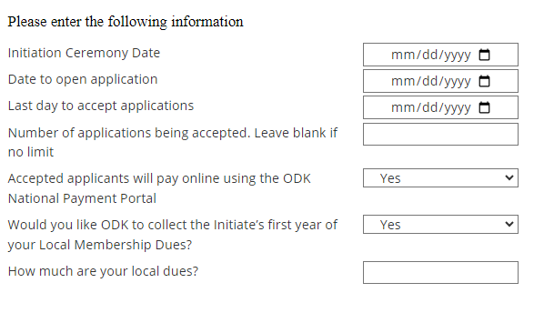
Application Creation – Local Dues
OΔK can now collect one-time local dues for circles in addition to the National Initiation Fee. Once initiation is complete and the Society ensures that all prospective members participated, OΔK will send the local dues as either a check or an electronic payment to the circle. Members pay a $4 service fee regardless of whether local dues are added.
To opt in to this while creating your circle’s application:
Choose “yes”
Choose “yes”
Enter the amount of local dues
Notes:
If this drop-down menu does not show up, the system is recognizing you as an officer of your circle. We are working with the developers on this piece.
You may only have 1 application process open at a time – again, consider it as an “event” and you cannot have overlapping events.
The most important part is the dates –
You will enter your initiation date, which cannot be changed unless there are extenuating circumstances (think, hurricane).
You will select your open/close dates, which cannot be changed. Note that the close date must be a minimum of 14 calendar dates before the ceremony. The system will not allow you to choose something within 14 calendar days.
You will select here whether you want members to pay us directly, or pay locally. We will be rolling out a new feature soon that allows us to collect local dues on behalf of the circle, and send those (through the mail or electronically) to the circle after the initiation, but this is not live yet.

Slide 19
Application Creation
Select Custom Questions
How Custom Questions Work
The national application is dynamic using conditional logic. It changes based on the first two (2) choices made by the applicant.
When first opened in a web browser, ALL applicants see the same application.
The first change occurs when they select College/University. This narrows their choices to only that circle.
The second change occurs when they choose the Initiation Class. Juniors and Seniors may see a different application depending on the selection made in the Special Request Fields.
The application a prospective member sees will be determined by the “Class” they select. For example, if an applicant selects “Junior,” s/he will receive the application with academic data and custom questions. If the applicant chooses "Faculty/Staff," s/he will receive an application that has only the fields the circle requires for them.
Notes:
Using custom questions is not required, but if your circle chooses to do so, note that the custom questions work using skip logic. Certain questions will show up for students, but not faculty/staff. Custom questions won’t show up until they select your circle.

Slide 20
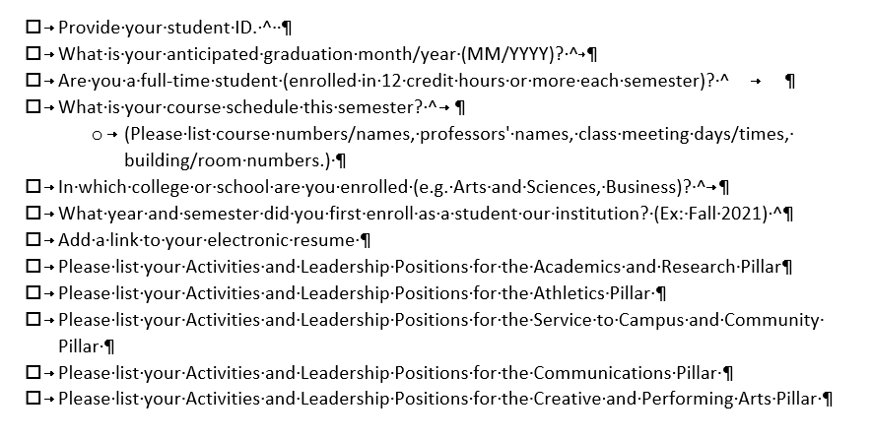
Application Creation
Custom Questions are set to ALL.
Unselect all
Select the items you want members to answer
NOTE: Items with a carat “^” at the end will not appear for faculty, staff, alumni, and honorary applicants
Notes:
PLEASE NOTE: currently custom questions are set to ALL – unless you want 40+ questions to show up, please choose “unselect all” and then choose the questions you want. We are working on this!

Slide 21
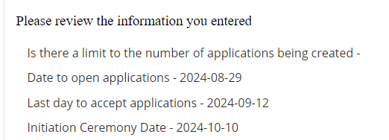
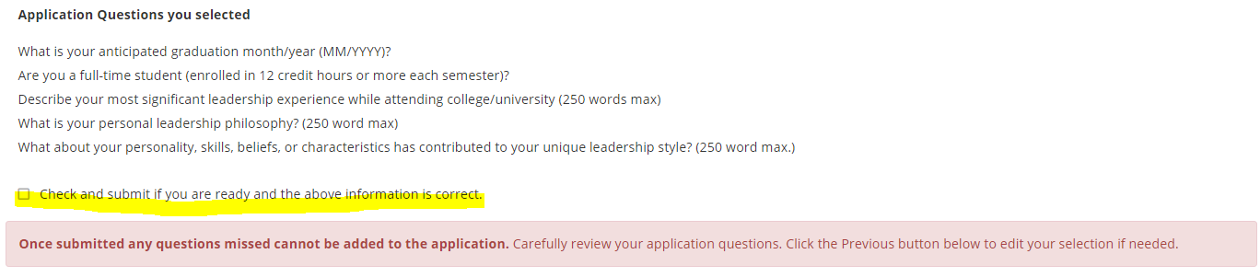
Application Creation
Review the Application Questions
This is a crucial step. You cannot change questions once the application set-up is complete.
Notes:
On this screen, you can review your dates and custom questions. Make sure all of this is correct, because it cannot be changed.
Once you hit submit, the application will go live on the date you have indicated.

Slide 22
Special or Surprise Initiation
Many circles want to surprise a faculty member, alumnus, or honorary member with initiation into ODK. That is perfectly fine to do. Please note the following:
This is the ONLY time you can complete an application for the individual.
This shall not be used for student initiates. This form should be used for NEW Circle Advisors.
To complete a Special Application, select the button in the Application Management dashboard. Before starting the application, make sure you have the required information about the person.
NEW! One additional feature is that you can search the database to see if the person you are inviting is already a member.
Notes:
If you want to initiate someone as a surprise, you will use this option. This is the only time you can submit an application on behalf of someone, and this cannot be used for student intiates. This creates an account on behalf of the individual, but this is not shared with them until after the ceremony. They will not get an email notification of anything until after the initiation.
Before you submit an application for a special initiation, you can now search to see if they are already a member. If they have a common name, etc. you can always reach out to your circle contact to confirm, but this search feature will help to avoid initiating someone who has already been initiated.
New circle advisors can also use this form, as it will not include any custom questions and is simpler.

Slide 23
Application Review and Approval
Four Steps to Application Processing

Slide 24
Application Review and Approval
There are four (4) steps in the Application Review and Approval Process:
Step 1 - Review Applications
Step 2 - Accept/Reject Applications
Step 3 - Verify Payment and Approve for Membership
Step 4 – Submit the Certificate Order
For on-campus or in-person initiation ceremonies: All of these steps should be completed no less than 14 calendar days prior to your initiation ceremony. This ensures that ΟΔΚ can process your order, print certificates, and ship them to you in time. Many times this takes less than 14 days. The minimum time allowed is seven (7) days before the ceremony.
Only circle officers are permitted to access applications. Applications can be printed or downloaded for a committee to review.
Advisors can download a spreadsheet of application information to provide to officers or committees as well.
IMPORTANT NOTICE: Circle advisors or other members of the circle are not permitted to complete an application for the initiate. This includes FACULTY/STAFF and ALUMNI* because the application constitutes a contract and includes permissions that the member must accept. A third party may no longer complete the application for the initiate. A third party can complete Honorary and Special Initiates* but MUST include all required information accurately submitted.
*If the circle seeks to surprise a Faculty/Staff or Alumni member with induction into ΟΔΚ, then a circle advisor may complete the application form for that individual.
Notes:
The review and approval process is very similar to MMS.
Please note: Certificate orders must be placed a minimum of 7 days prior to the ceremony. The portal will shut off after this time and you will not be able to submit without HQ assistance. Remember that you cannot change the ceremony date!

Slide 25
Step 1: Application Review
To access applications, select Application Management
Start by filtering by initiation date. (Although you can have only one application active, uncleared data from previous applications may still appear if you do not filter by the initiation date.
Notes:
The “Application Management” area has some new features: you can filter by “initiation date” to ensure you are only looking at the apps for this recruitment cycle. You can also search for a specific applicant, or use the alphabet buttons to see applicants with a last name starting with that letter.

Slide 26
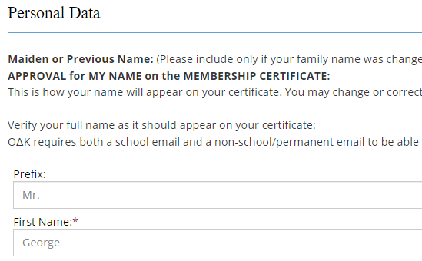
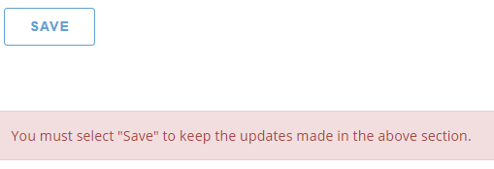
Correcting the Personal Data
If you find a problem with the information provided on a National Membership Application, you can ask the individual to change their Personal Data, or an officer may edit the information BEFORE you submit the final order.
Open the Application
Select and Open the Member Application
Locate the item with the issue
Change the information (e.g. correct the name spelling)
Scroll to Bottom, Select Save Changes
NOTE: Once the application has been submitted, the information in Custom/Initiate Questions cannot be changed.
Notes:
If you see something wrong on an applicant’s data, you can correct it, but you can also notify the applicant that they need to log in to correct it in their profile. Personal data can be updated at any time, and it will update on their application as well. The applicant will not be able to make any changes to custom question responses once submitted.

Slide 27
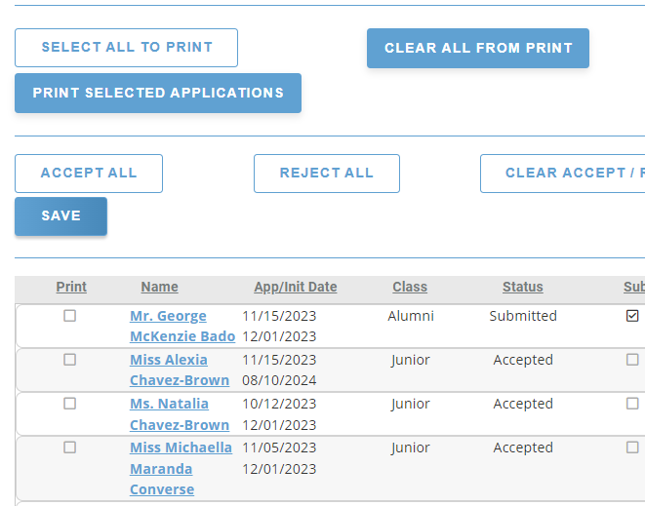
Step 2: Accept or Reject
Each circle has its own process by which they review and vote on candidates for membership. Circles may choose to print applications to PDF and distribute them for review, or print hard copies.
a. Select applications to print
b. Click print applications
Once all applications have been reviewed and the circle has voted, return to the Application or to the Applications panel to Accept or Reject each application.
Rejected applications will be removed from the list and stored for future reference.
Accepted applications will appear with the bold term “Accepted.”
Notes:
Accept/reject features have remained very similar to MMS. You can select applications to print to PDF or hard copy. Clicking on the individual’s name will take you to their application.
A feature rolling out soon is the ability to run a CSV file with applicant information.

Slide 28
Application Dashboard
Notes:
At each step in the process is completed, check boxes change.
Once an order has been submitted and processed, any applications not approved should be rejected.

Slide 29
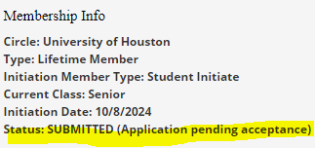
Application Status Messages
At each stage of the application process, the applicant will be notified of their status. The following are the messages they will see on their Applicant Dashboard.
* There are different messages depending on the payment process.
This is what appears on the Applicant Dashboard
Status | Dashboard Message | Confirmation Message
STARTED | (Application pending submission) | You have started the membership application.
SUBMITTED | (Application pending acceptance) | Your application has already been submitted.
ACCEPTED | (Application pending approval) | Your application is pending payment. Please select PAY YOUR MEMBERSHIP FEES at link below.
APPROVED | (Application accepted and paid) | Your application has been accepted and paid.
COMPLETED | (Completed) | Your initiation has been completed.
REJECTED | (Rejected) | Your application for membership in Omicron Delta Kappa has not been accepted by the circle through which you applied. Your MyODK profile will remain active to allow you to apply again in the future. If you have questions, please contact a Circle Advisor.
Notes:
A new feature is that applicants will get messages notifying them of their application status. Circles will still need to communicate initiation details, etc. separately, but this will allow them to log in to see where they are at in the process.
Depending on the payment options you selected, some of these messages will vary a bit.

Slide 30
Step 3: Membership Payment
For Circles using the MyODK payment portal:
Upon acceptance:
Application status becomes: ACCEPTED (Application pending approval)
Application message will be: Your application is pending approval. Please check your outstanding orders to pay your initiation fees.
Upon payment:
Application Status becomes: APPROVED (Application accepted and paid)
Application message will be: Your application has been approved and paid.
And, they will receive an email confirmation of payment.
After Initiation Ceremony (without changes to record)
Application Status becomes: COMPLETED
Notes:
These are the messages the applicant will receive if you are using the MyODK payment portal to collect fees. Note that once you mark someone as accepted, they will receive a notice that they are accepted and need to pay within MyODK. We will no longer need to open/close the payment portal for you.

Slide 31
Step 3: Membership Fee Verification
Circles not using the MyODK payment portal will need to verify payment on the Circle Executive Dashboard.
Applicants for Circles not using the MyODK Payment portal will see these messages.
Upon acceptance:
Application status becomes: ACCEPTED (Application pending approval)
Application message will be: Your application is pending approval. Your circle is not using the MyODK payment portal for this initiation. Please contact your circle advisor to pay your initiation fee.
Upon payment:
Application Status becomes: APPROVED (Application accepted and paid)
Application message will be: Your application has been approved and paid.
And, they will receive an email confirmation of payment.
After Initiation Ceremony (without changes to record)
Application Status becomes: COMPLETED
Notes:
If you are collecting fees locally, you will still go in and mark them as “fee paid to circle.” The applicant will receive a notice that their payment has been logged by the circle.

Slide 32
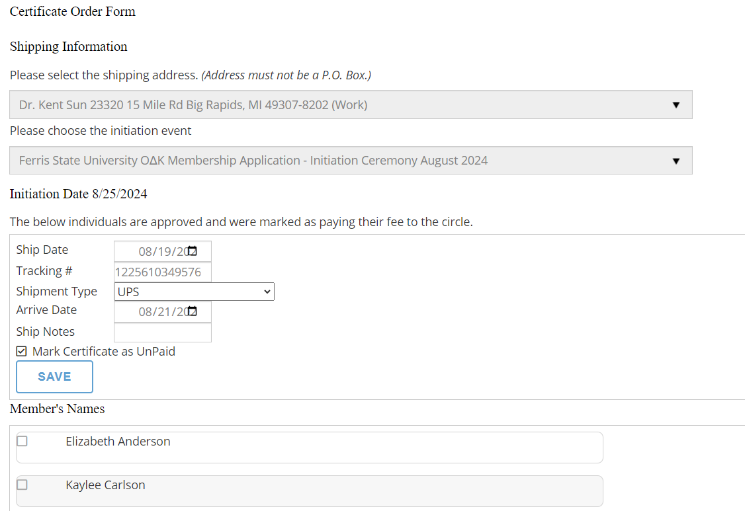
Step 4: Certificate Order Form
Select which address for shipping.
Initiation date is automatically inserted
Ship date, type and tracking are provided by OΔK
List of initiate names
Notes:
A few changes to the certificate order form – you will no longer enter the intiation date, this is automatically pulled from your setup. You can select the address for shipping from your profile – you can add a work address if needed.
Shipping information is still added later by ODK staff.

Slide 33
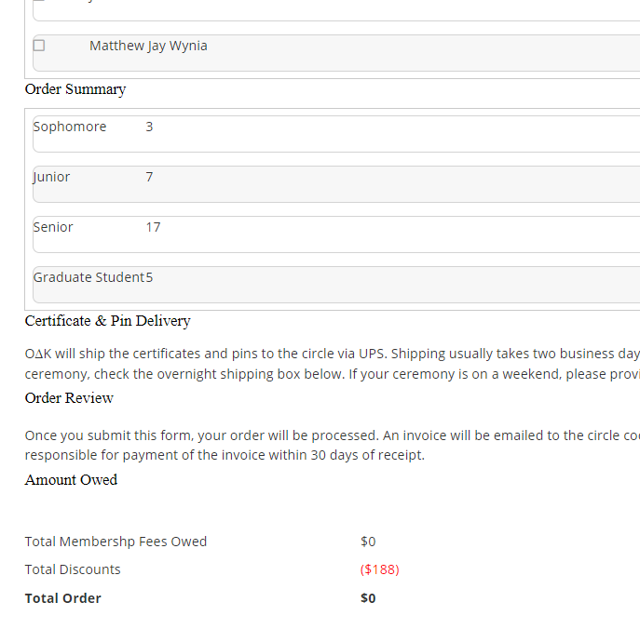
Amount Owed Section
To fully demonstrate what the circle will owe upon submission of the order, this section has been revised. The order below shows what an order would look like with expedited shipping.
Count by class of initiates
Cost for expedited shipping is usually ($70 - $100)
The circle owes OΔK for members who paid the circle locally
Credits for members who paid online, free advisor, free honorary
Total owed to OΔK, which will be invoiced.
Notes:
This screen still looks much the same as MMS.

Slide 34
Instructions for Applicants
The new process is easier but still needs explanation

Slide 35
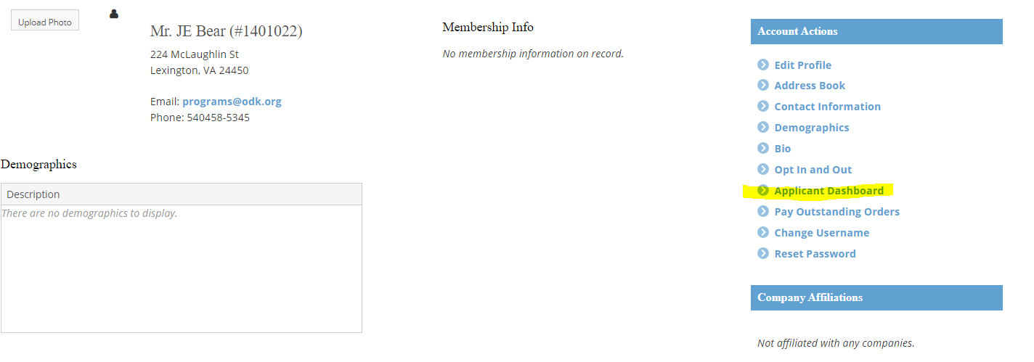
Instructions to Applicant
MyODK is different from MMS because each applicant must create an account to gain access to the application.
These accounts will eventually be deleted if the applicant is not accepted and initiated.
Steps to Apply
Create and Activate an Account on my.odk.org
2) Go to the Applicant Dashboard
Instructions for Applying can be found at: https://odk.org/members/apply-for-membership/
Notes:
https://odk.org/members/apply-for-membership/
Prospective members will create and activate an account on MyODK first

Slide 36
Instructions for Application
3) Start Application
4) Edit Profile if necessary – NOTE: Anytime the profile is changed, it automatically updates the application.
5) Select a Circle

Slide 37
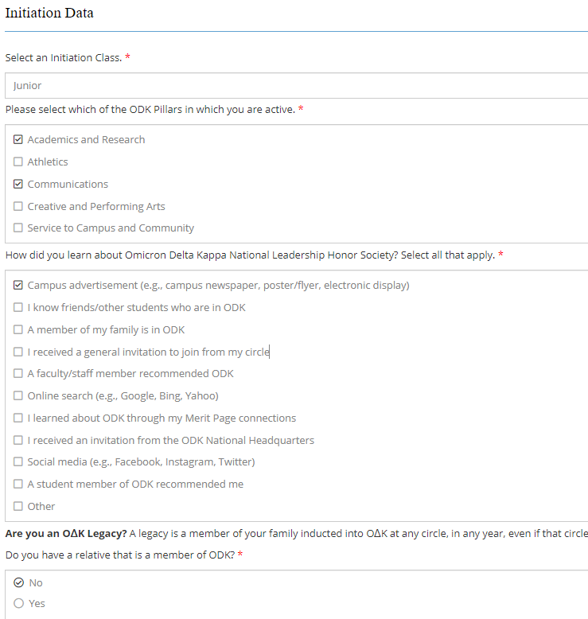
Instructions for Application
6) Applicant completes the following steps:
Personal Data – updating and adding as necessary
Applicants must enter two email addresses
Initiation Data
Class
Pillars
Marketing Information
Legacy Information
Demographic Data (only birthdate is required)
Academic Information
Employment Information (if full-time employee)
Custom Questions (Initiate Questions)
Review and Save or Submit

Slide 38
End of Part 1
That’s all for now.
This will get you started on your application process.
Look for Part 2 Training on how to manage reports, registering for events, and other features coming in September.
QUESTIONS?

