Slide 1
Step Into OΔK
A Guide to Creating a Profile and Applying for Membership in
Omicron Delta Kappa, The National Leadership Honors Society
Fall 2024

Slide 2
STEP 1: Start Your MyODK Profile
This is the first step in a lifetime journey with Omicron Delta Kappa. You are not just entering information for an application; you are creating the first profile for your MyODK, which, if selected, will be your connection to ODK members and benefits for the rest of your life. There are many steps, but once you have started, you can always return and complete it later.

Slide 3
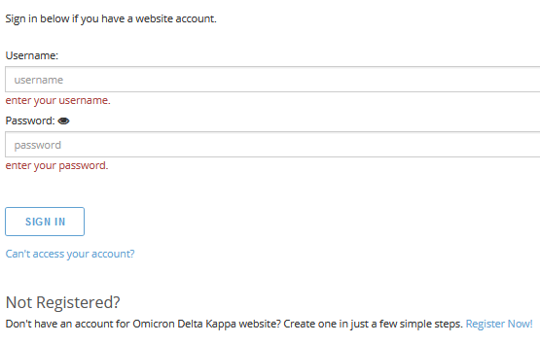
STEP 2: REGISTER YOUR ACCOUNT
To Begin Your Profile,
Select Register Now!

Slide 4
STEP 3: ENTER YOUR EMAIL
Follow the directions in the email you receive to verify your email and create your user name and password. Be sure to check spam if you do not see it in your inbox.

Slide 5
Step 4: Sign In To MyODK
Once you have set your username and password, return to MyODK when you are ready to begin your application.

Slide 6
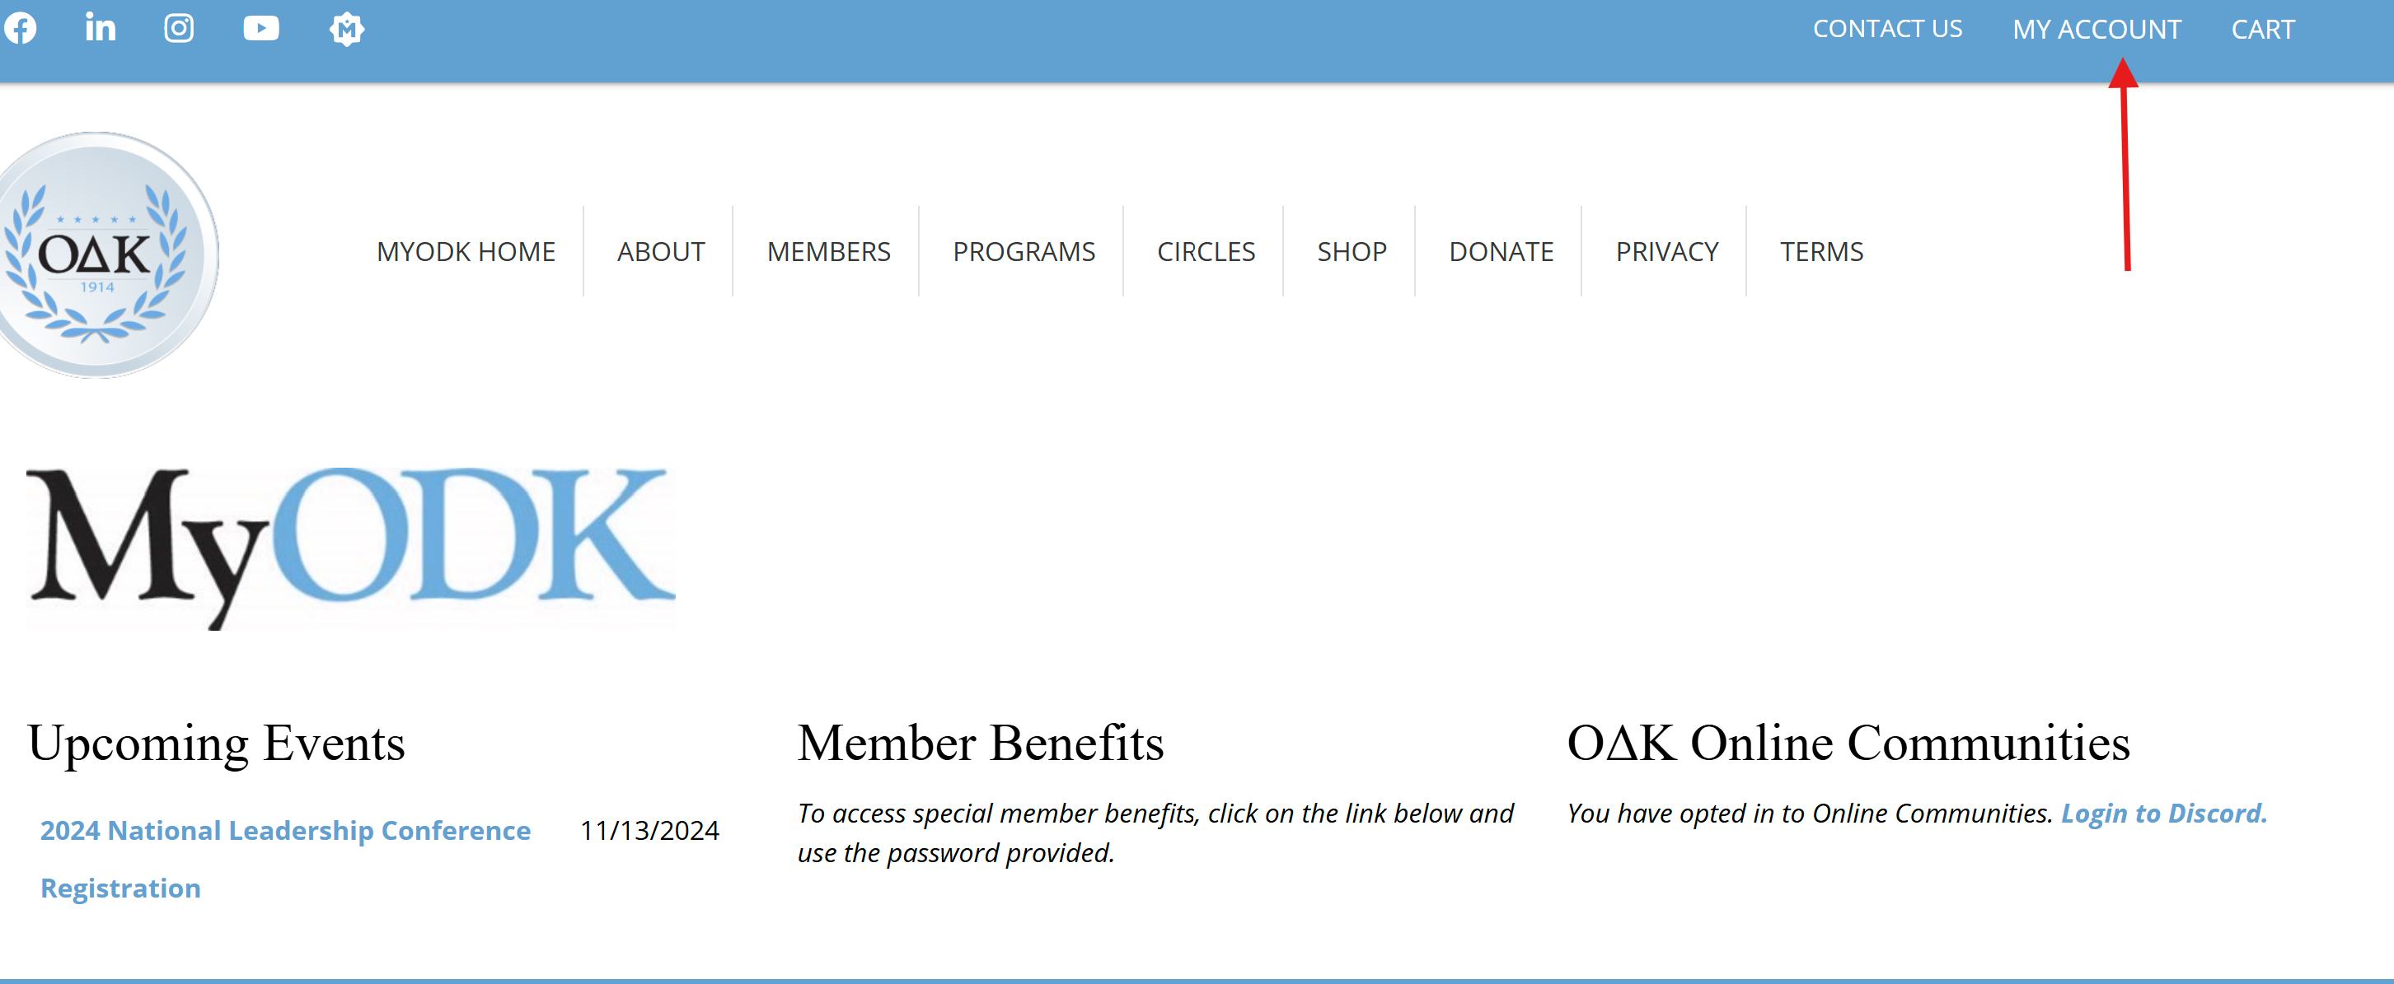
Step 5: OPEN MANAGE MY ACCOUNT
This is the MyODK homepage. To access your profile and Account Actions, select My Account, then Manage My Account

Slide 7
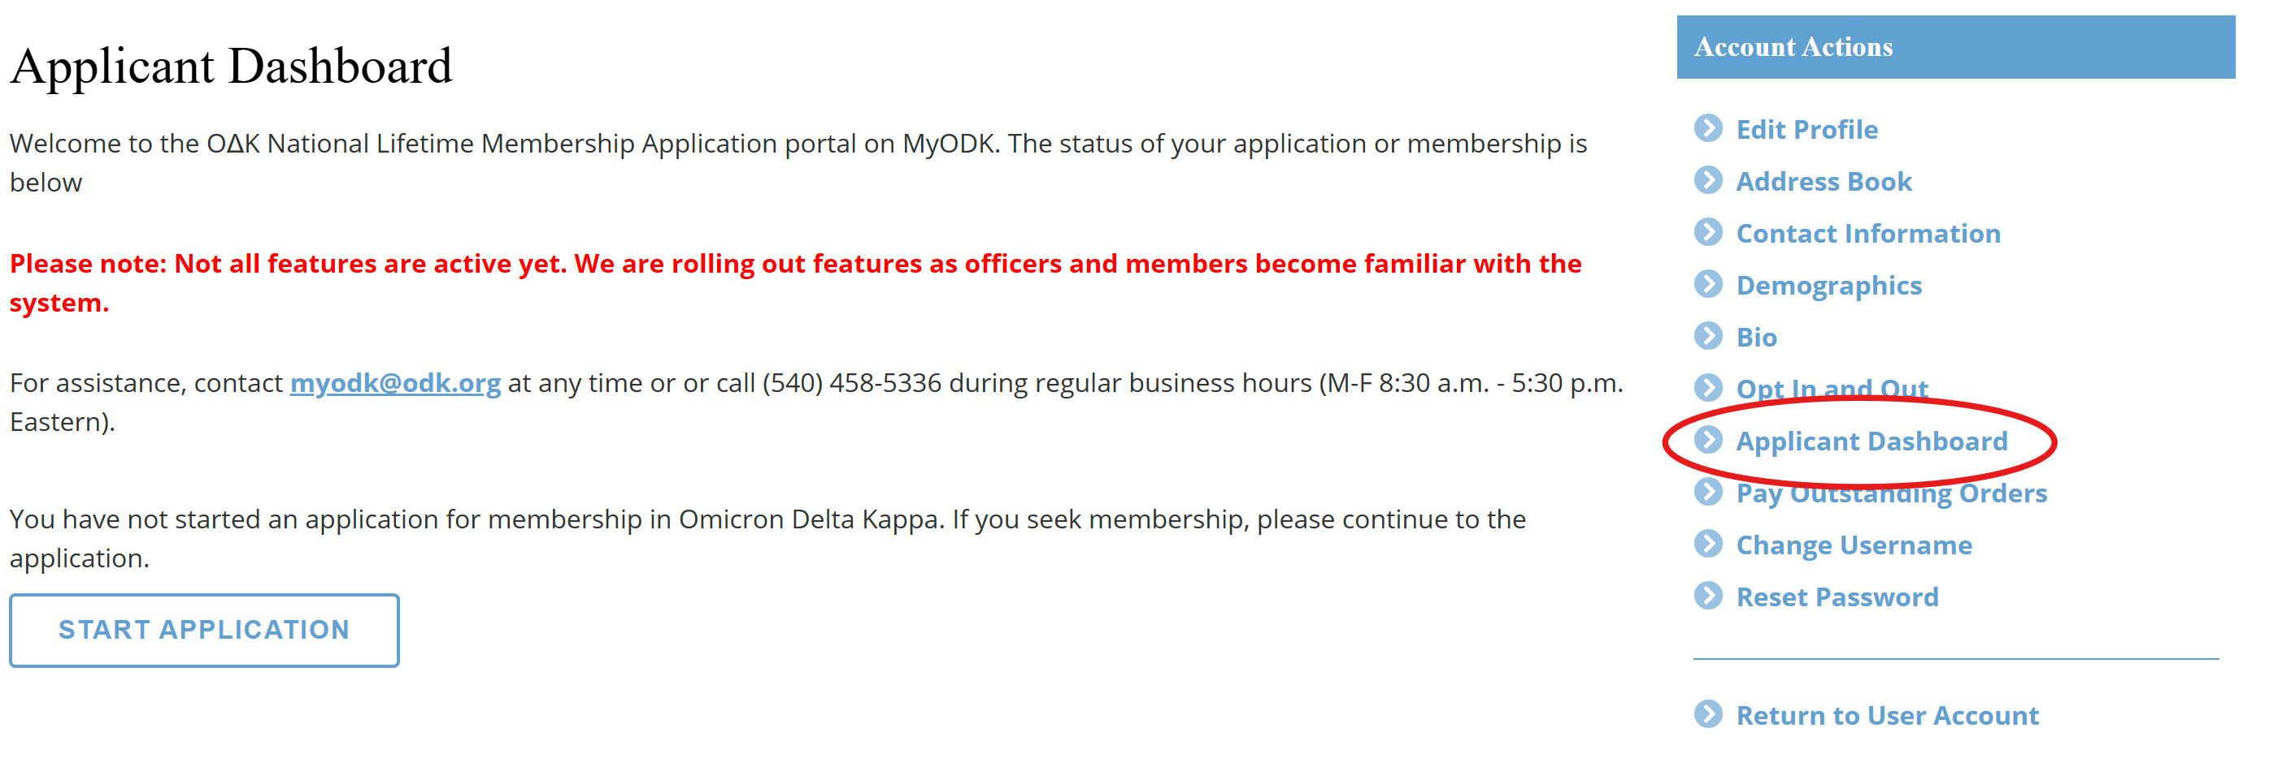
Step 6: OPEN APPLICANT DASHBOARD
SELECT START APPLICATION

Slide 8
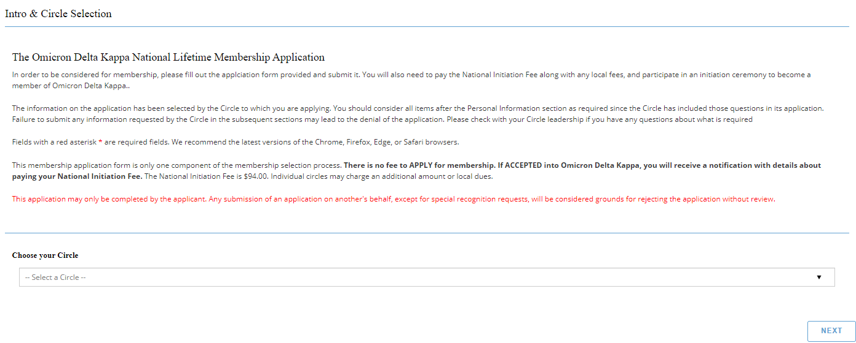
STEP 7: SELECT YOUR CIRCLE (CHAPTER)
SELECT THE CIRCLE TO WHICH YOU HAVE BEEN INVITED

Slide 9
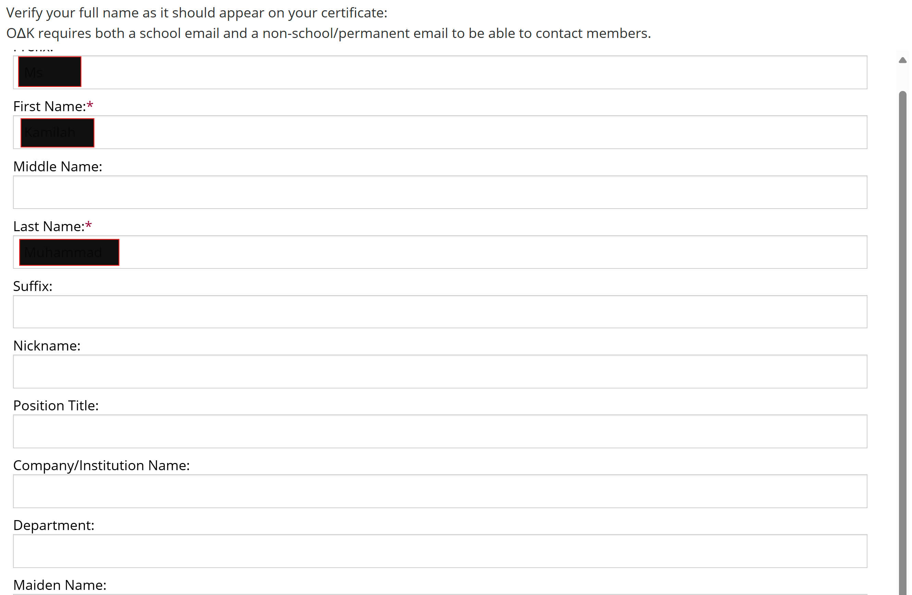
STEP 8: REVIEW NAME
Review your name and enter other information.
Note: Some fields are required.

Slide 10
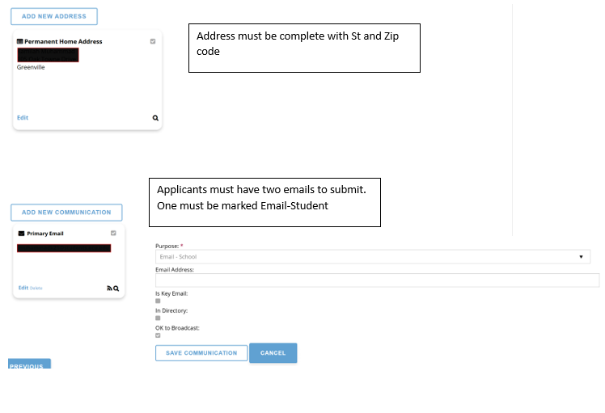
STEP 9: REVIEW MAILING AND COMMUNICATION FIELDS

Slide 11
STEP 10: COMPLETE INITIATION DATA

Slide 12
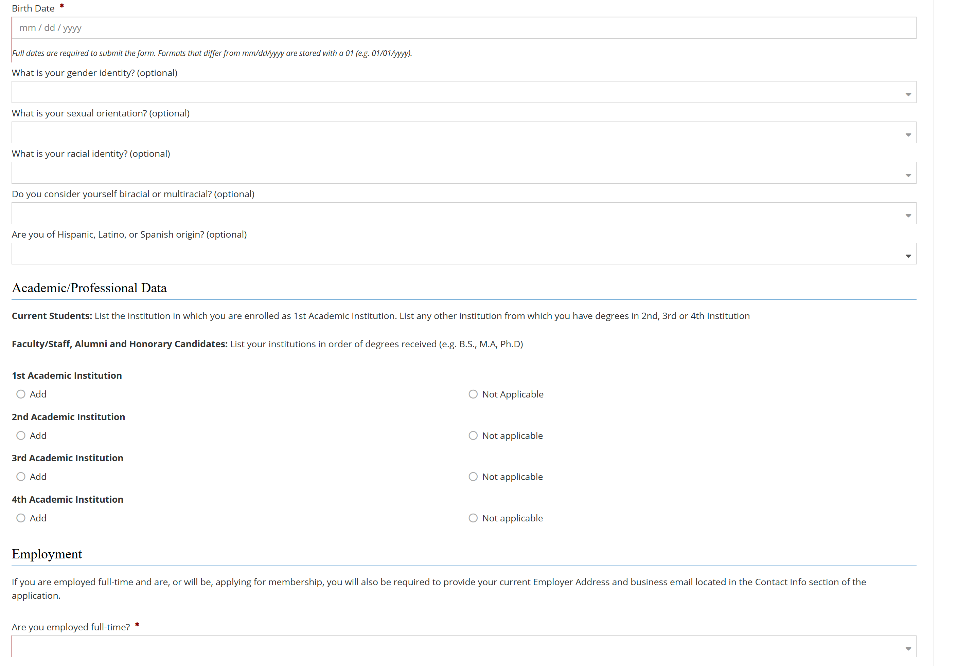
STEP 11: COMPLETE DEMOGRAPHICS

Slide 13
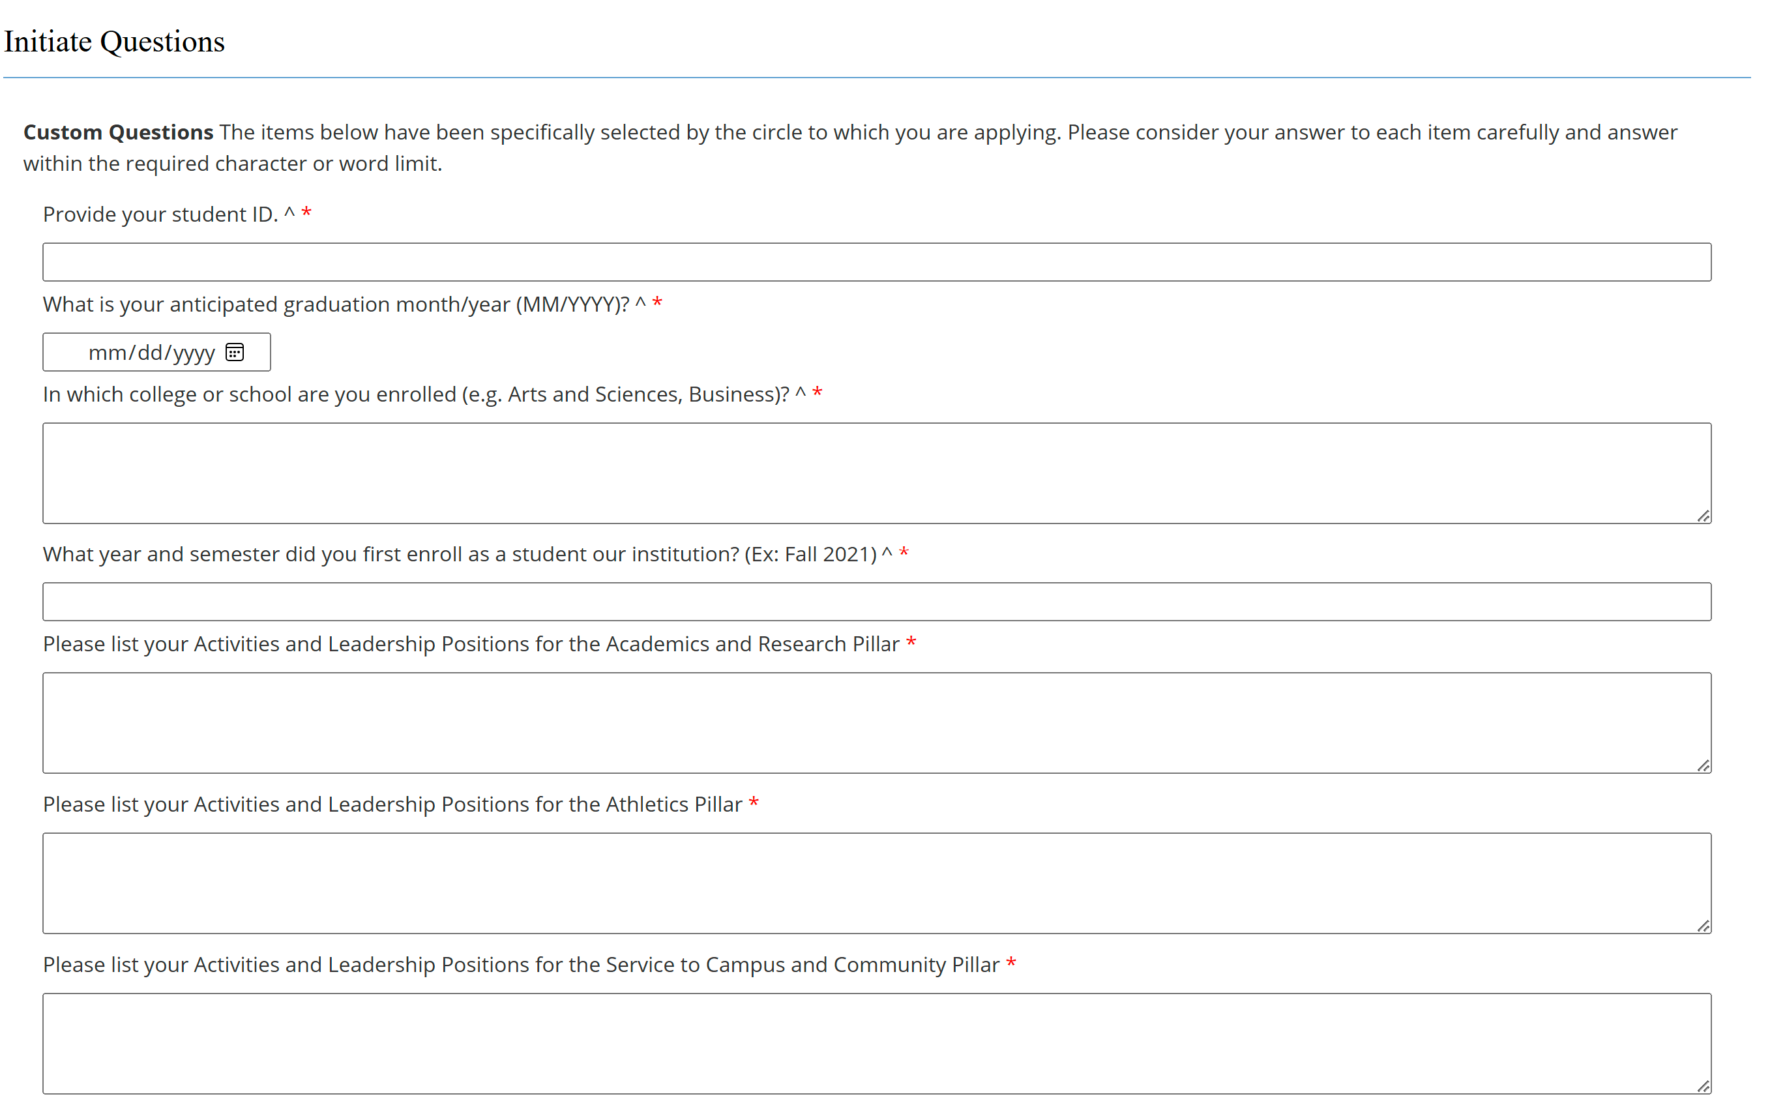
Step 12: COMPLETE INITIATE QUESTIONS
NOTE: Each circle selects these questions. The number varies depending on the circle. ALL initiate questions listed are required.
SAVE: You can save your answers at any point. After you have saved, you may exit the application and return later. NOTE: Your application cannot be considered until you have fully submitted it.

Slide 14
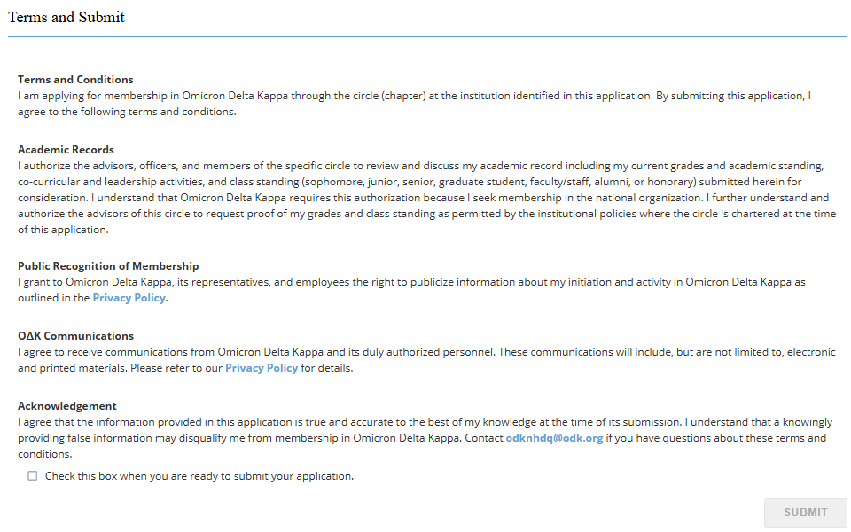
STEP 13: ACKNOWLEDGMENT AND SUBMIT
WARNING: When you select SUBMIT, you are not done. There are two (2) more steps!

Slide 15
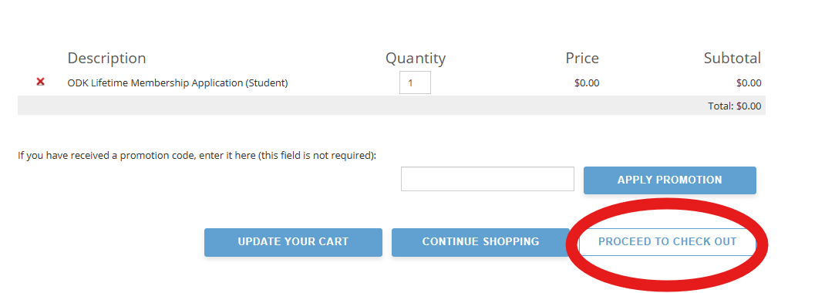
STEP 14: VERIFY YOUR APPLICATION
ALMOST DONE: This is your shopping cart. APPLYING FOR MEMBERSHIP is free. Make sure the Application shows a $0.00 balance, then select “PROCEED TO CHECK OUT.”

Slide 16
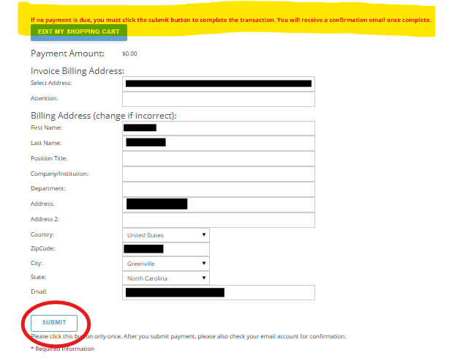
STEP 15: SUBMIT TO CHECK OUT
LAST STEP: Make sure your billing address and email are correct. If they are not, you need to return to your profile and correct them.
Once everything is correct, select SUBMIT. Your Membership Profile Status will be updated to SUBMITTED.
You are one step closer to membership in Omicron Delta Kappa.

Slide 17
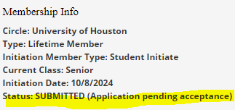
NEXT STEPS
FOLLOW THE STEPS BY CHECKING YOUR PROFILE
Check the Status line in the Membership Info Section of your profile
The Status messages you can see are below.
The Circle will update you about payment of fees and initiation ceremony
Status | Dashboard Message | Confirmation Message
STARTED | (Application pending submission) | You have started the membership application.
SUBMITTED | (Application pending acceptance) | Your application has already been submitted.
ACCEPTED | (Application pending approval) | Your application is pending payment. Please select PAY YOUR MEMBERSHIP FEES at link below.
APPROVED | (Application accepted and paid) | Your application has been accepted and paid.
REJECTED | (Rejected) | Your application for membership in Omicron Delta Kappa has not been accepted by the circle through which you applied. Your MyODK profile will remain active to allow you to apply again in the future. If you have questions, please contact a Circle Advisor.

Slide 18
Contact Information
MyODK Team, Omicron Delta Kappa National Headquarters
myodk@odk.org
(540) 458-5336
Find a Circle
https://odk.org/circle-directory/
Copyright © 2024. All Rights Reserved. O∆K, a registered 501(c)3 nonprofit, is a member of the Honor Society Caucus.
Johnson Center for Leadership O∆K National Headquarters 224 McLaughlin Street Lexington, Virginia 24450-2002 1-(540) 458-5336 odknhdq@odk.org
Privacy and Website Policy Diversity, Equal Opportunity, and Hazing Statements

