Slide 1
Steps to Pay OΔK National and Local Fees
A Guide to the National Initiation Fee and Local Dues
Omicron Delta Kappa, The National Leadership Honors Society
Fall 2024

Slide 2
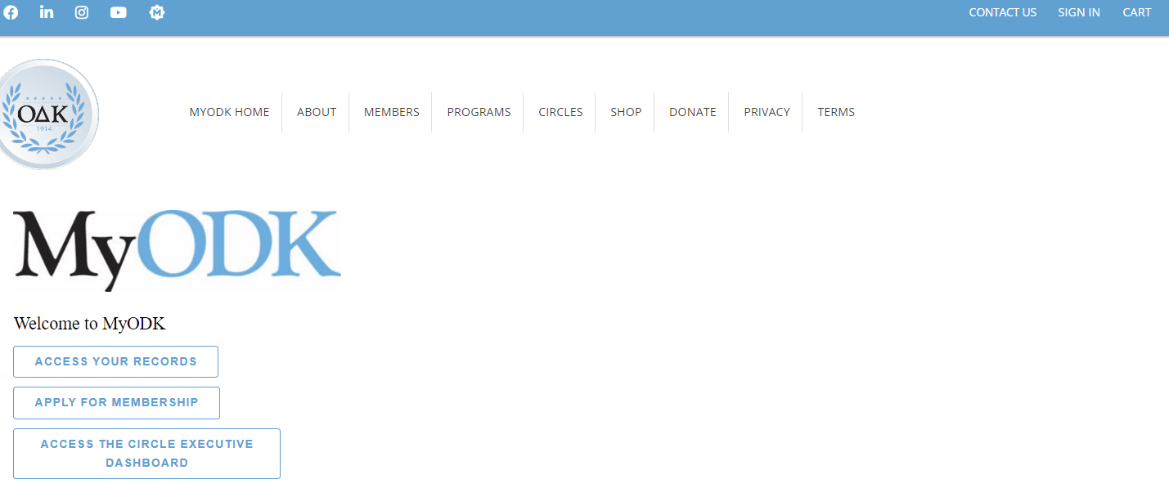
STEP 1: SIGN IN to Your MyODK Profile
For any MyODK transaction, start by signing in at my.odk.org.
Anytime you need to update information, pay fees, register for a conference, or access Member Benefits, you will need to sign into you MyODK Account.
Select SIGN IN or ACCESS YOUR RECORDS TO SIGN IN TO MyODK.

Slide 3
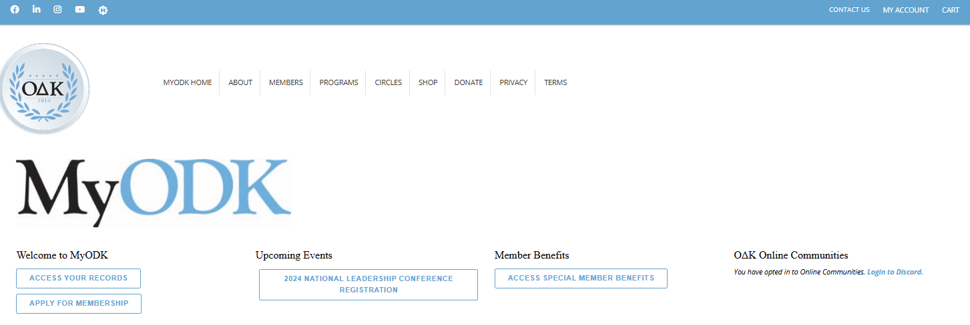
Step 5: ACCESS YOUR MyODK ACCOUNT
This is the MyODK homepage.
To access your profile, select MY ACCOUNT, then Manage My Account
Or Select ACCESS YOUR RECORDS

Slide 4
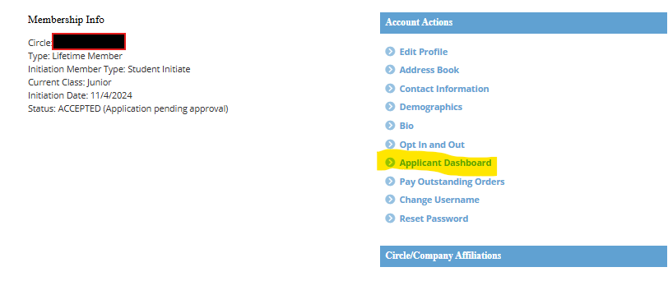
STEP 6: CHECK YOUR STATUS
IF YOUR STATUS IS “ACCEPTED,” GO TO YOUR APPLICANT DASHBOARD
TO ACCESS THE PAYMENT PORTAL, YOUR STATUS MUST BE “ACCEPTED.”

Slide 5
STEP 7: START THE PAYMENT PROCESS
IF YOUR STATUS IS ACCEPTED AND YOUR CIRCLE HAS OPTED TO USE THE MyODK PORTAL, YOU WILL SEE THIS MESSAGE.
START YOUR PAYMENT PROCESS BY CLICKING ON THE LINK.

Slide 6
STEP 8: OPEN THE SHOPPING CART
Review the fees associated with joining Omicron Delta Kappa. If your circle has elected to collect the local dues through the portal, that fee will be shown below.
SELECT “PROCEED TO SHOPPING CART” TO PAY FEES

Slide 7
STEP 9: REVIEW YOUR FEES
Review the fees associated with joining Omicron Delta Kappa. The Local Dues shown here are an example. The actual local dues will show in your cart.
SELECT “PROCEED TO CHECK OUT” TO PAY FEES

Slide 8
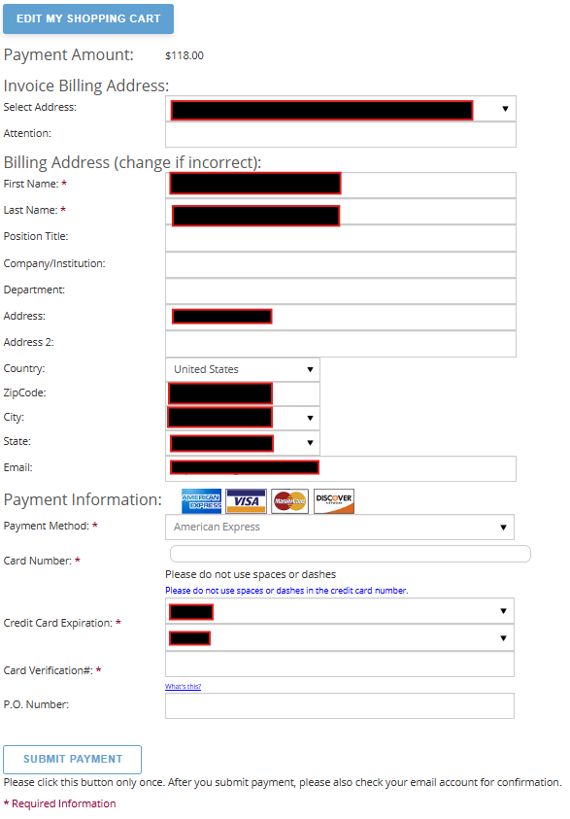
STEP 10: COMPLETE CARD PAYMENT AND SUBMIT
Ensure that the Billing Address matches the mailing address for the credit or debit card you are using.
Your payment will be rejected if any of the required information on this page does not match.
You may need to return to the address section of your profile and update an address to ensure the payment processes. You can always return to this page to complete the process.
SELECT “SUBMIT PAYMENT” TO COMPLETE THE PROCESS.

Slide 9
PAYMENT RECEIPT
Check the email you used in the previous step. You should have received an email receipt for the transaction.
Make sure you have the initiation date on your calendar. We look forward to working with you as a Lifetime member of Omicron Delta Kappa.

Slide 10
Contact Information
MyODK Team, Omicron Delta Kappa National Headquarters
myodk@odk.org
(540) 458-5336
Find a Circle
https://odk.org/circle-directory/
Copyright © 2024. All Rights Reserved. O∆K, a registered 501(c)3 nonprofit, is a member of the Honor Society Caucus.
Johnson Center for Leadership O∆K National Headquarters 224 McLaughlin Street Lexington, Virginia 24450-2002 1-(540) 458-5336 odknhdq@odk.org
Privacy and Website Policy Diversity, Equal Opportunity, and Hazing Statements

