Slide 1
Steps to Pay
OΔK National and Local Fees
A Guide to the National Initiation Fee and Local Dues
Omicron Delta Kappa, The National Leadership Honors Society
Updated: January 2025
Notes:
Welcome to My ODK Steps to Pay. This short presentation will show you how to pay your ODK National Initiation Fee, and if required by your circle, the local dues. If you have any questions about paying, please contact my odk @ odk dot org.

Slide 2
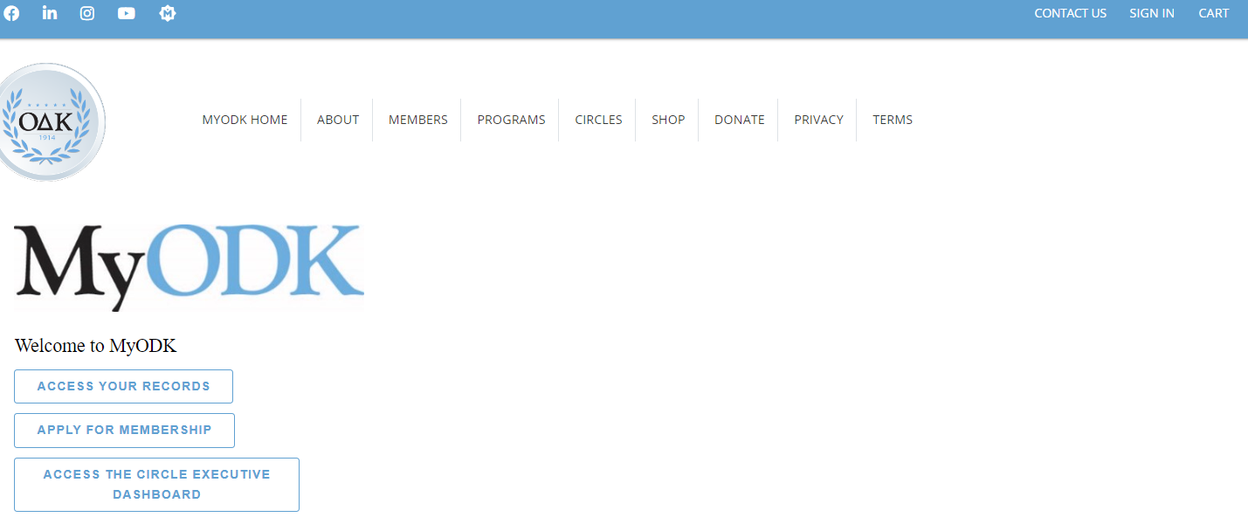
STEP 1: SIGN IN to Your MyODK Profile
  For any MyODK transaction, start by signing in at my.odk.org.
  You must sign into your MyODK account anytime you need to update information, pay fees, register for a conference, or access Member Benefits.
Select SIGN IN or ACCESS YOUR RECORDS TO SIGN IN TO MyODK.
Notes:
For any My ODK transaction, start by signing in at My dot ODK dot org. You must sign into your My ODK account to update information, pay fees, register for an event, or access Member Benefits. First, sign in to your My ODK portal. You can do this by selecting the Sign In link in the top right toolbar or clicking on the Access Your Records button on the homepage.

Slide 3
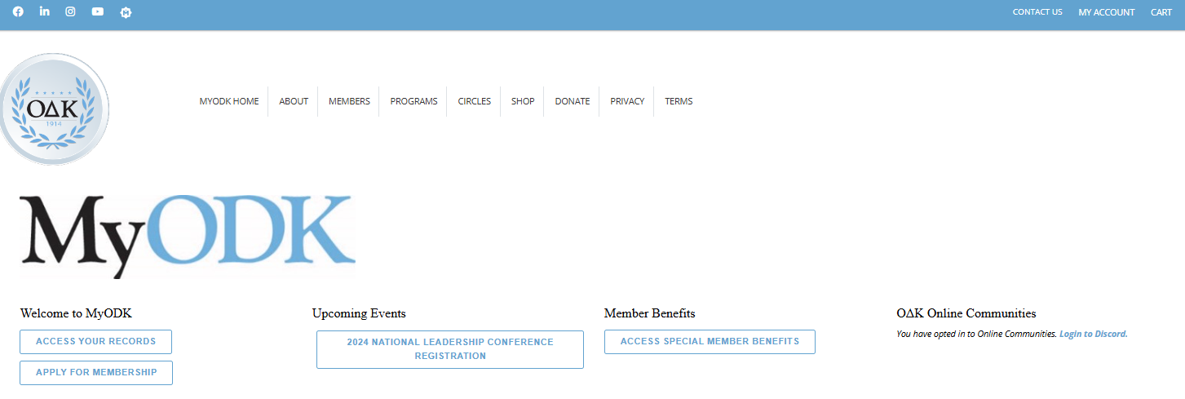
Step 5: ACCESS YOUR MyODK ACCOUNT
This is the MyODK homepage.
To access your profile, select MY ACCOUNT, then Manage My Account
Or Select ACCESS YOUR RECORDS
Notes:
This is the MyODK homepage. To access your profile, Select ACCESS YOUR RECORDS button on the lower left section of the page. You can also select MY ACCOUNT in the top right corner, then Manage My Account in the dropdown.

Slide 4
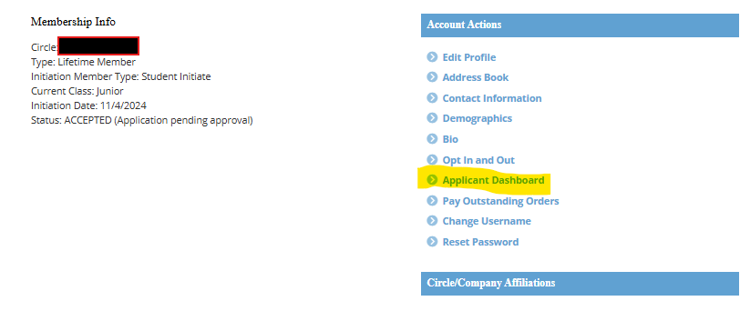
STEP 6: CHECK YOUR STATUS
IF YOUR STATUS IS “ACCEPTED,” GO TO YOUR APPLICANT DASHBOARD
TO ACCESS THE PAYMENT PORTAL, YOUR STATUS MUST BE “ACCEPTED.”
Notes:
Next, check your status. To access the payment portal, your status must be listed as Accepted. If your status is Accepted, select Applicant Dashboard from the Account Actions Menu on the right side.

Slide 5
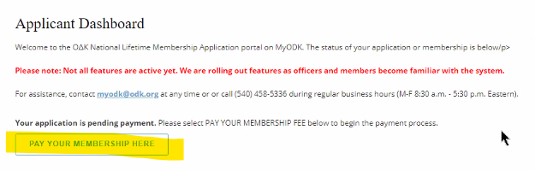

STEP 7: START THE PAYMENT PROCESS
IF YOUR STATUS IS ACCEPTED AND YOUR CIRCLE HAS OPTED TO USE THE MyODK PORTAL, YOU WILL SEE THIS MESSAGE.
START YOUR PAYMENT PROCESS BY CLICKING ON THE LINK.
Do not select the cart button on the top tool bar. This will not activate until an order has been started.
Notes:
If your circle has chosen to use the payment portal, you will see a box with PAY YOUR MEMBERSHIP HERE inside. If you do not see this box, you will need to pay the circle directly. Contact your circle. Start your payment process by clicking on the Pay Your Membership Here box. You should ignore the CART button on the top tool bar at this point. This will not activate until an order has been started. Once you have started your order, you can leave and come back. Then the item will be in your cart and the CART button will be active.

Slide 6
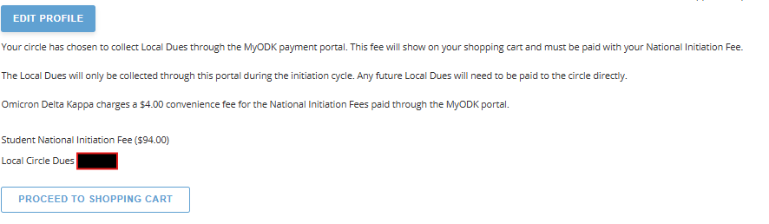
STEP 8: OPEN THE SHOPPING CART
Review the fees associated with joining Omicron Delta Kappa. If your circle has elected to collect the local dues through the portal, that fee will be shown below.
SELECT “PROCEED TO SHOPPING CART” TO PAY FEES
Notes:
Review the fees associated with joining Omicron Delta Kappa. If your circle has elected to collect the local dues through the portal, that fee will be shown on this screen. You should see the National Initiation Fee and your local dues if your circle collects them. Select Proceed to Shopping Cart to pay your fees.

Slide 7
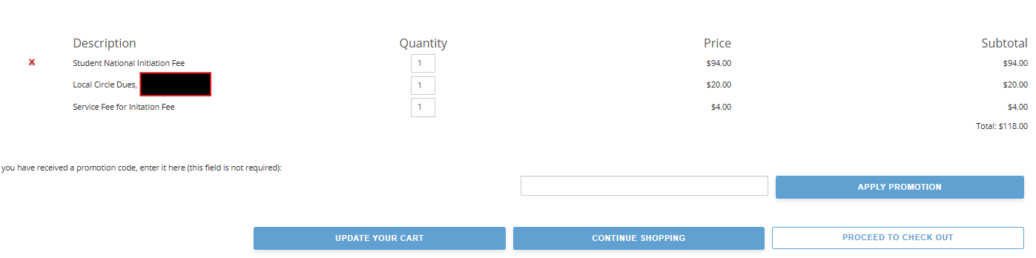
STEP 9: REVIEW YOUR FEES
Review the fees associated with joining Omicron Delta Kappa. The Local Dues shown here are an example. The actual local dues will show in your cart.
SELECT “PROCEED TO CHECK OUT” TO PAY FEES
Notes:
In the cart, you will see a complete list of fees. Review the fees associated with joining Omicron Delta Kappa. The Local Dues shown here are an example. The actual local dues will show in your cart. Select Proceed to Check Out to complete the payment form.

Slide 8
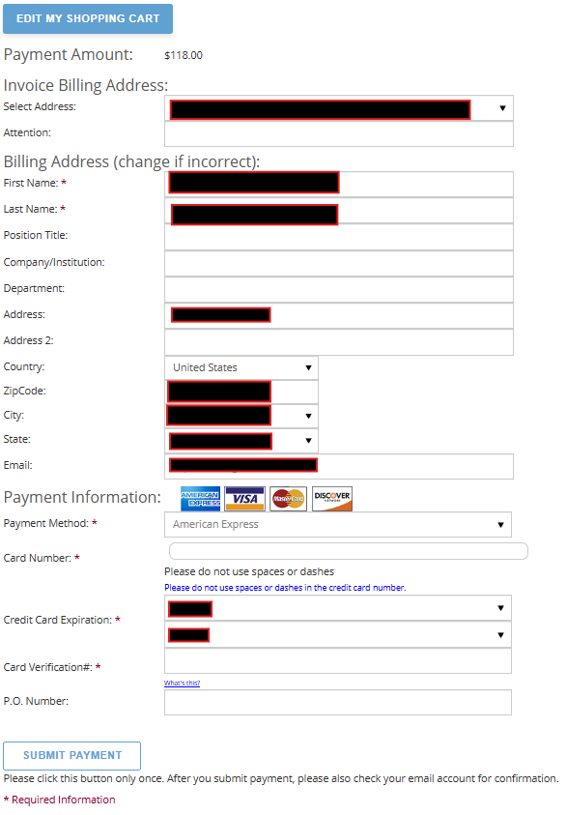
STEP 10: COMPLETE CARD PAYMENT AND SUBMIT
Ensure that the Billing Address matches the mailing address for the credit or debit card you are using.
Your payment will be rejected if any of the required information on this page does not match.
You may need to return to the address section of your profile and update an address to ensure the payment processes. You can always return to this page to complete the process.
SELECT “SUBMIT PAYMENT” TO COMPLETE THE PROCESS.
Notes:
Complete the payment form. Ensure that the Billing Address matches the mailing address for the credit or debit card you use. Your payment will be rejected if any of the required information on this page does not match. You may need to return to the address section of your profile and update an address to ensure the payment processes. You can always return to this page to complete the process. Once all the correct information is entered, select Submit Payment to complete the process.

Slide 9
PAYMENT RECEIPT
Check the email you used in the previous step. You should have received an email receipt for the transaction.
Make sure you have the initiation date on your calendar.
We look forward to working with you as a Lifetime member of Omicron Delta Kappa.
Notes:
Once you submit payment, you will receive an email receipt. Check the email you used in the previous step. Make sure you have the initiation date on your calendar. We look forward to working with you as a Lifetime member of Omicron Delta Kappa.

Slide 10
Contact Information
MyODK Team, Omicron Delta Kappa National Headquarters
  myodk@odk.org
  (540) 458-5336
Find a Circle
  https://odk.org/circle-directory/
Copyright © 2024. All Rights Reserved.
O∆K, a registered 501(c)3 nonprofit, is a member of the Honor Society Caucus.
Johnson Center for Leadership
O∆K National Headquarters
224 McLaughlin Street
Lexington, Virginia 24450-2002
1-(540) 458-5336
odknhdq@odk.org
Privacy and Website Policy
Diversity, Equal Opportunity, and Hazing Statements
Notes:
If you have any questions or problems with paying your National Initiation Fees, contact my odk at odk dot org.

