Slide 1
MyODK Training
Basic Instructions for Circle Officers
2025-2026
Updated August 2025

Slide 2
Instructions
Circle officers should review all slides thoroughly. At the end of the course, please use the link/QR code to access the MyODK Training Knowledge Check quiz to ensure you have retained information related to the management of the Circle Executive Dashboard features.
In order to receive access to the Circle Executive Dashboard, you must complete the Knowledge Check quiz. Once the quiz is completed, you will receive access to the dashboard within two business days.

Slide 3
Table of Contents
What is MyODK?
How to Access a MyODK Account
  Log In Credentials
  Edit Your Account
Circle Executive Dashboard
Creating Your Membership Applications
  Application Development Process
  Application Structure
  Application Management
  Application Creation
    Set Dates
    Select Custom Questions
  Review and Submit
  Special or Surprise Initiation
Application Review and Approval
  Step 1: Application Review
  Step 2: Accept or Reject
  Step 3: Membership Payment/Verification
Certificate Orders
  Certificate Order Form
  Total Members and Amount Owed
Circle Reports
  Past Certificate Orders
  Member Export
  Circle Standards
  Circle Annual Reports
Instructions for Applicants
To return to the Table of Contents at any time, click the MyODK logo in the top right corner.

Slide 4
What is MyODK?
Description of the Program

Slide 5
What is MyODK?
MyODK is a Member Engagement Platform (MEP) that provides members with 24/7 access to stay connected and engaged with OΔK throughout their lifetime. MyODK is powered by aarwinMEP, developed by JL Systems.
For Members
  Permanent Record for your OΔK Experience
  Update Personal and Professional Information (addresses, emails, career changes)
  View all OΔK activities (officer positions, volunteer roles, events attended)
  Access Member Benefits (links to members-only benefits)
  Networking (connect with members through the Discord Communities, register for the National Leadership Conference, search for other OΔK members in your field)
For Circles
  Application process with more customizable fields
  Access to reports and data about members
  National and local fee payment options during the recruitment process
  Greater access to training and support

Slide 6
How to Access a MyODK Account
Log In Credentials, CIRCLE EXECUTIVE Page, Edit Your Account

Slide 7
Access Instructions
Start at my.odk.org and click "Sign In"
If you were initiated before July 2024: You should have received an email providing you with a link to set up your credentials. As an existing member of OΔK, you already have a record in the portal that needs to be activated.
If you were initiated after July 2024: Click on “Can’t access your account?” You will need to enter an email. If the system does not recognize the email, you need to contact myodk@odk.org
If you have received a Quick Activation link via email, go to Register Now! and select Quick Activation.

Slide 8
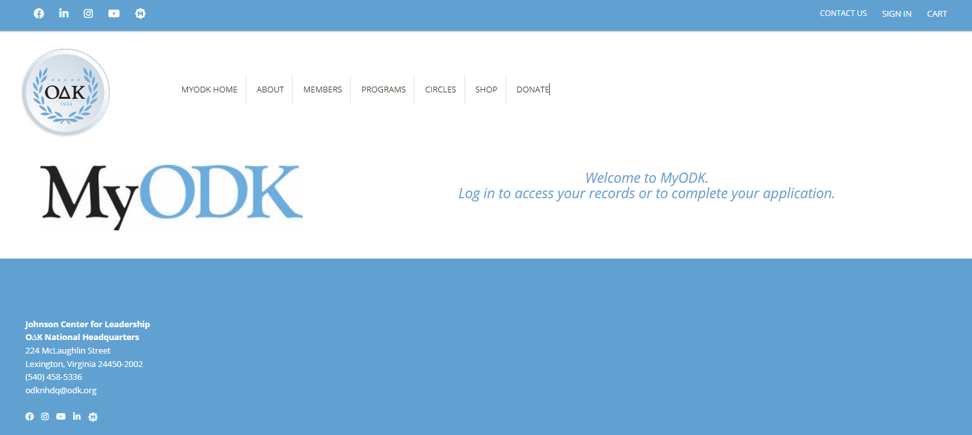
Start at my.odk.org
Sign in with your email and MyODK password

Slide 9
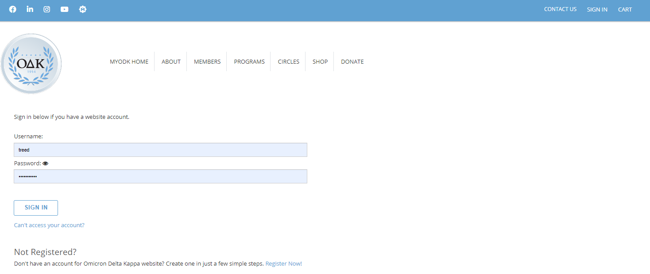
Login Credentials
First Time: You should have received an email providing you with a link to set up your credentials. As a member of OΔK, you already have a record in the portal. You need to activate it.
The first time you sign in, go to “Can’t access your account?” You will need to enter an email. If the system does not recognize the email, you need to contact myodk@odk.org
If you have received a Quick Activation link, go to Register Now! and select Quick Activation.

Slide 10
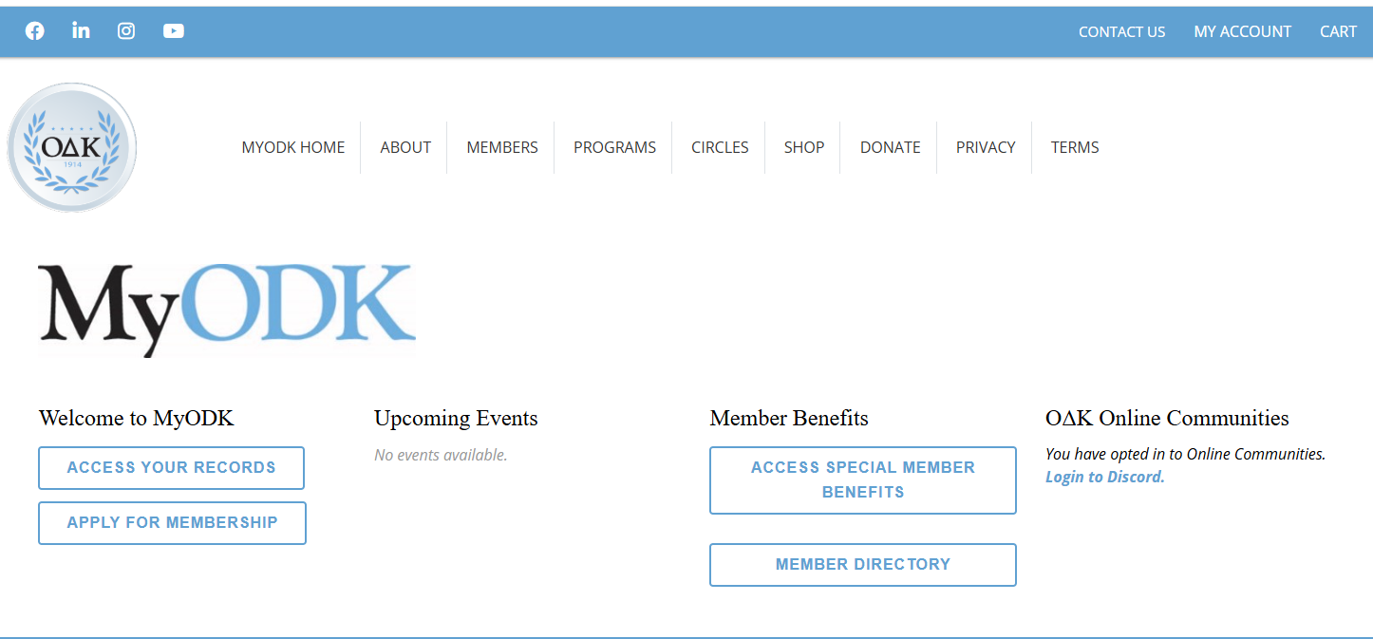
MyODK Home Page

Slide 11
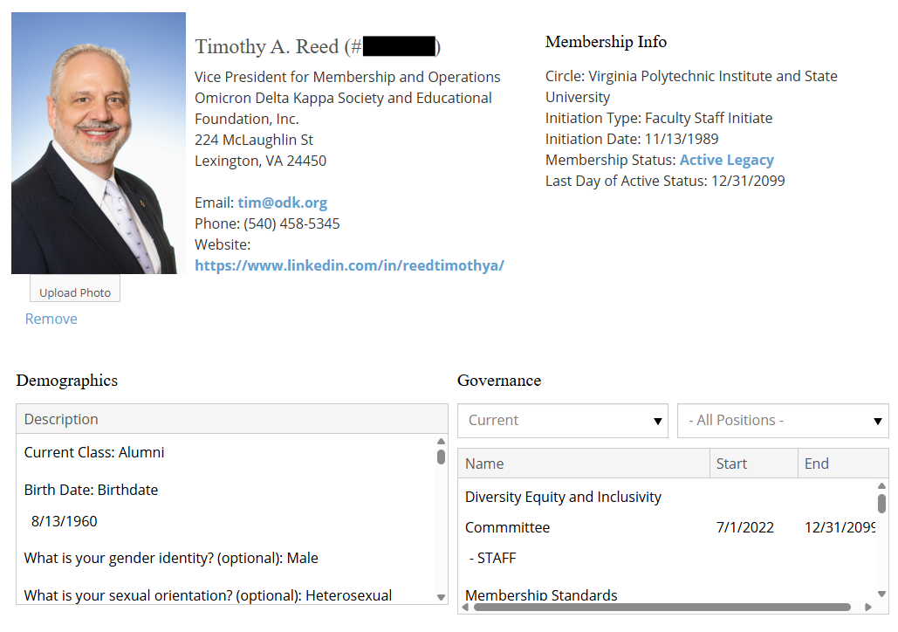
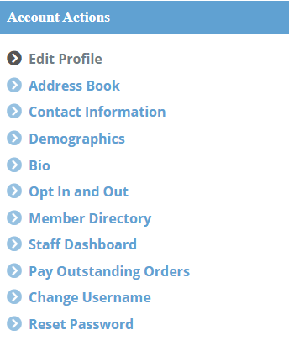
Your MyODK Account Dashboard
General Membership Information
Account Actions
These are how you update personal information and access the Circle Executive Dashboard

Slide 12
Your MyODK Account Dashboard
The Governance section will include circle officer roles, attending previous conferences, and volunteer positions such as serving on committees. This information is still being updated, so more information will be added, but if you see anything that needs to be changed, please let us know.
If you do not not see a "Circle Officer" section in Demographics, please email myodk@odk.org for assistance. You need this item in Governance in order to access the Circle Executive Dashboard.
Use “Change Username” or “Reset Password” to update that information - ODK staff cannot change passwords or usernames.
Use “Edit Profile” or “Contact Information” to update your profile information (address, email, phone, etc.)
Use "Bio" to add information about yourself. This will show up in the searchable member directory.
Click "Demographics" to update educational and employment information, which will be visible in our searchable member directory.
Demographics also includes information related to your race, gender, and orientation, if you answered those questions in your application. This information will not show up in the directory.
Circle Officers will use “Circle Executive Dashboard” to access the applications, etc.

Slide 13
Circle Executive Dashboard
Three Sections
  Circle Officers Information
  Application Management
  Circle Reports
At the top of the Circle Executive Dashboard, you will see messages intended for circle officers. ODK staff will occasionally update this section with information relevant to all circle officers, such as the Circle Annual Report opening for submissions.

Slide 14
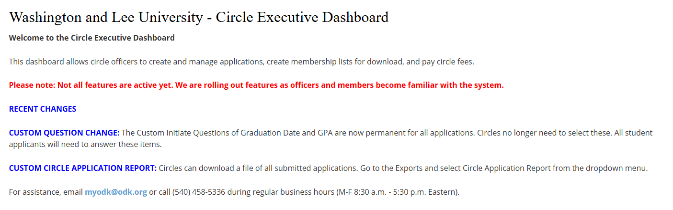
Circle Executive Dashboard

Slide 15
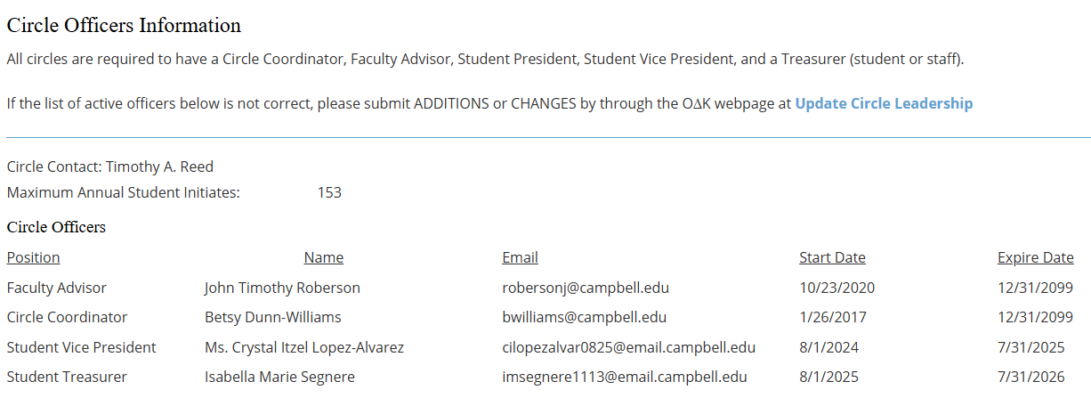
Circle Executive Dashboard
NOTE: Student Officers automatically expire after one year unless they submit a new form or contact OΔK to request an extension of their appointment.
The first part of the dashboard area provides information about the officers for which OΔK has received Officer Agreements. This is required for Circle executives to have access to the Circle Executive Dashboard. Faculty Advisors, Circle Coordinators, Alumni Advisors and Circle Assistants must submit the Circle Advisor Agreement. Student officers must submit the Student Officer Agreement.

Slide 16
Circle Executive Dashboard
Advisors retain access indefinitely, or until ODK is notified that there has been a transition of leadership.
Student officers have access to the Circle Executive Dashboard for one calendar year. If a student is transitioning from one role to another (for example, from a treasurer to president) the student needs to complete a new agreement. If a student is serving in the same officer role for more than one year, they should email myodk@odk.org to request an extension of their access.
Many circles have more student officers than those listed. Not all student officers need access to MyODK.

Slide 17
Creating Your
Membership Application
Circles can add special questions and fields to the national application

Slide 18
Application Development Process
REVIEW
CREATE
PUBLISH
The application process requires that all fields be accurate when the application is finalized. Review all questions and items before starting the application creation process.
MyODK is different from MMS. Each application is unique, and items from past applications are not used to create the next application. However, applications are available for officers to review.
All application changes are live when the “submit” button is selected. Make sure
everything is set before the application is saved.​

Slide 19
Application Structure
The National Membership Application has two types of items:
Required (by the Society) and Custom (inserted by the circle).​
Required items include the basic membership information (name, email, address, etc.) that is required and cannot be changed. The default application has the required items. If the circle does not change any fields, this is the application your prospective members will see.
Custom items are those that the circle chooses to select and add to the application. Only the items selected and approved by the circle will appear on the application seen by individuals on your campus. Circles are limited to the options shown and cannot create items specific to only their campus.

Slide 20
Application Creation
INITIATION DATE: The initiation date must be set first. This must be a firm and final date - it cannot be changed except in truly extenuating circumstances with assistance from the national headquarters. The application must close no less than 14 days before the initiation date.
APPLICATION DATES: Application Open/Close dates are required for the application setup process. Once set, these cannot be changed without HQ approval. SPECIAL NOTE ON APPLICATION DATES: All applications open and close at 00:00:01 (12:00:01 a.m.) on the dates selected. Please use the day AFTER the last day you want to collect applications as your closing date. For Example - If you want applications open all day on 2024-10-01 (Oct 1), then select 2024-10-02 (Oct 2) as your closing date. This is a system configuration that cannot be changed universally.
PAYMENT PORTAL: Select whether your circle will use the MyODK National Payment Portal to accept the National Initiation Fee.
MAXIMUM NUMBER OF APPLICATIONS: The circle may now opt to set a maximum number of applications they will accept. Circles should remember to be selective, not exclusive, in its recruitment process. Once the maximum number of applications is reached, the application will automatically close and can only be reopened with HQ assistance, even if the application close date has not passed.
Once you have finalized these and opened your application, you will see these dates in your Circle Executive Dashboard.

Slide 21
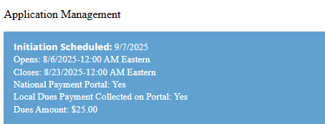
Application Creation
The Application Management section will display your active application. The fields will be blank until you create your application

Slide 22
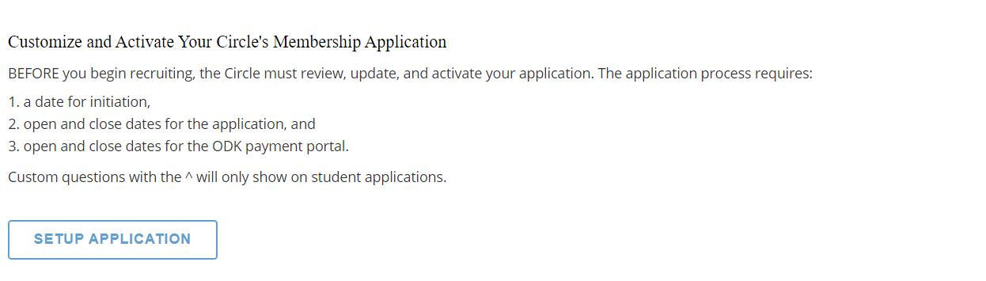
Application Creation

Slide 23
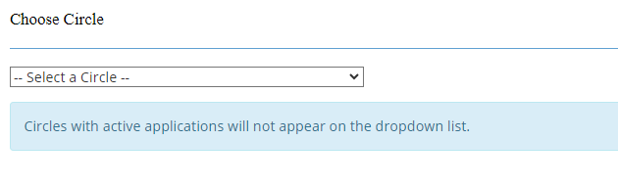
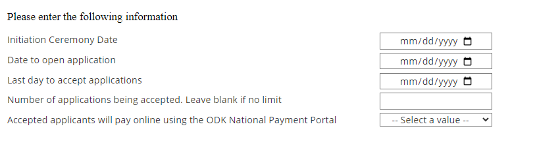
Application Creation
Select Your Circle
Enter Your Dates. All Dates are Required Fields
NOTE: Circle may only have one (1) application process open at a time. If you have an open application, you will not be able to start another one.
If this drop-down does not appear, it means the system has recognized you as the circle officer, and you need to proceed to set the dates.
This cannot be changed, so be sure!
Give yourself time to review, accept, and approve.
This date must be no less than 14 calendar days before the ceremony. #
Once this limit is reached, no more applications will be allowed.
Circles select to use the payment portal or have applicants pay the circle.
# The application closes at 12:00:01 (a.m.) Eastern. Set your application for the date after you want it to close. Ex: For Dec. 1, set the date to Dec 2.

Slide 24
Payment Options
Circles can opt for selected applicants to pay via the National Payment Portal in MyODK, or may collect the funds locally and opt to be invoiced by the national headquarters. This is an all-or-none option - either everyone pays through the portal, or everyone pays locally, with a few exceptions: If the circle covers costs for a few individuals locally (by providing funds from a donor or department, for example), those names should be communicated to your circle contact. National Headquarters will mark the individuals as "paid to circle," and the circle will be invoiced for those costs once a certificate order is placed.
Those submitted via the Special Membership Application for a surprise or special initiation will be billed to the circle. Each circle receives one free honorary member per year.
Students who receive a Gift of Membership will have a waiver applied to their account by national headquarters.
For circles choosing the National Payment Portal through MyODK, the portal closes 8 calendar days before the initiation date and will not be reopened. This is because the certificate order must be submitted 7 calendar days before the initiation. A $4 service fee is applied to all payments through the National Payment Portal.

Slide 25
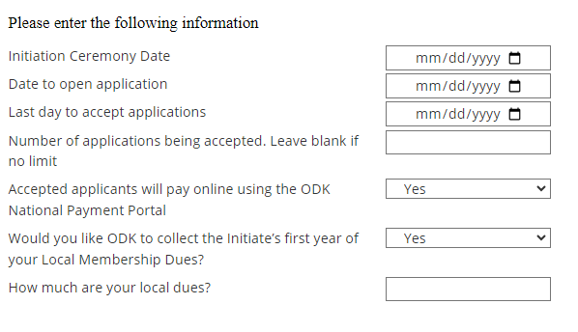
Application Creation – Local Dues
OΔK can now collect one-time local dues for circles in addition to the National Initiation Fee. Once initiation is complete and the Society ensures that all prospective members participated, OΔK will send the local dues as either a check or an electronic payment to the circle. Members pay a $4 service fee regardless of whether local dues are added.
To opt in to this while creating your circle’s application:
Opens at 12:00:01 Eastern
Closes at 12:00:01 Eastern
Choose “yes”
Choose “yes”
Enter the amount of local dues

Slide 26
Application Creation
Select Custom Questions
How Custom Questions Work
The national application is dynamic using conditional logic. It changes based on the first two (2) choices made by the applicant.
When first opened in a web browser, ALL applicants see the same application.
The first change occurs when they select College/University. This narrows their choices to only that circle.
The second change occurs when they choose the Initiation Class. Juniors and Seniors may see a different application depending on the selection made in the Special Request Fields.
  The application a prospective member sees will be determined by the “Class” they select. For example, if an applicant selects “Junior,” s/he will receive the application with academic data and custom questions. If the applicant chooses "Faculty/Staff," s/he will receive an application that has only the fields the circle requires for them.

Slide 27
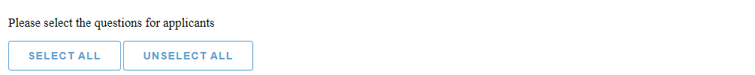
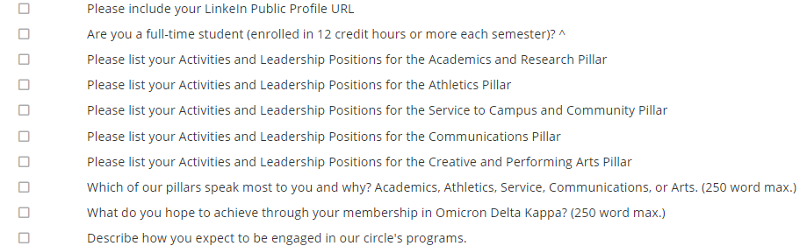

Application Creation
Select the items you want members to answer. Then, all selected questions become required for the applicant to complete.
NOTE: Items with a carat “^” at the end will not appear for faculty, staff, alumni, and honorary applicants

Slide 28
Application Creation
OΔK Recommended Questions
After research and experimentation with a variety of questions, ODK has determined that a quality application can be narrowed to the items below.
(Faculty/Staff only)
  Please list in detail your academic and professional organization memberships, leadership positions held, as well as awards and honors received. Do not include activities as a college student. # (250 words max.)
(Student Only)
  Describe your leadership experience, including positions and significant actions, in at least one of the pillars you selected (250 words max)
  Please list in detail your college organization memberships, leadership positions held, as well as awards and honors received. Do not include high school activities.
  Describe your most significant leadership experience while attending college/university (250 words max)

Slide 29
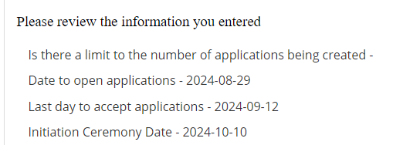
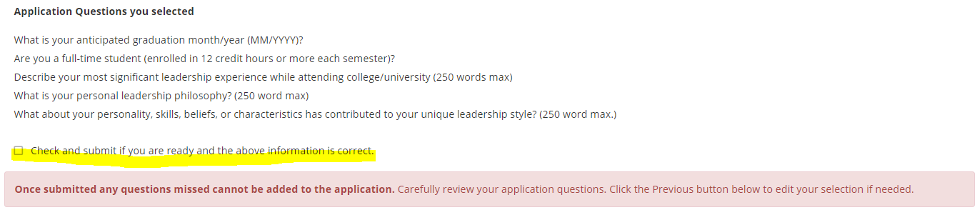
Application Creation
Review the Application Questions
This is a crucial step. You cannot change questions once the application set-up is complete.
Note: The application closes at 12:00:01 Eastern on this date. If you want to include this application date, set the close date to the next day (2024-09-13)

Slide 30
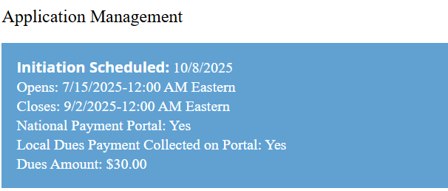
Application Creation
Once you have created your application your Circle Executive Dashboard will display all the information about your application cycle.

Slide 31
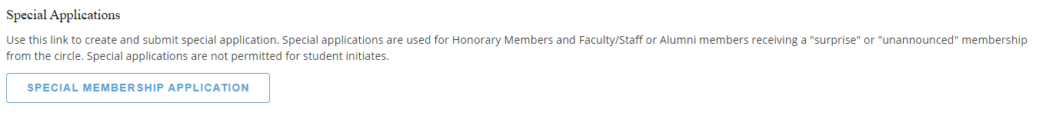
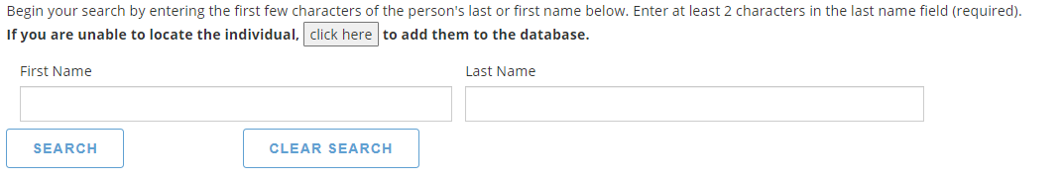
Special or Surprise Initiation
Many circles want to surprise a faculty member, alumnus, or honorary member with initiation into ODK. That is perfectly fine to do. Please note the following:
This is the ONLY time you can complete an application for the individual. This shall not be used for student initiates. This form should be used for NEW Circle Advisors.
To complete a Special Application, select the button in the Application Management dashboard. Before starting the application, make sure you have the required information about the person, including date of birth, employment and educational history, address, and email address. Individuals submitted through this form will be invoiced directly to the circle.
NEW! One additional feature is that you can search the database to see if the person you are inviting is already a member.

Slide 32
Application Review and Approval
Four Steps to Application Processing

Slide 33
Application Review and Approval
There are four (4) steps in the Application Review and Approval Process:
  Step 1 - Review Applications
  Step 2 - Accept/Reject Applications
  Step 3 - Verify Payment and Approve for Membership
  Step 4 – Submit the Certificate Order
For on-campus or in-person initiation ceremonies: All of these steps should be completed no less than 14 calendar days prior to your initiation ceremony. This ensures that ΟΔΚ can process your order, print certificates, and ship them to you in time. Many times this takes less than 14 days. The minimum time allowed is seven (7) days before the ceremony.
Only circle officers are permitted to access applications. Applications can be printed or downloaded for a committee to review.
Advisors can download a spreadsheet of application information to provide to officers or committees as well.
IMPORTANT NOTICE: Circle advisors or other members of the circle are not permitted to complete an application for the initiate. This includes FACULTY/STAFF and ALUMNI* because the application constitutes a contract and includes permissions that the member must accept. A third party may no longer complete the application for the initiate. A third party can complete Honorary and Special Initiates* but MUST include all required information accurately submitted.
*If the circle seeks to surprise a Faculty/Staff or Alumni member with induction into ΟΔΚ, then a circle advisor may complete the application form for that individual.

Slide 34
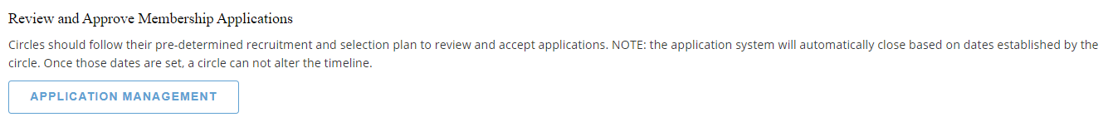
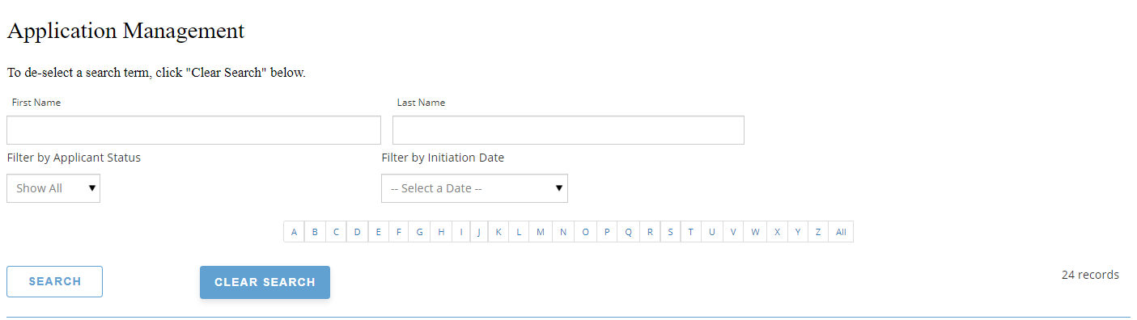
Step 1: Application Review
To access applications, select Application Management
Start by filtering by initiation date. Although you can have only one application active, uncleared data from previous applications may still appear if you do not filter by the initiation date.

Slide 35
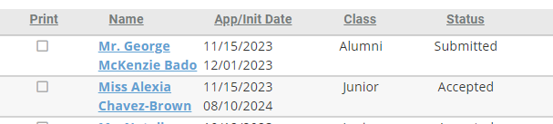
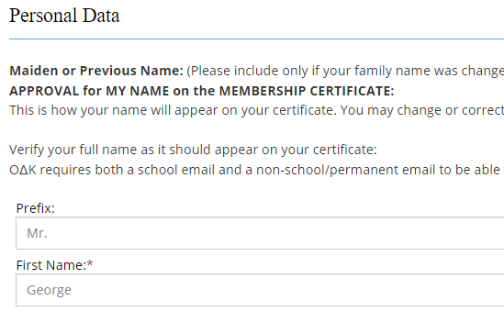
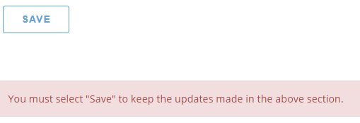
Correcting the Personal Data
If you find a problem with the information provided on a National Membership Application, you can ask the individual to change their Personal Data, or an officer may edit the information BEFORE you submit the final order.
Open the Application
Select and Open the Member Application
Locate the item with the issue
Change the information (e.g. correct the name spelling)
Scroll to Bottom, Select Save Changes
NOTE: Once the application has been submitted, the information in Custom/Initiate Questions cannot be changed.

Slide 36
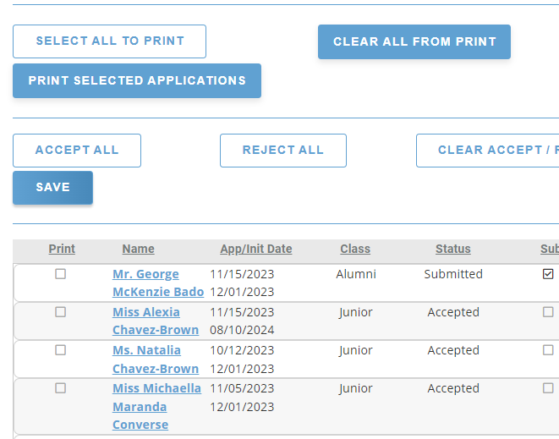
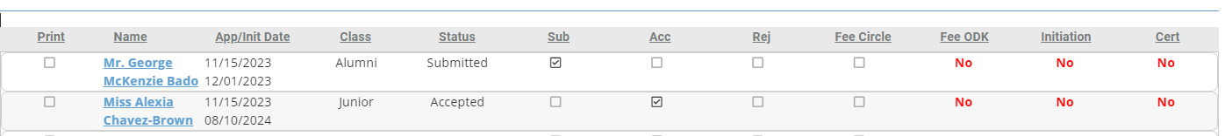
Step 2: Accept or Reject
Each circle has its own process by which they review and vote on candidates for membership. Circles may choose to print applications to PDF and distribute them for review, or print hard copies.
a. Select applications to print
b. Click print applications
Once all applications have been reviewed and the circle has voted, return to the Application or to the Applications panel to Accept or Reject each application. Mark the boxes under “Acc” and “Rej” accordingly.
Rejected applications will be removed from the list and stored for future reference. If this is done in error, reach out to myodk@odk.org.
Accepted applications will appear with the bold term “Accepted.”
You can run a report of members by status (accepted, rejected, submitted) using the "Member Export" button under "Circle Reports" on the Circle Executive Dashboard.

Slide 37
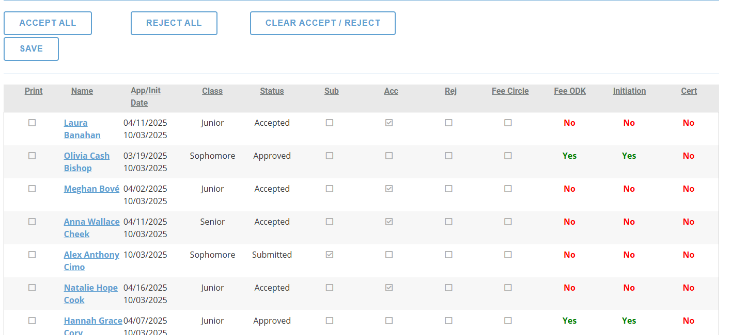
Application Dashboard

Slide 38
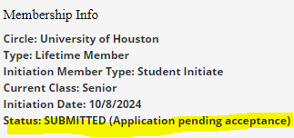
Application Status Messages
At each stage of the application process, the applicant will be notified of their status. The following are the messages they will see on their Applicant Dashboard.
* There are different messages depending on the payment process.
This is what appears on the Applicant Dashboard
Status | Dashboard Message | Confirmation Message
STARTED | (Application pending submission) | You have started the membership application.
SUBMITTED | (Application pending acceptance) | Your application has already been submitted.
ACCEPTED | (Application pending approval) | Your application is pending payment. Please select PAY YOUR MEMBERSHIP FEES at link below.
APPROVED | (Application accepted and paid) | Your application has been accepted and paid.
COMPLETED | (Completed) | Your initiation has been completed.
REJECTED | (Rejected) | Your application for membership in Omicron Delta Kappa has not been accepted by the circle through which you applied. Your MyODK profile will remain active to allow you to apply again in the future. If you have questions, please contact a Circle Advisor.

Slide 39
Step 3: Membership Payment
For Circles using the MyODK payment portal:
Upon acceptance:
  Application status becomes: ACCEPTED (Application pending approval)
  Application message will be: Your application is pending approval. Please check your outstanding orders to pay your initiation fees.
Upon payment:
  Application Status becomes: APPROVED (Application accepted and paid)
  Application message will be: Your application has been approved and paid.
  And, they will receive an email confirmation of payment.
After Initiation Ceremony (without changes to record)
  Application Status becomes: COMPLETED

Slide 40
Step 3: Membership Fee Verification
Circles not using the MyODK payment portal will need to verify payment on the Circle Executive Dashboard.
Applicants for Circles not using the MyODK Payment portal will see these messages.
Upon acceptance:
  Application status becomes: ACCEPTED (Application pending approval)
  Application message will be: Your application is pending approval. Your circle is not using the MyODK payment portal for this initiation. Please contact your circle advisor to pay your initiation fee.
Upon payment:
  Application Status becomes: APPROVED (Application accepted and paid)
  Application message will be: Your application has been approved and paid.
  And, they will receive an email confirmation of payment.
After Initiation Ceremony (without changes to record)
  Application Status becomes: COMPLETED

Slide 41
Certificate Orders

Slide 42

Certificate Order Rules
What is the Certificate order? This is the official request to process the memberships for the individuals the circle will initiate soon. From this order, the OΔK National Headquarters staff create the individual certificates and provide the Key of Membership pins for the individual.
The following are the rules for submitting a certificate order. Beginning in December 2024, these rules are strictly enforced to prevent duplicate orders, additional certificate processing, and increased shipping and labor costs.
Only advisors or circle assistants may place certificate orders.
The order must be submitted no less than 7 calendar days before the ceremony.
Only ONE (1) order per initiation date is permitted.
Once the order is submitted, no additions can be made. Please be sure all candidates approved for the initiation are included in this order.
No payments to the national payment portal will be accepted once the order is submitted.
When you are ready to submit, select the Certificate Order Form button in the Circle Executive Dashboard.

Slide 43
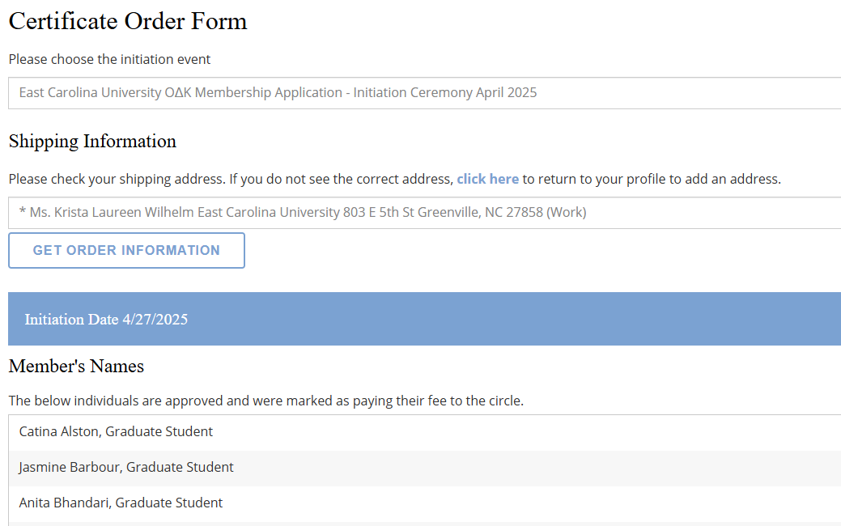
Certificate Order Form
Initiation date is automatically inserted
Select which address for shipping.
These come from the advisor or circle’s profile. If the address is not correct, select click here to change.
List of initiate names

Slide 44
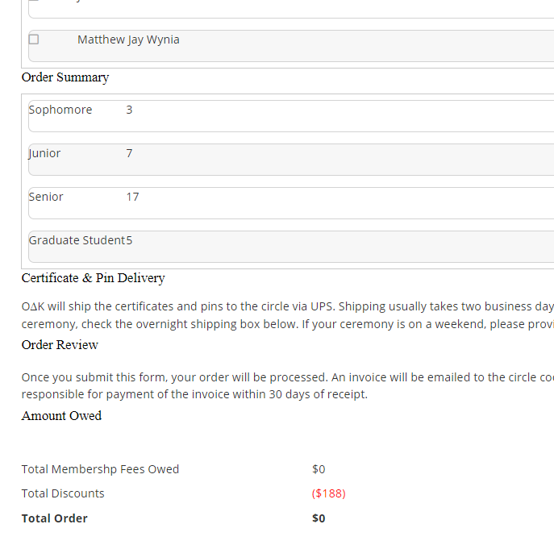
Amount Owed Section
To fully demonstrate what the circle will owe upon submission of the order, this section has been revised. The order below shows what an order would look like with expedited shipping.
Count by class of initiates
Cost for expedited shipping is usually ($70 - $100)
The circle owes OΔK for members who paid the circle locally
Credits for members who paid online, free advisor, free honorary
Total owed to OΔK, which will be invoiced.

Slide 45
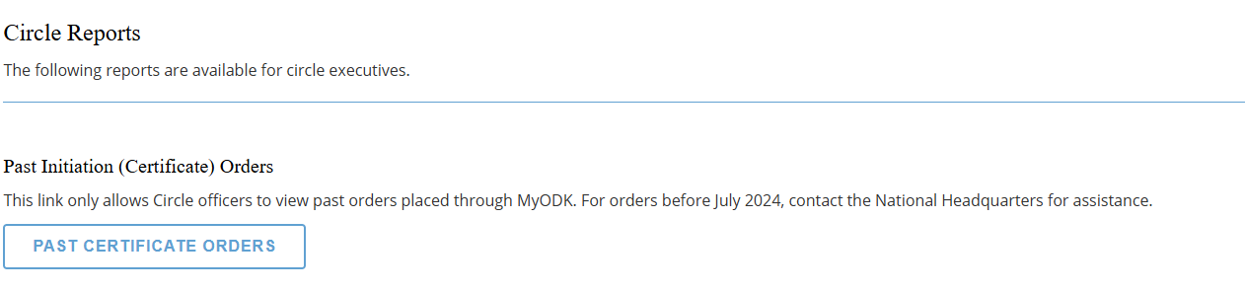
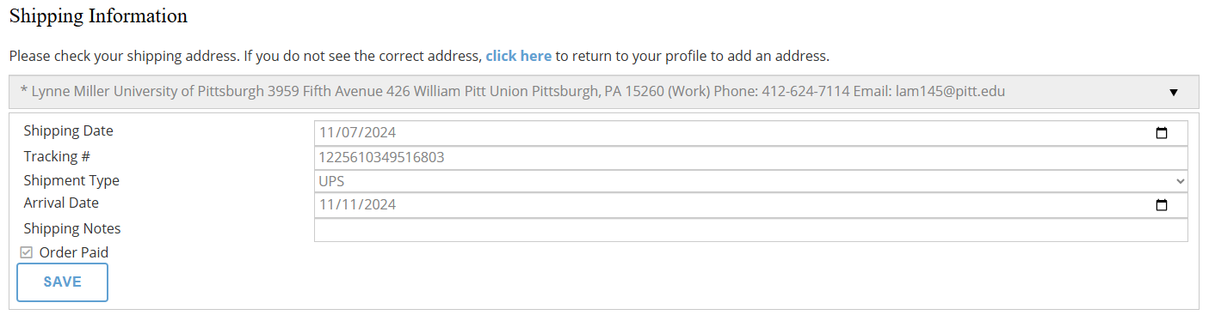
Shipping Information
Once the order has been processed, the shipping information will be added to your order.
Open the Past Certificate Orders un Circle Reports. The shipping information will appear at the top.

Slide 46
Circle Reports

Slide 47
Circle Reports
Past Initiation (Certificate) Orders - This option allows Circle officers to view past orders placed through MyODK. For orders before July 2024, contact the National Headquarters for assistance.
Member List Export - Circles can download two different lists of members – Member Export and Application Report.
  Member Export generates a list of members between certain years and with specific statuses.
  Select the range of initiation dates. For statuses other than Approved, this is the planned initiation date for the applicant(s). Select the Status. To select multiple statuses, hold down the Control key (or Command key for Apple) and select the statuses. Select Run Report. Then select "Click here to go to My Reports." It may take a few minutes depending on the number of records.
  Application Report is for generating a list of applicants that can be downloaded for review and selection. (This is not available at this time.)
Circle Standards - Once this feature is live, circle officers will be able to track their progress toward meeting Circle Standards.
Annual and Health Reports – Circle officers can download the last year’s Circle Annual Report and Circle Health Reports (if available).

Slide 48
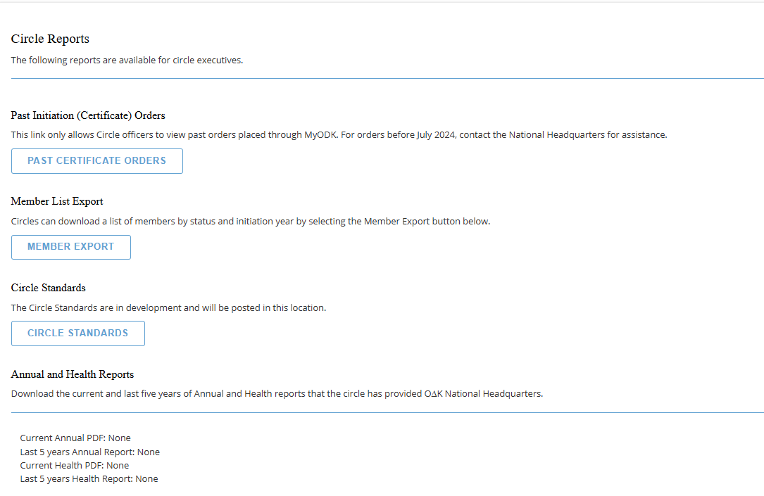
Circle Reports

Slide 49
Instructions for Applicants
The new process is easier but still needs explanation

Slide 50
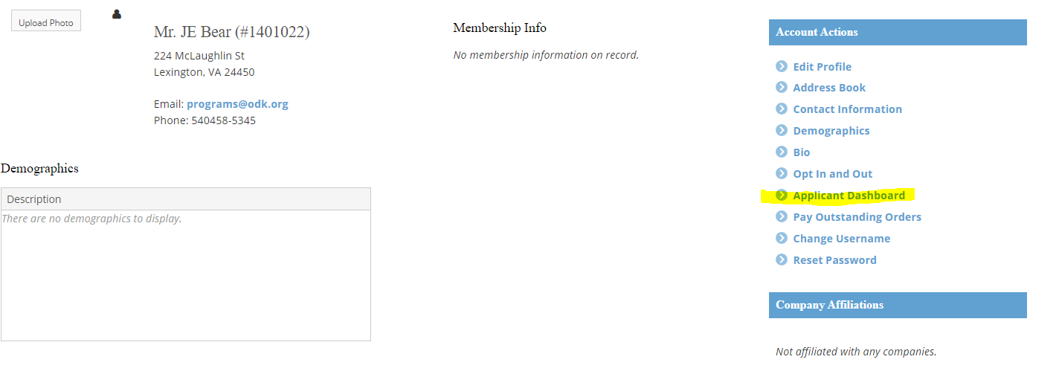
Instructions to Applicant
MyODK is different from MMS because each applicant must create an account to gain access to the application.
These accounts will eventually be deleted if the applicant is not accepted and initiated.
Steps to Apply
Create and Activate an Account on my.odk.org
Go to the Applicant Dashboard in Manage My Account OR use the “Apply for Membership” button on the homepage
Instructions for Applying can be found at: https://odk.org/members/apply-for-membership/

Slide 51
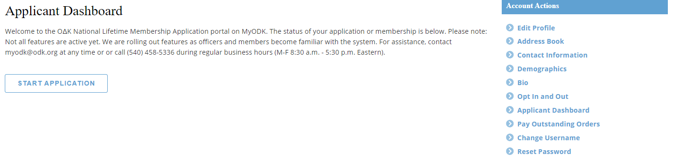
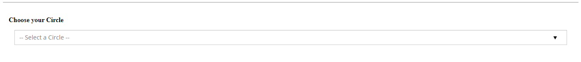
Instructions for Application
3) Start Application
4) Edit Profile if necessary – NOTE: Anytime the profile is changed, it automatically updates the application.
5) Select a Circle

Slide 52
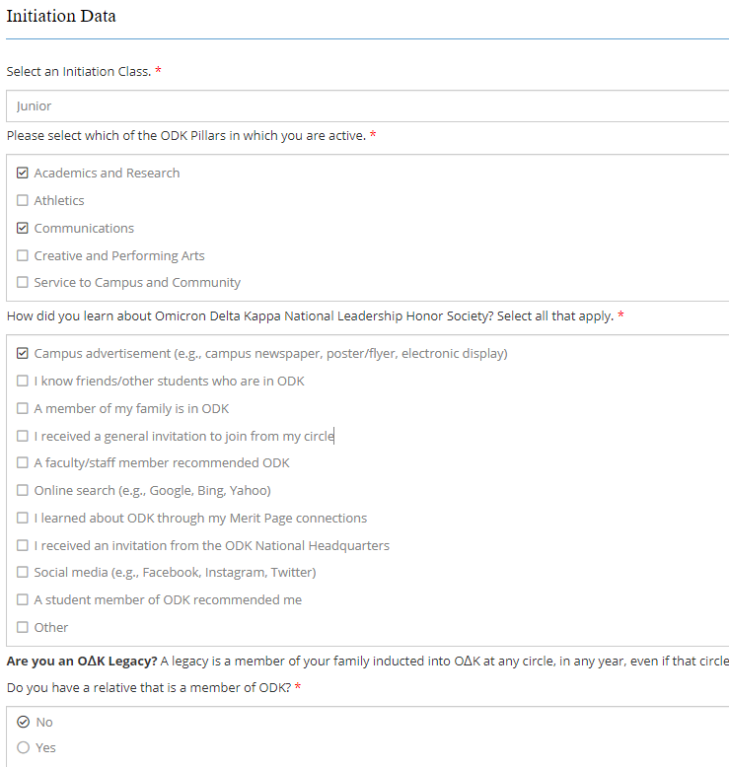
Instructions for Application
6) Applicant completes the following steps:
  Personal Data – updating and adding as necessary
    Applicants must enter two email addresses
  Initiation Data
    Class
    Pillars
    Marketing Information
    Legacy Information
  Demographic Data (only birthdate is required)
  Academic Information
  Employment Information (if full-time employee)
  Custom Questions (Initiate Questions)
  Review and Save or Submit

Slide 53
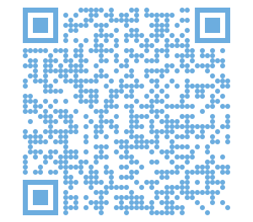
Knowledge Check – Click here to access the quiz

